Slide 1


In Scotland we throw away 600,000 tonnes of food every year from our homes.
Notes:
This PowerPoint is designed to set the scene for your learners and can be edited to suit the needs of your lesson.
The 600,000 tonnes figure refers to both avoidable and unavoidable food waste. Avoidable food waste is what this lesson focuses on and included food that could have been eaten. Unavoidable food waste includes things like apple cores, skins and peelings – in other words food that couldn’t have been eaten.

Slide 2
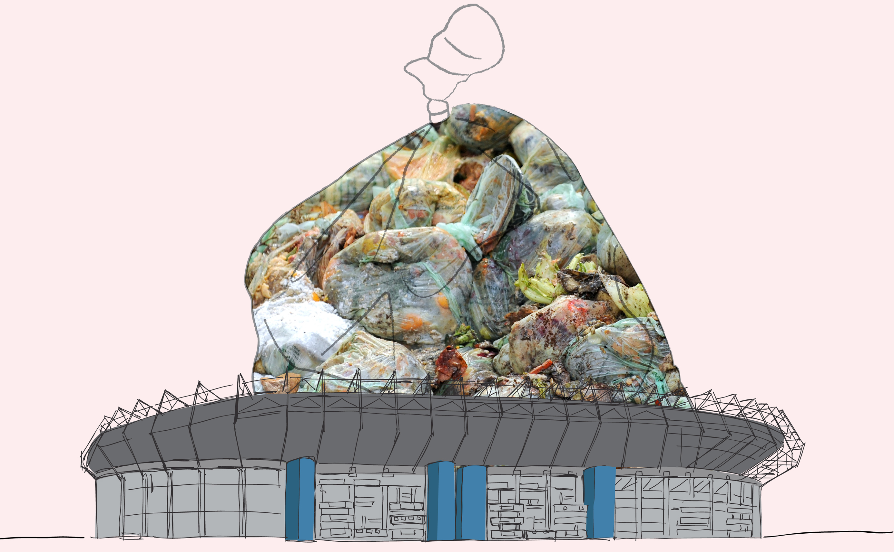
This is enough to fill up Murrayfield stadium 4 times over.
...more than half of this is food that could have been eaten.
Notes:
More than half’ refers to the avoidable food waste as opposed to unavoidable food waste.
Ask your learners how big they think Murrayfield stadium is? Has anyone ever been?

Slide 3

We bin £90 million worth of bakery products...
...we waste 2 million slices of bread a day.
Notes:
These figures are calculated for 1 year and are Scottish specific.

Slide 4
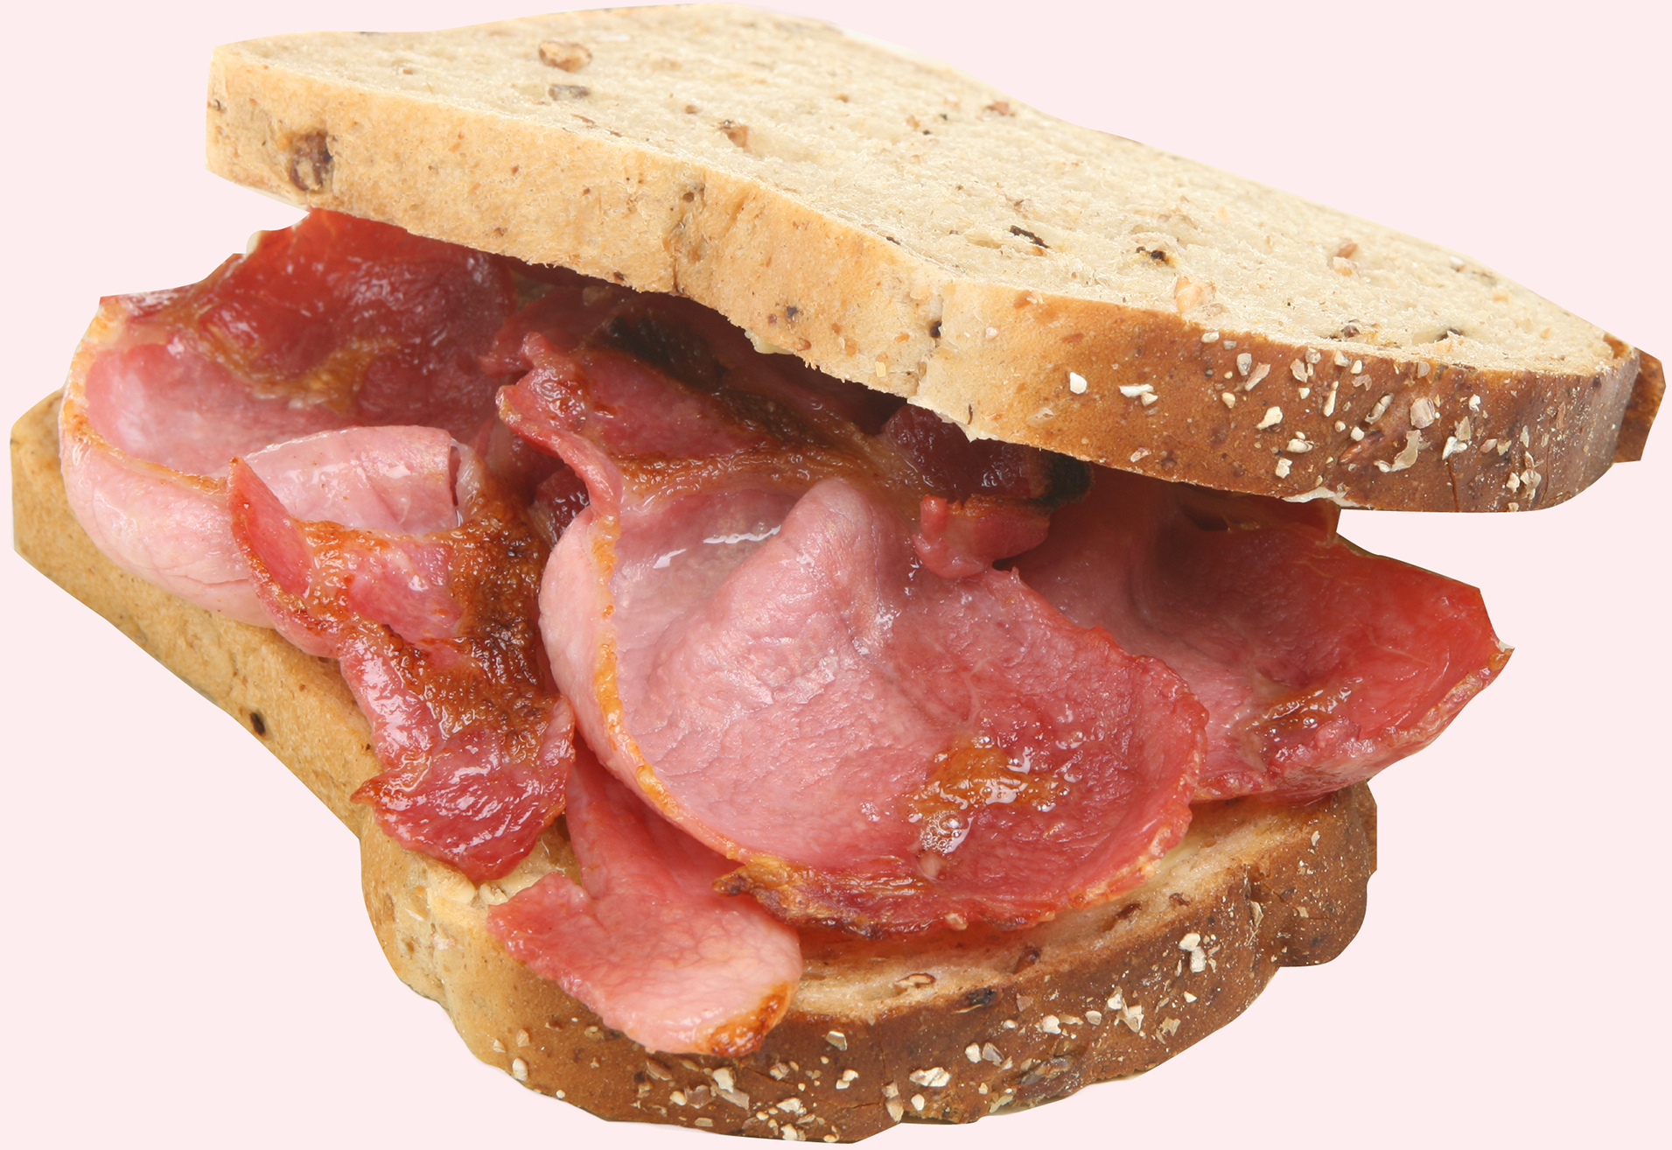
We waste £190 million worth of fresh meat & fish...
...enough to make everyone in Scotland a bacon buttie every Saturday for the next year.

Slide 5

We waste £79 million of fresh fruit...
...enough to give every learner and teacher in Scotland an apple every day for a year

Slide 6

The average household we could save £460 a year...
...enough for 46 trips to the cinema!
Shocking!
Notes:
This is the money that could be saved if the food was eaten instead of being thrown away. The average household in Scotland could save £460, for an individual this is £200 and for a family of 4 the potential savings rise to £700.
On a national level, Scottish households waste £1.1 billion worth of food every year.

Slide 7

...or a family of 4 we could save £700
What would you buy with £700?

Slide 8

When we waste food we waste all the energy and natural resources that go into producing it…
Wasted food also lets off harmful gases in landfill...
...this is bad for our environment

Slide 9

If we saved all the avoidable food waste from the bin in Scotland...
...it would have the same positive environmental impact as taking 1 in 4 cars off the road
Notes:
This refers to CO2 emissions generated by wasting the food in landfill and all the effort that is required to grow and transport food.

Slide 10

The Scottish Government has pledged to reduce food waste in Scotland by 33%
by 2025...
...what can you do to help?
Notes:
For more information on the target please see the Zero Waste Scotland website.

Slide 11


Slide 12


