Slide 1
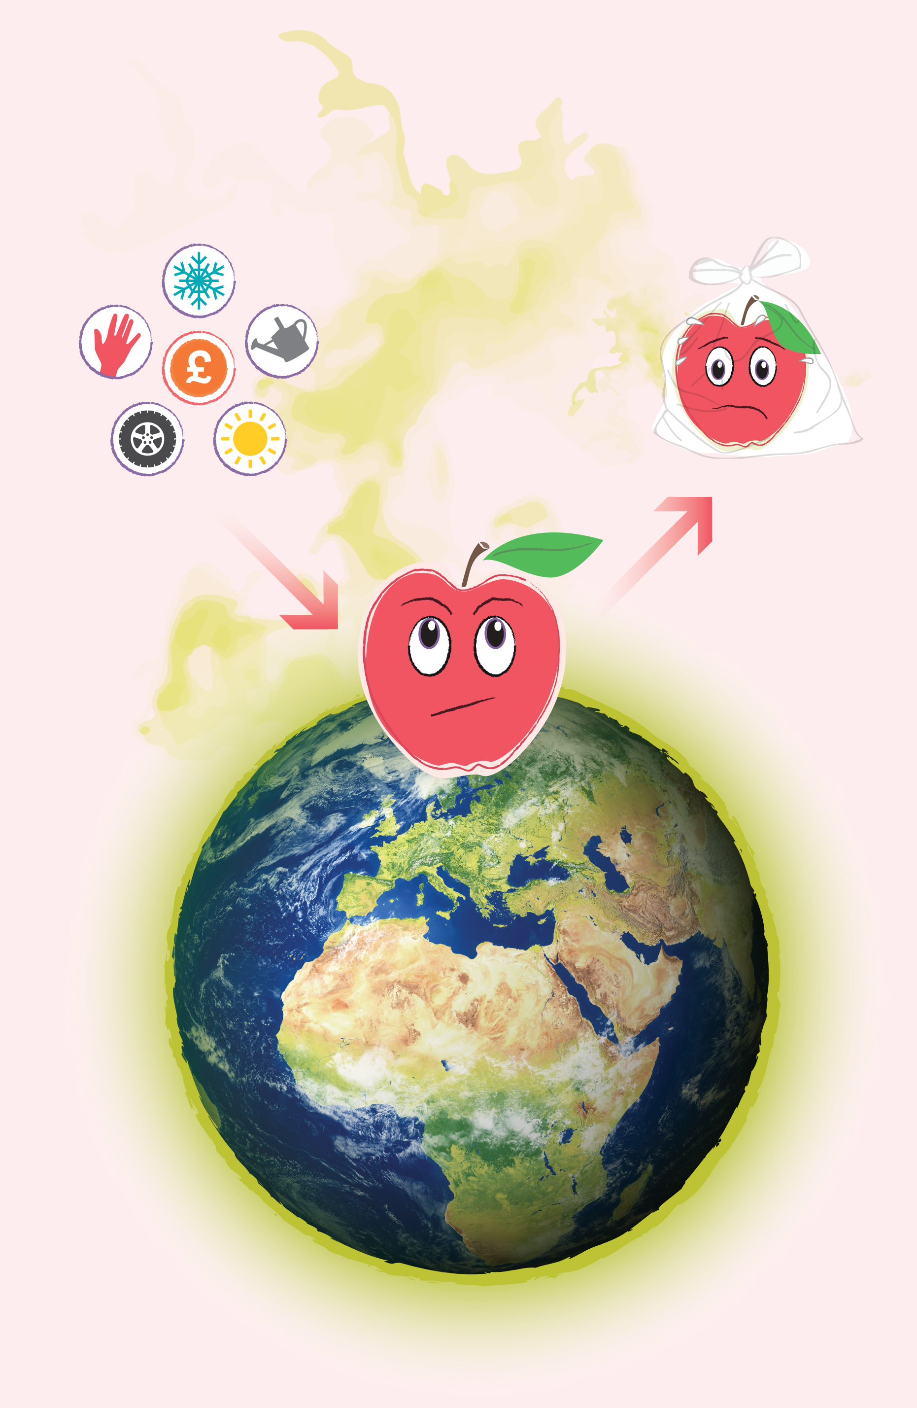

When we waste food we waste all the effort, energy and resources that go into producing it.
Wasted food also lets off harmful gases in landfill.
These gases cause our planet to heat up making it harder to live on.
Notes:
Have a discussion with your learners about how much effort goes into creating food. This could be in terms of the water used (12 liters is required to grow 1 tomato!), or the energy used to transport, store and package food, the land and soil space required, the human effort and impact.
If wasted food is put in the rubbish bin and goes to landfill it releases harmful greenhouse gases. If food waste is put in the food waste recycling bin these gases are captured and not released into the atmosphere. The level of detail required may be too much for your learners but the main point to stress is that wasted food lets off harmful gases in landfill which has a negative impact on our planet.

Slide 2
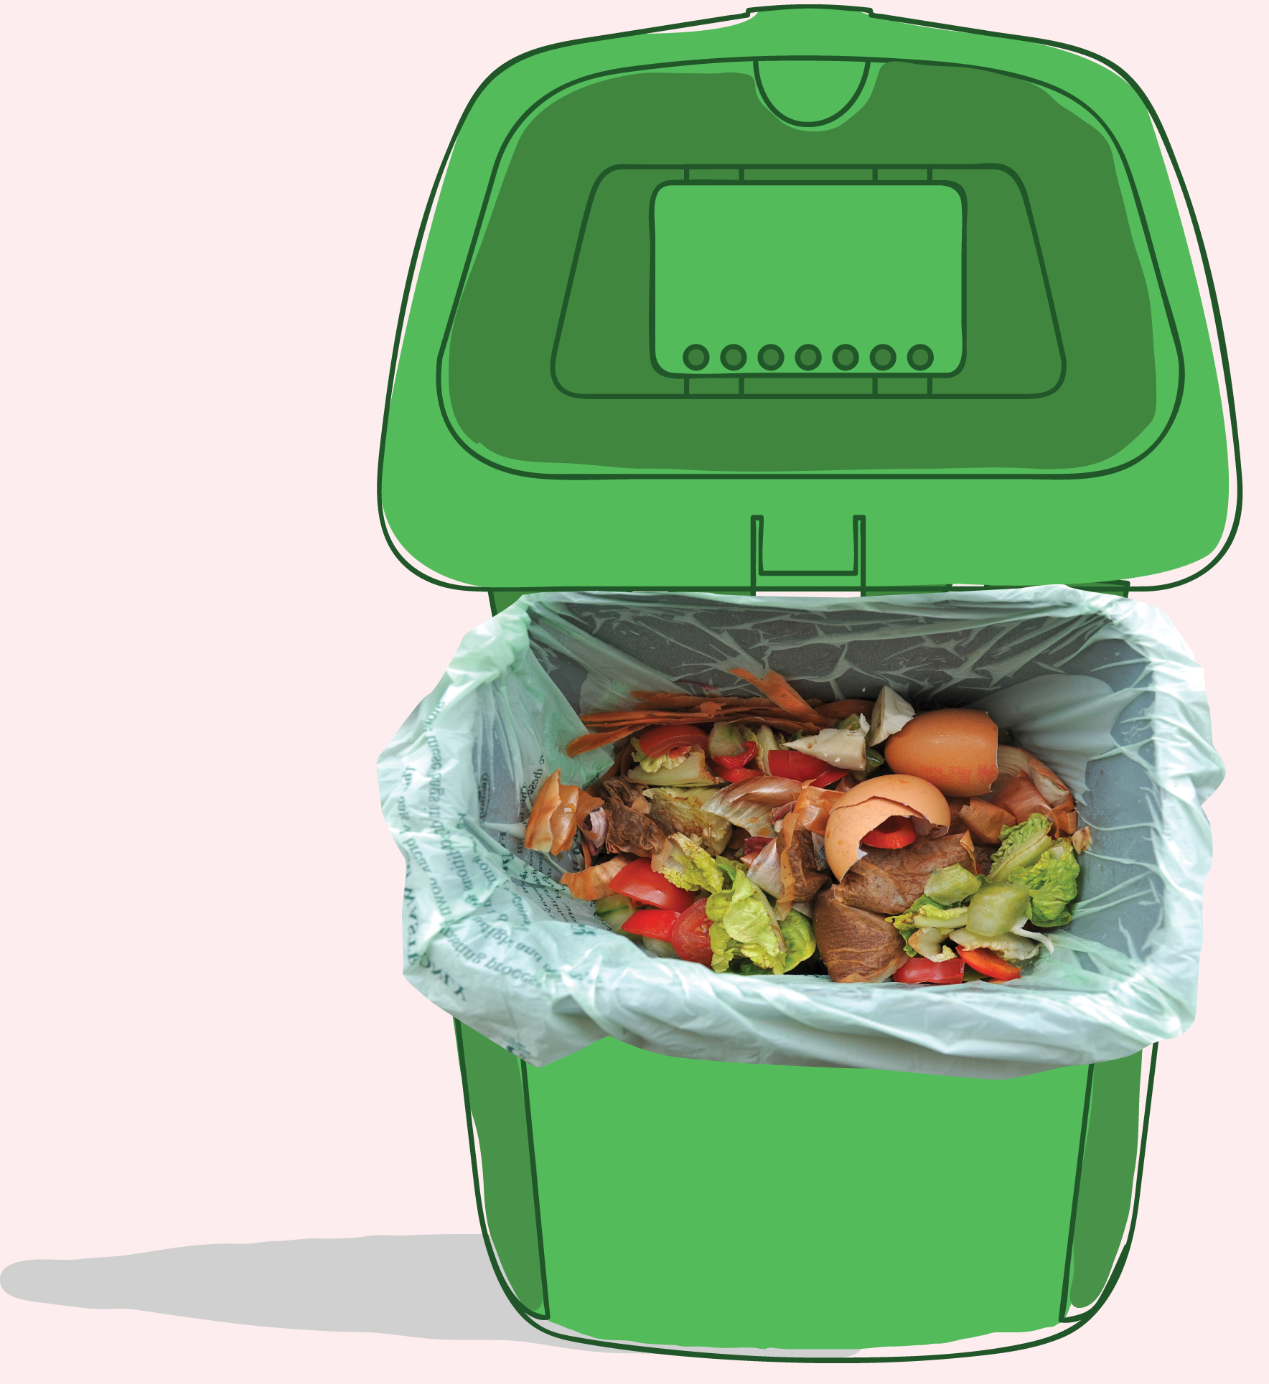
Recycling food waste is better for the planet because it is composted or sent for anaerobic digestion…
...a process that creates energy from the waste
But that still means you’re wasting all the effort that went into producing it in the first place!

Slide 3

If we saved all the avoidable food waste from the bin in Scotland...
...it would have the same positive environmental impact as taking 1 in 4 cars off the road

Slide 4

In Scotland we throw away 600,000 tonnes of food every year from our homes.
...this costs us £1.1 billion every year as a country!

Slide 5

For the average household we could save £460 a year by using our food better...
...enough for 46 trips to the cinema!

Slide 6

The Scottish Government has pledged to reduce food waste in Scotland by 33%
by 2025...
...what can you do to help?

Slide 7
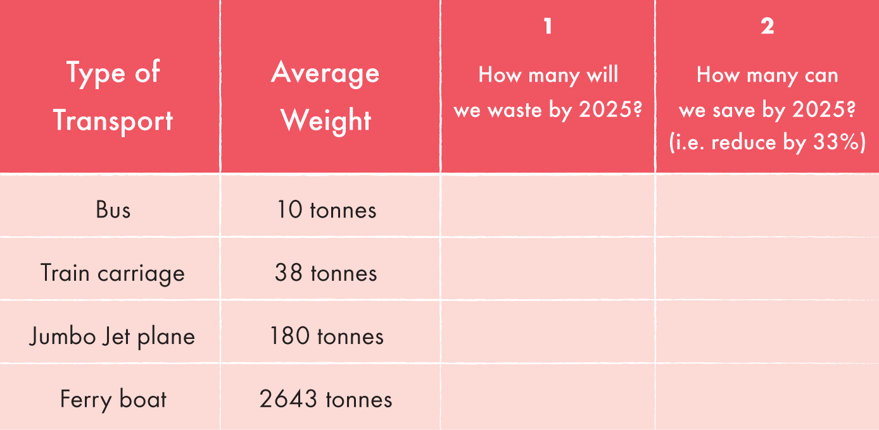
The road to reduction

