Slide 1
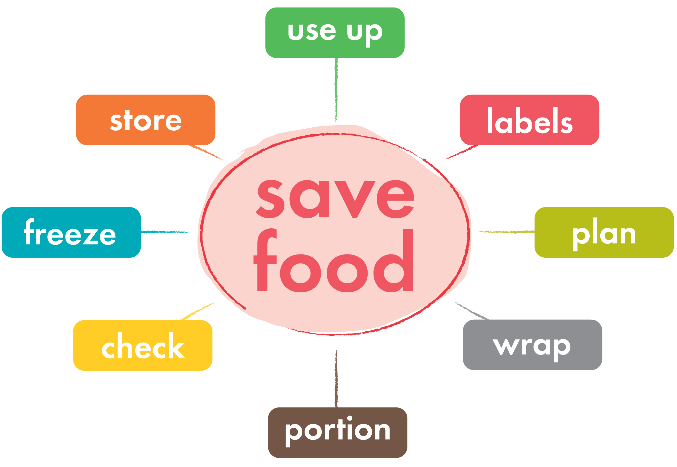

There are 8 key things that can save food from the bin

Slide 2
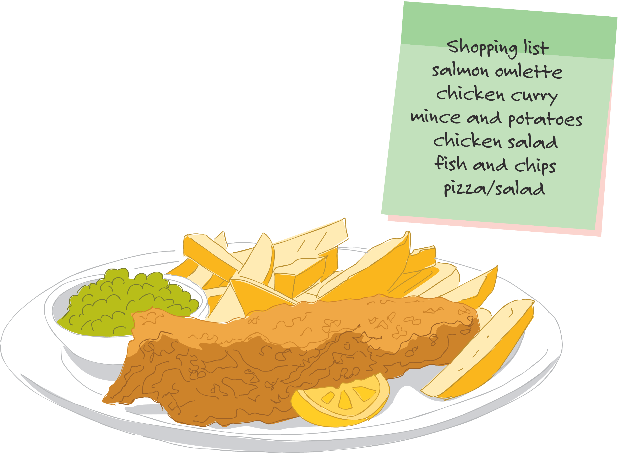
Plan - know what meals we are having this week and how we'll use everything up

Slide 3
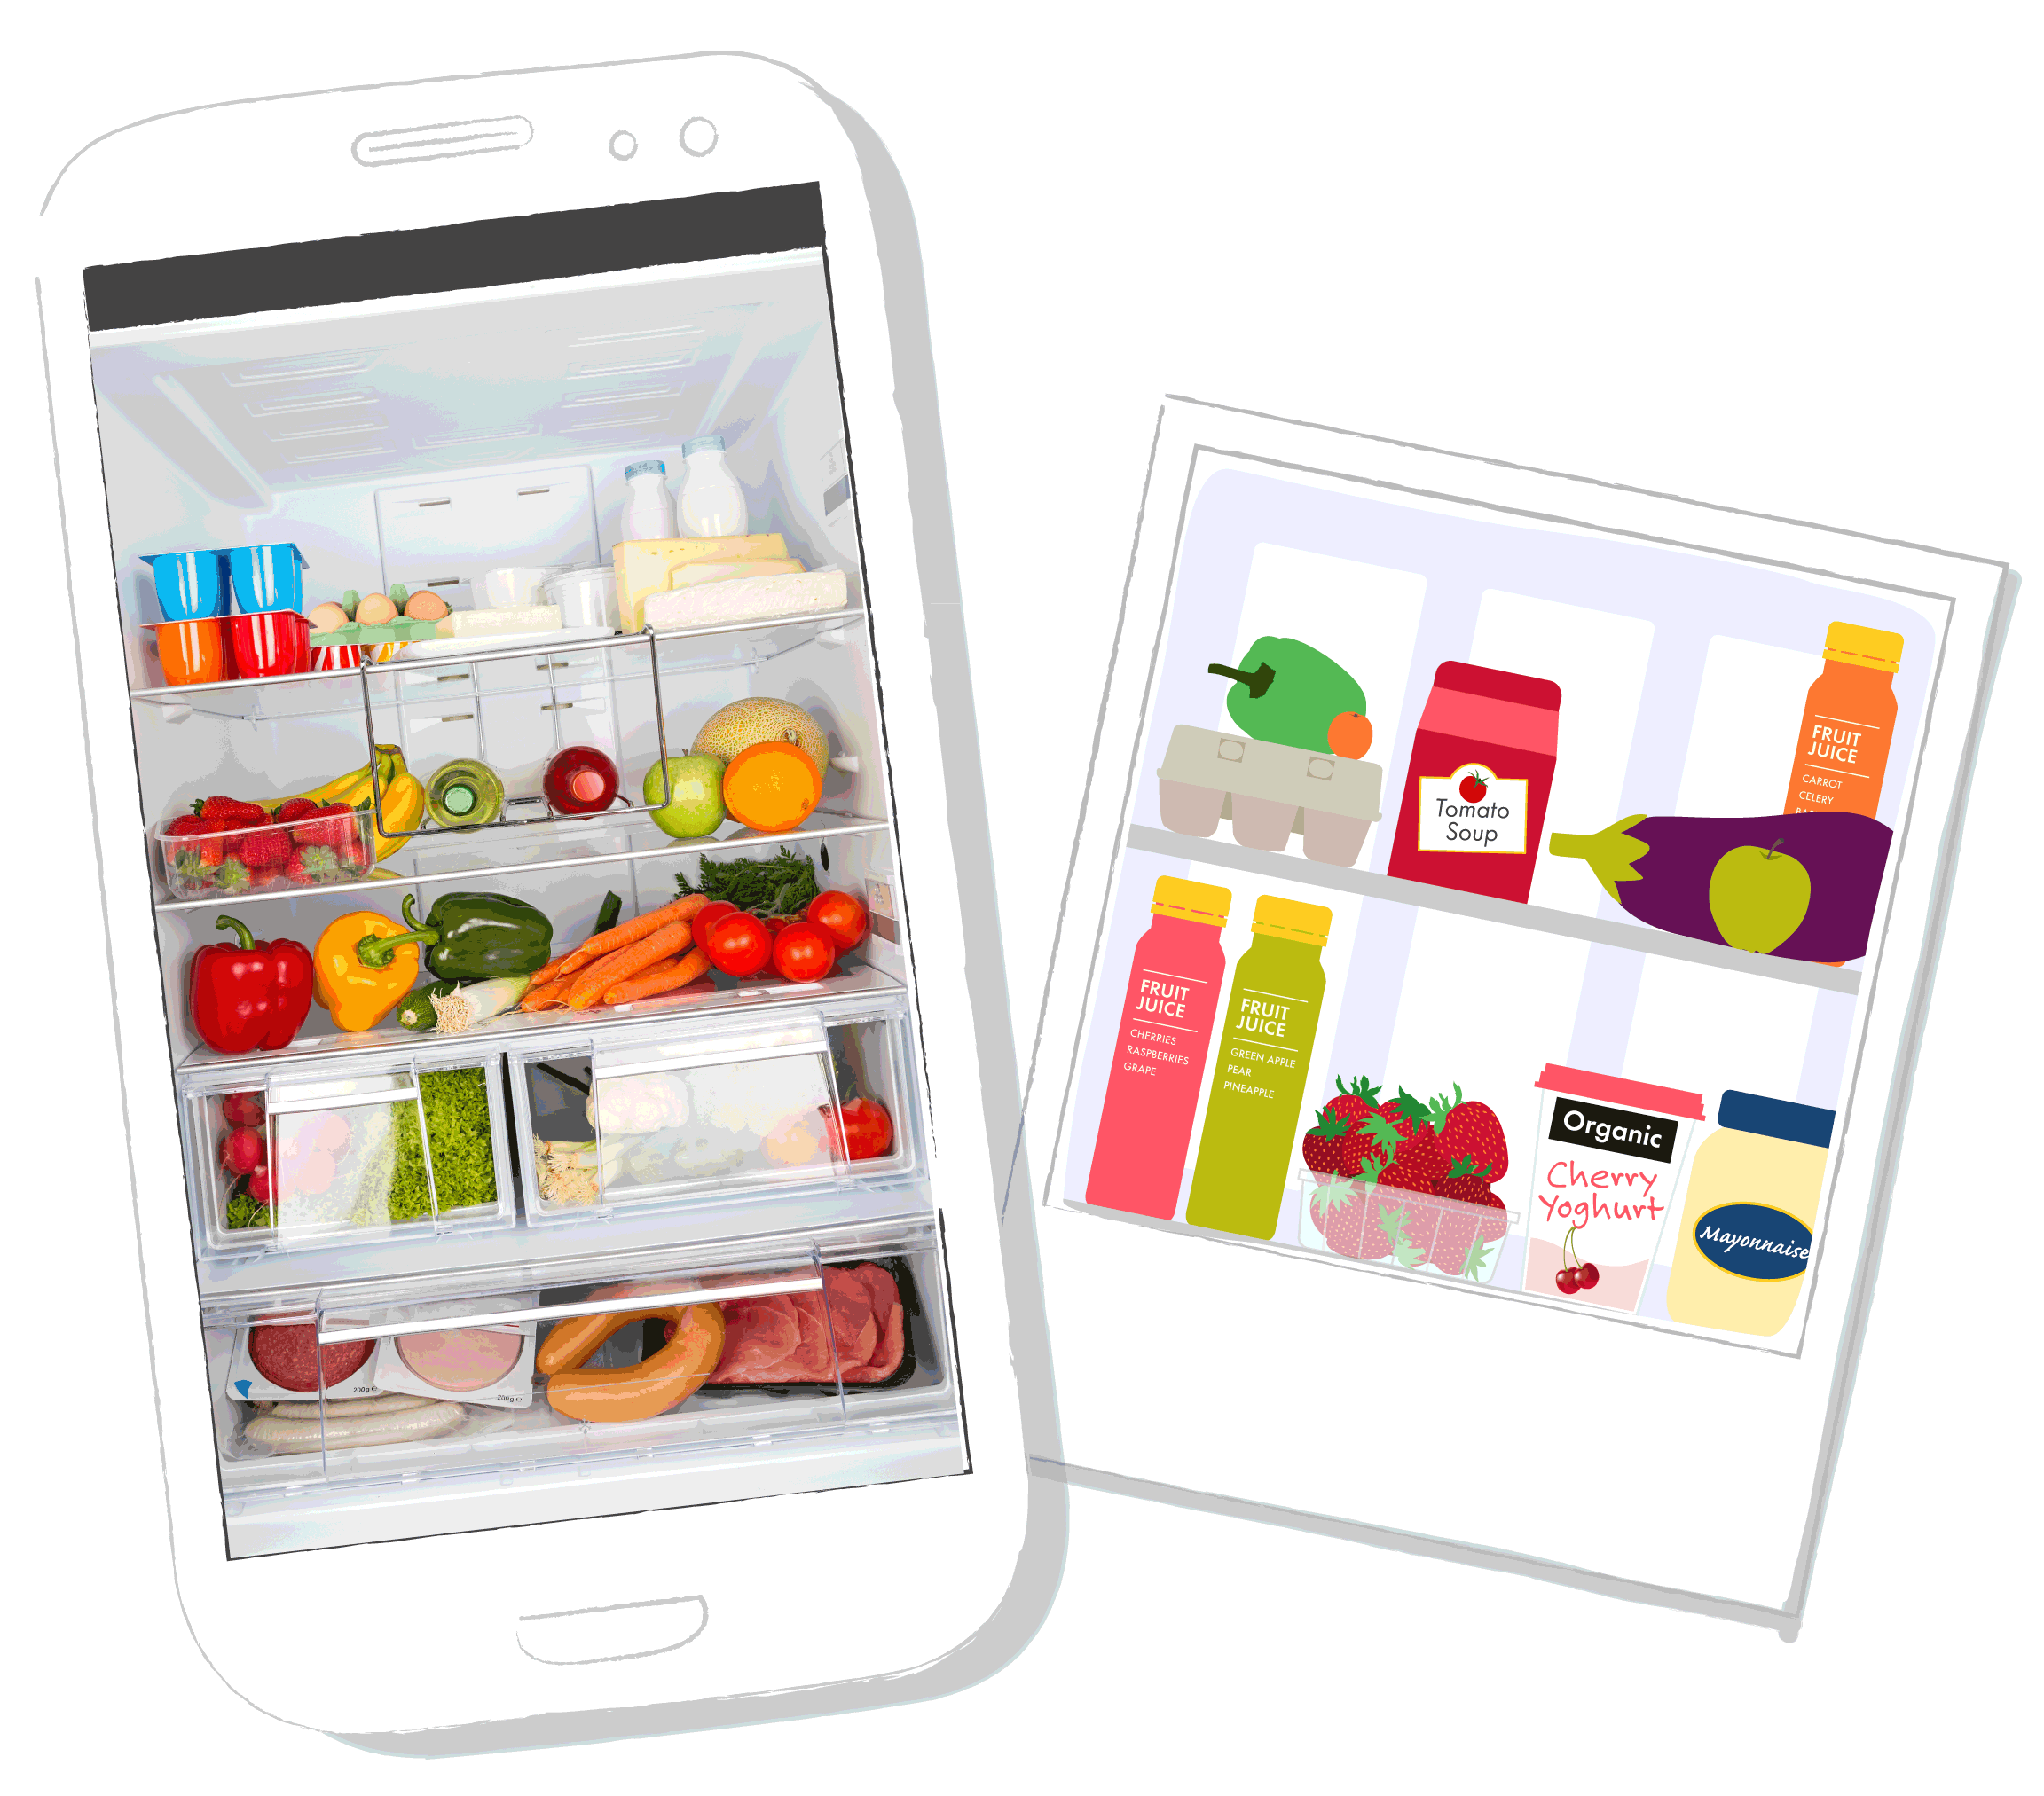
Check - look in our
cupboards and shelves before going shopping…
...why not take a photo of your fridge so you don't end up with too much?
Notes:
Ask learners how shopping is bought in their home, do they go once a week or every other day? Is it done online?

Slide 4
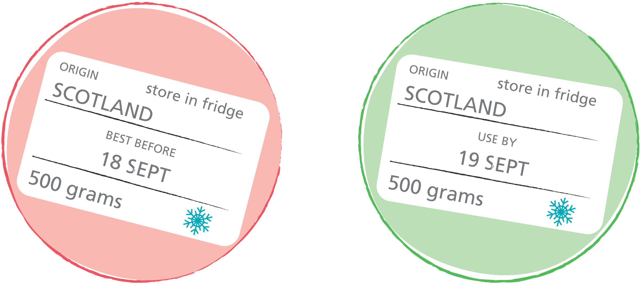
Label - 'best before' doesn't mean you throw it away!
'Use by' tells you when food is safe to eat until
'Best before' is more about the quality of the food rather than the safety
Notes:
Other date labels often found on food include:
Display Until
Sell By
Both of these labels are for the supermarket staff and not relevant in our own kitchens. You can eat food past the Display Until and Sell By dates.
For further information on date labels please see:
http://www.foodstandards.gov.scot/foodlabels/

Slide 5
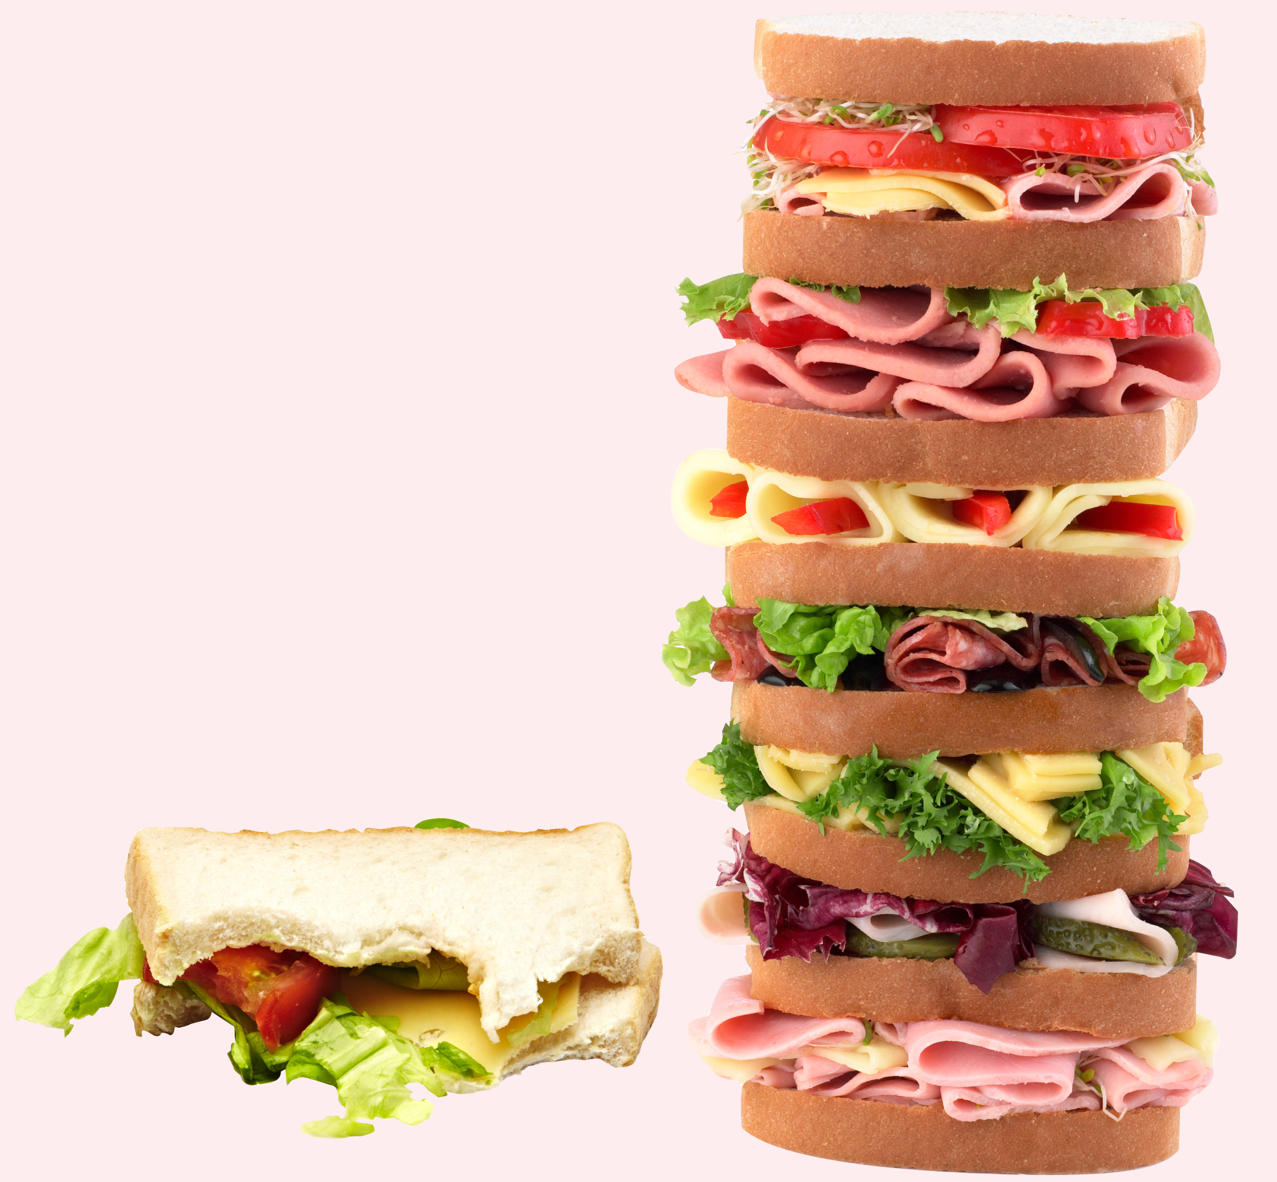
Portion - don't take what we can't finish

Slide 6
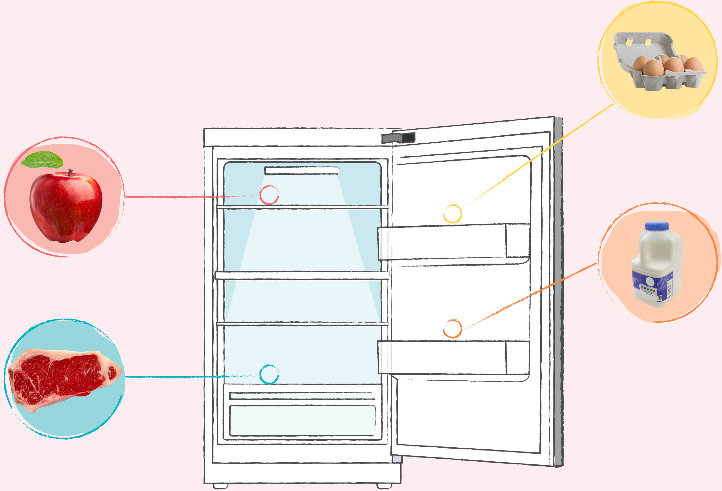
Store - put food in the right places to keep it fresher for longer

Slide 7
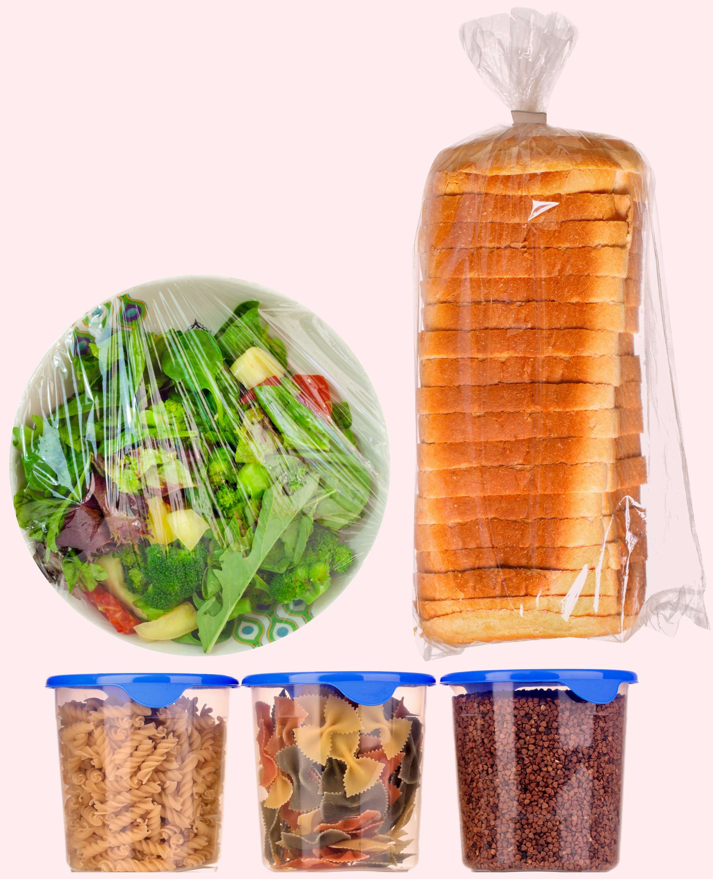
Wrap – protect food that needs a little extra help...
...don't leave open packets uncovered!
Notes:
What food needs to be wrapped up? Ask your learners for examples. Leftovers are always better kept in sealed containers or in clingfilm to keep fresh. Often keeping food in the original packaging it came in can help food to last longer.

Slide 8
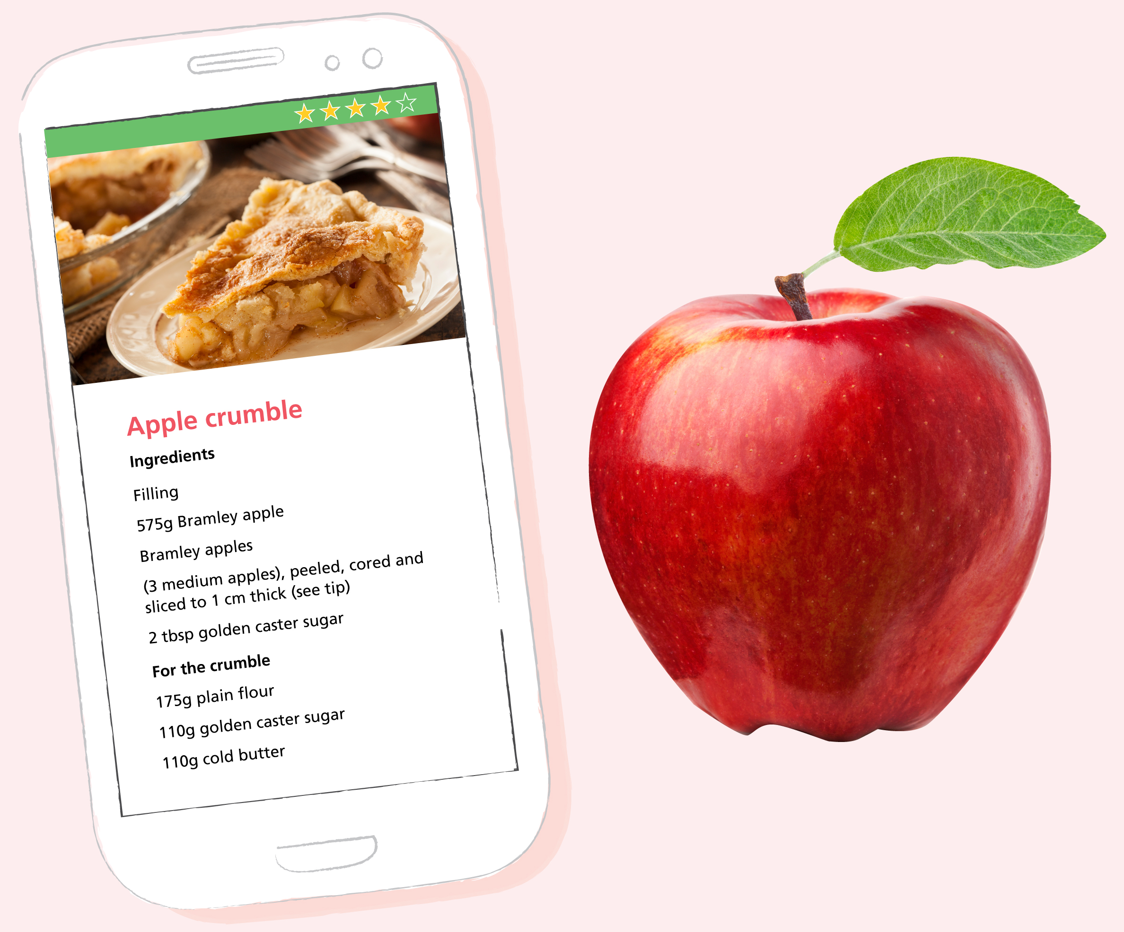
Use up – turn food into many tasty meals...
...reimagine your leftovers.
Notes:
You may wish to list examples here of common ways to use up food including soups, smoothies, omelettes, pancakes (both sweet and savoury), pastas and salads.
Why not ask your learners if they have any examples of how they use up food at home?

Slide 9
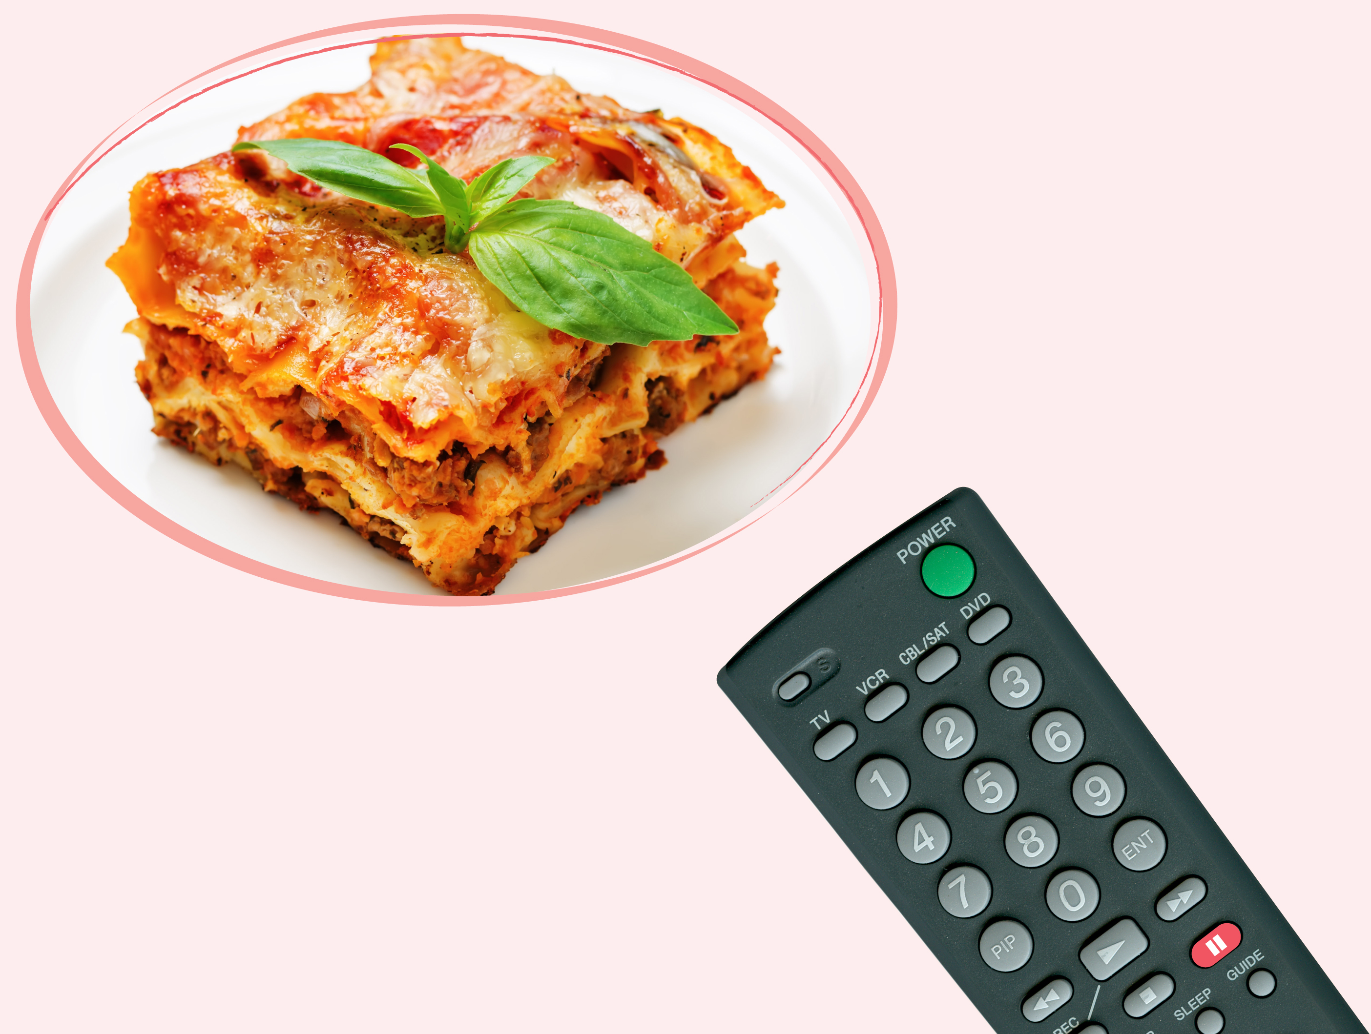
Freeze – put food in the freezer if you don’t think you’ll eat it in time
...the freezer is like pressing pause on food...
….it stops it going off and keeps it fresh for us to eat another day!
Notes:
Ask learners how often they use their freezer at home if they have one?
Tell them that a whole range of things can be frozen – including bread, milk and cheese.

Slide 10

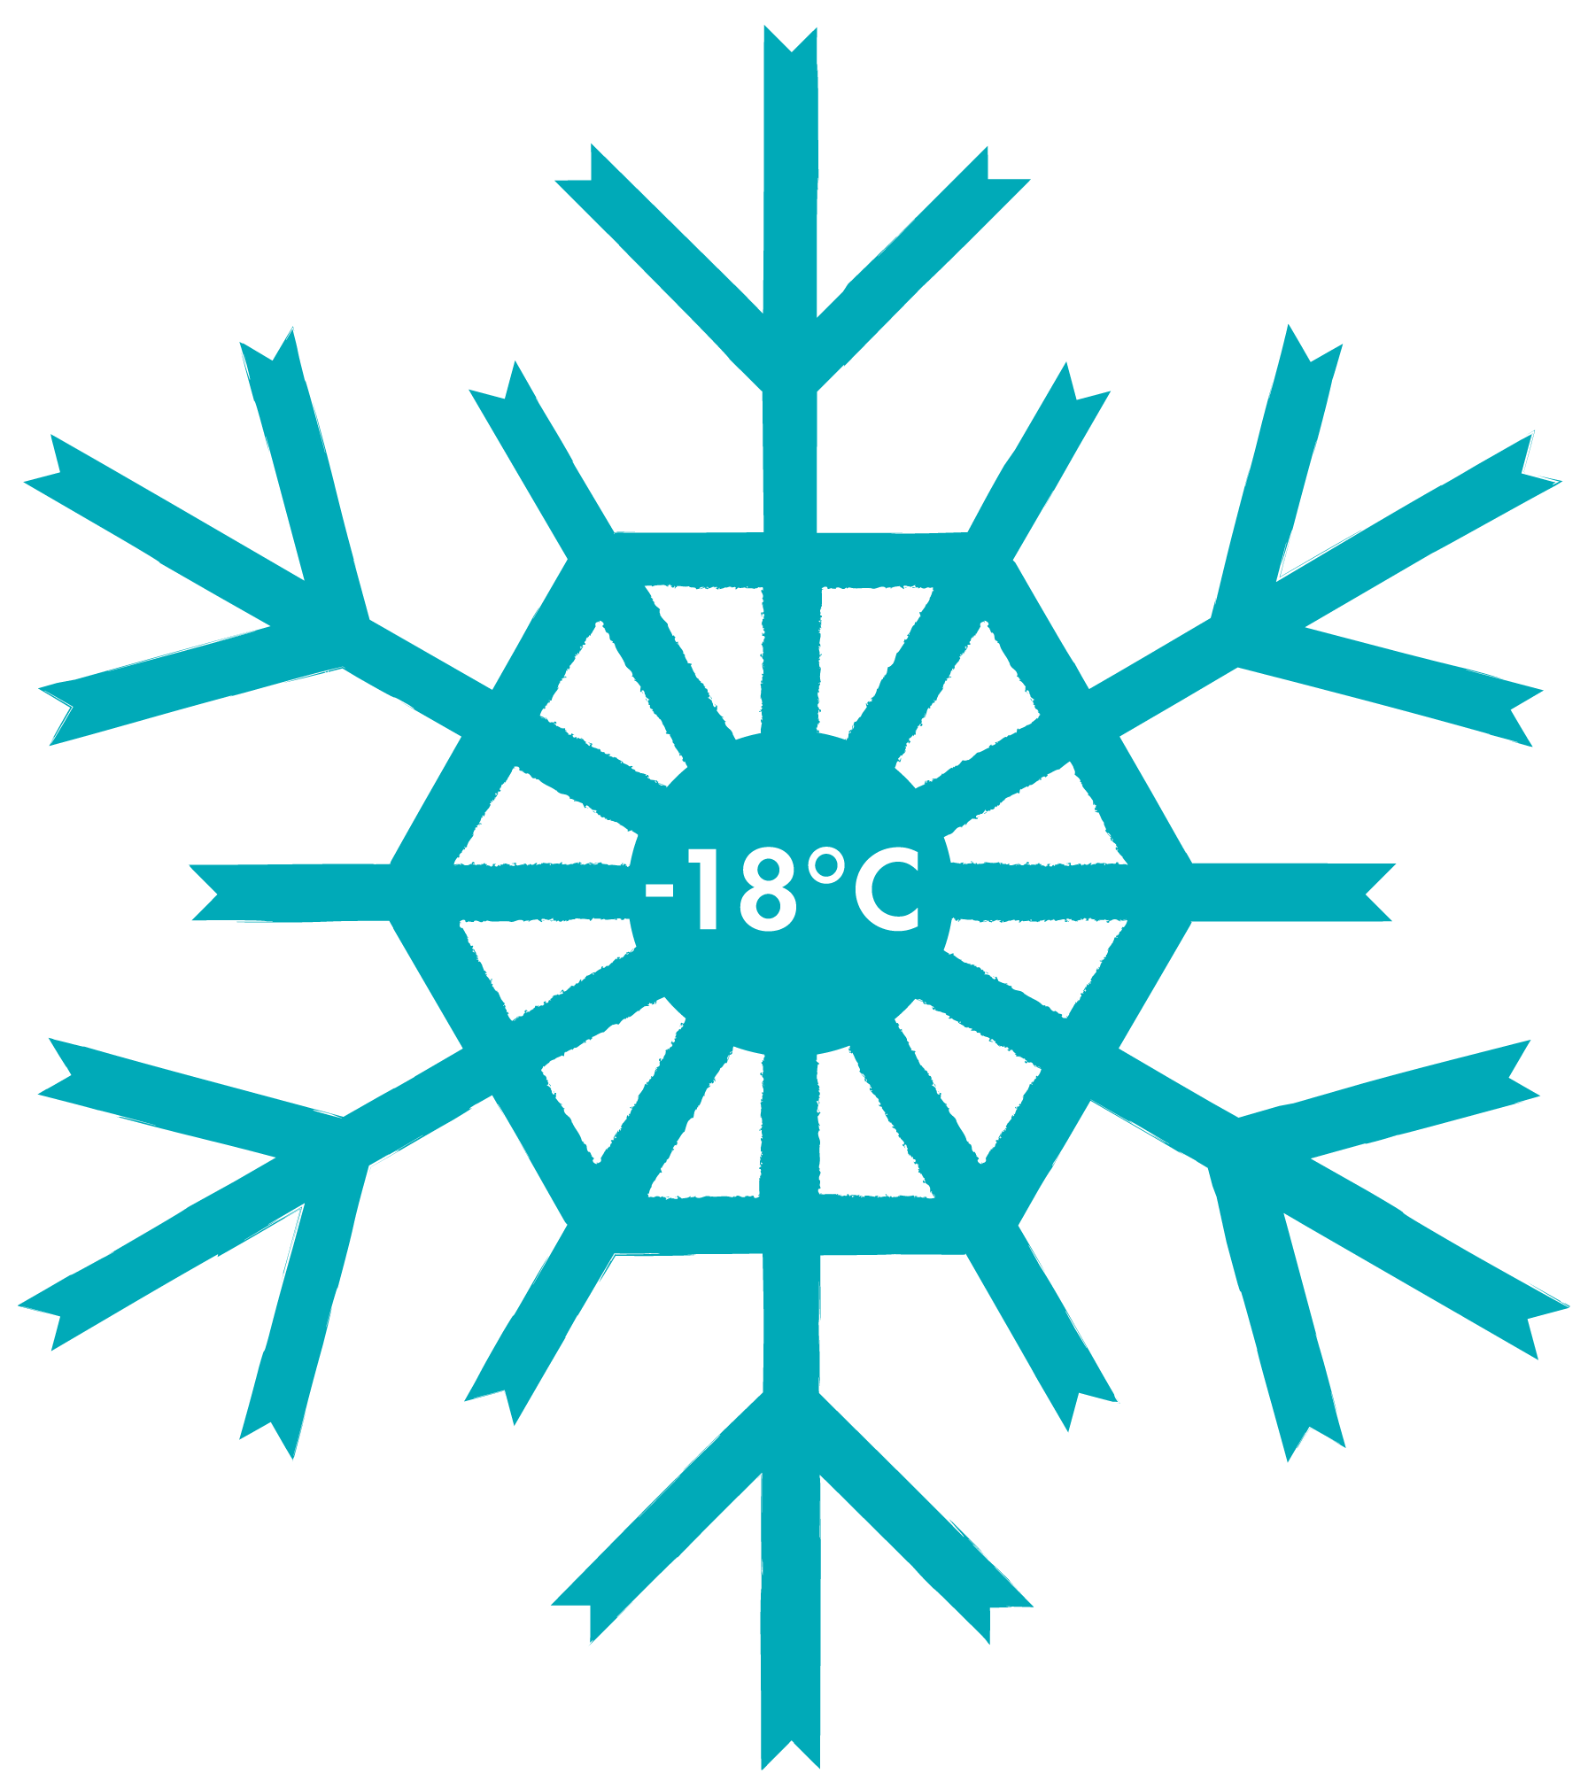

The optimum temperature for freezing food is -18 degrees Celcius

Slide 11
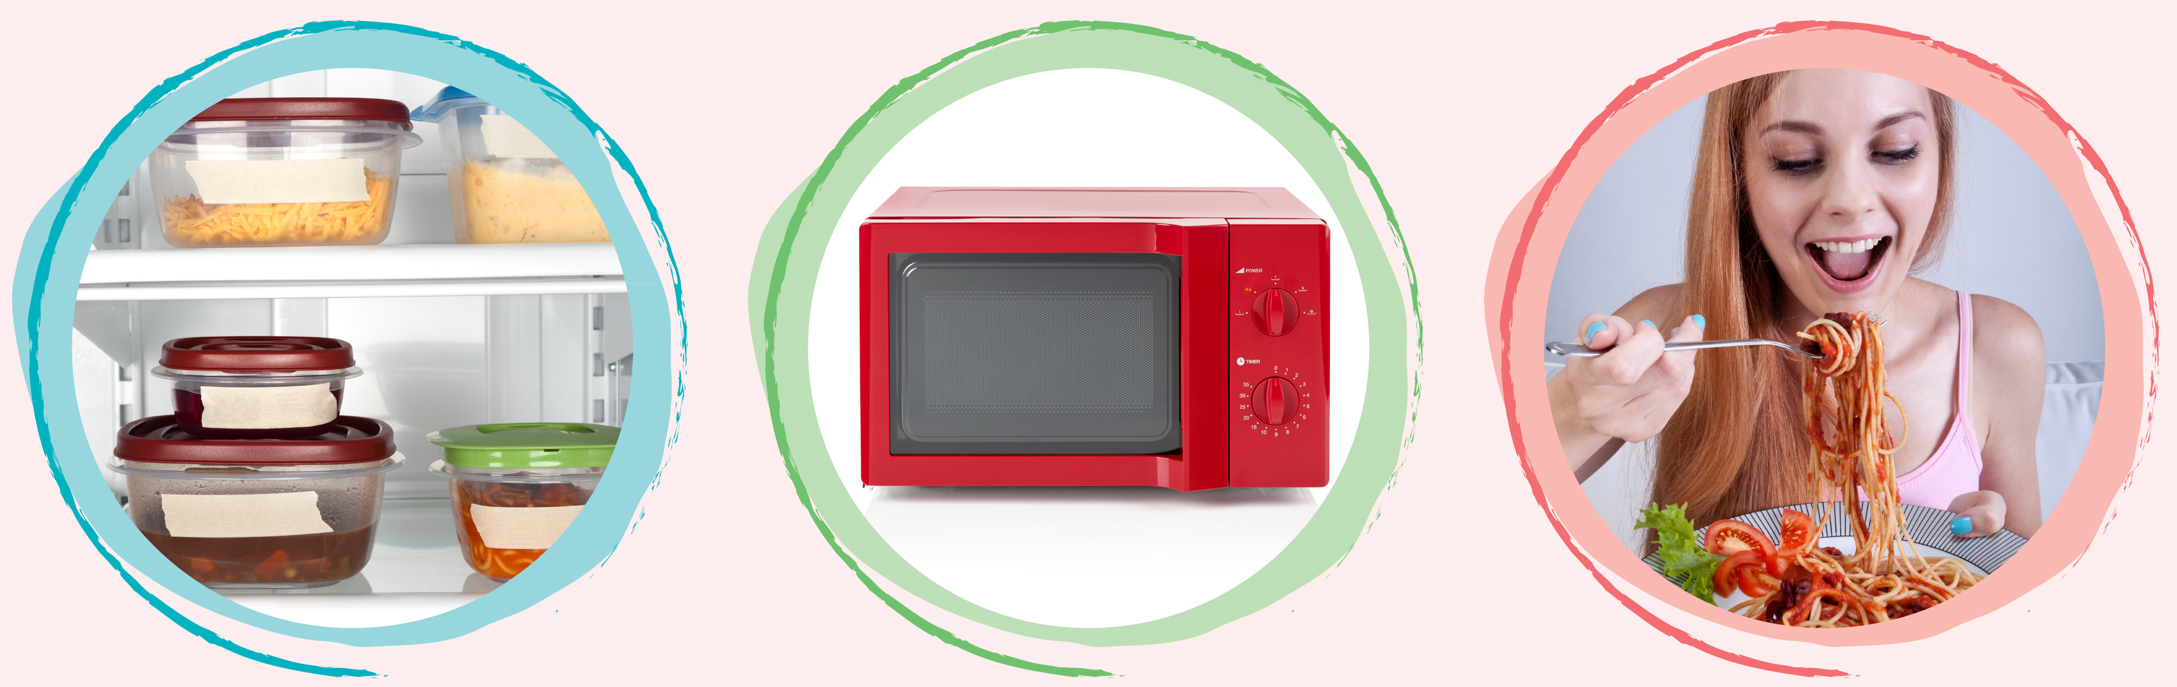
The best way to defrost food is in the fridge overnight
Or defrost in a
microwave if you are eating straight away
Once food is defrosted eat within 24 hours!

