Slide 1
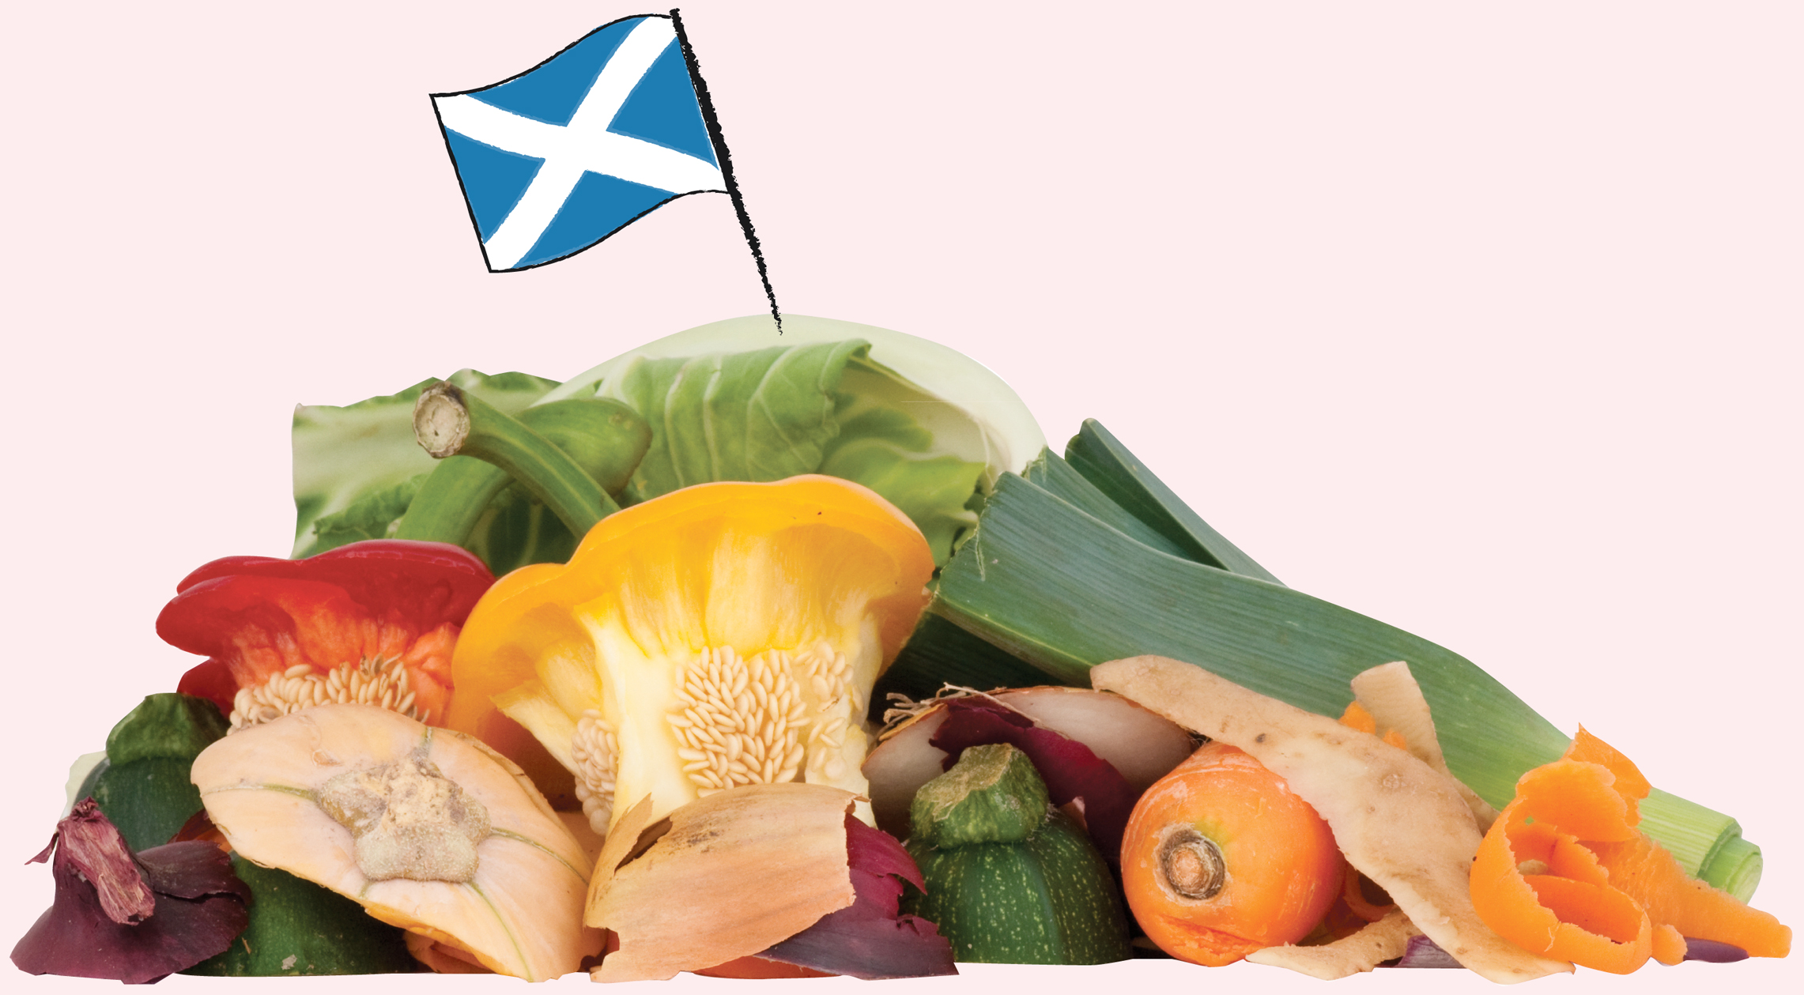

In Scotland we throw away 600,000 tonnes of food every year from our homes.
Notes:
This figure refers to both avoidable food waste (food that could have been saved from the bin) and unavoidable food waste (egg shells, apple cores).

Slide 2
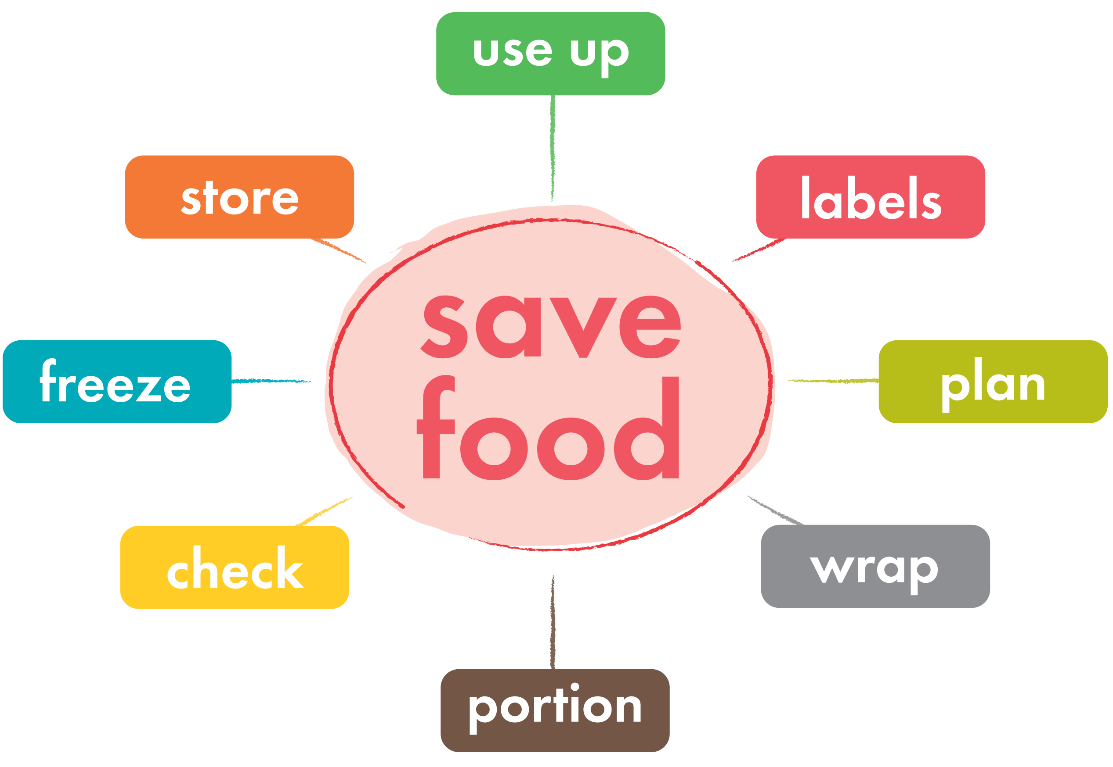
There are 8 key things that can help save food from the bin…

Slide 3
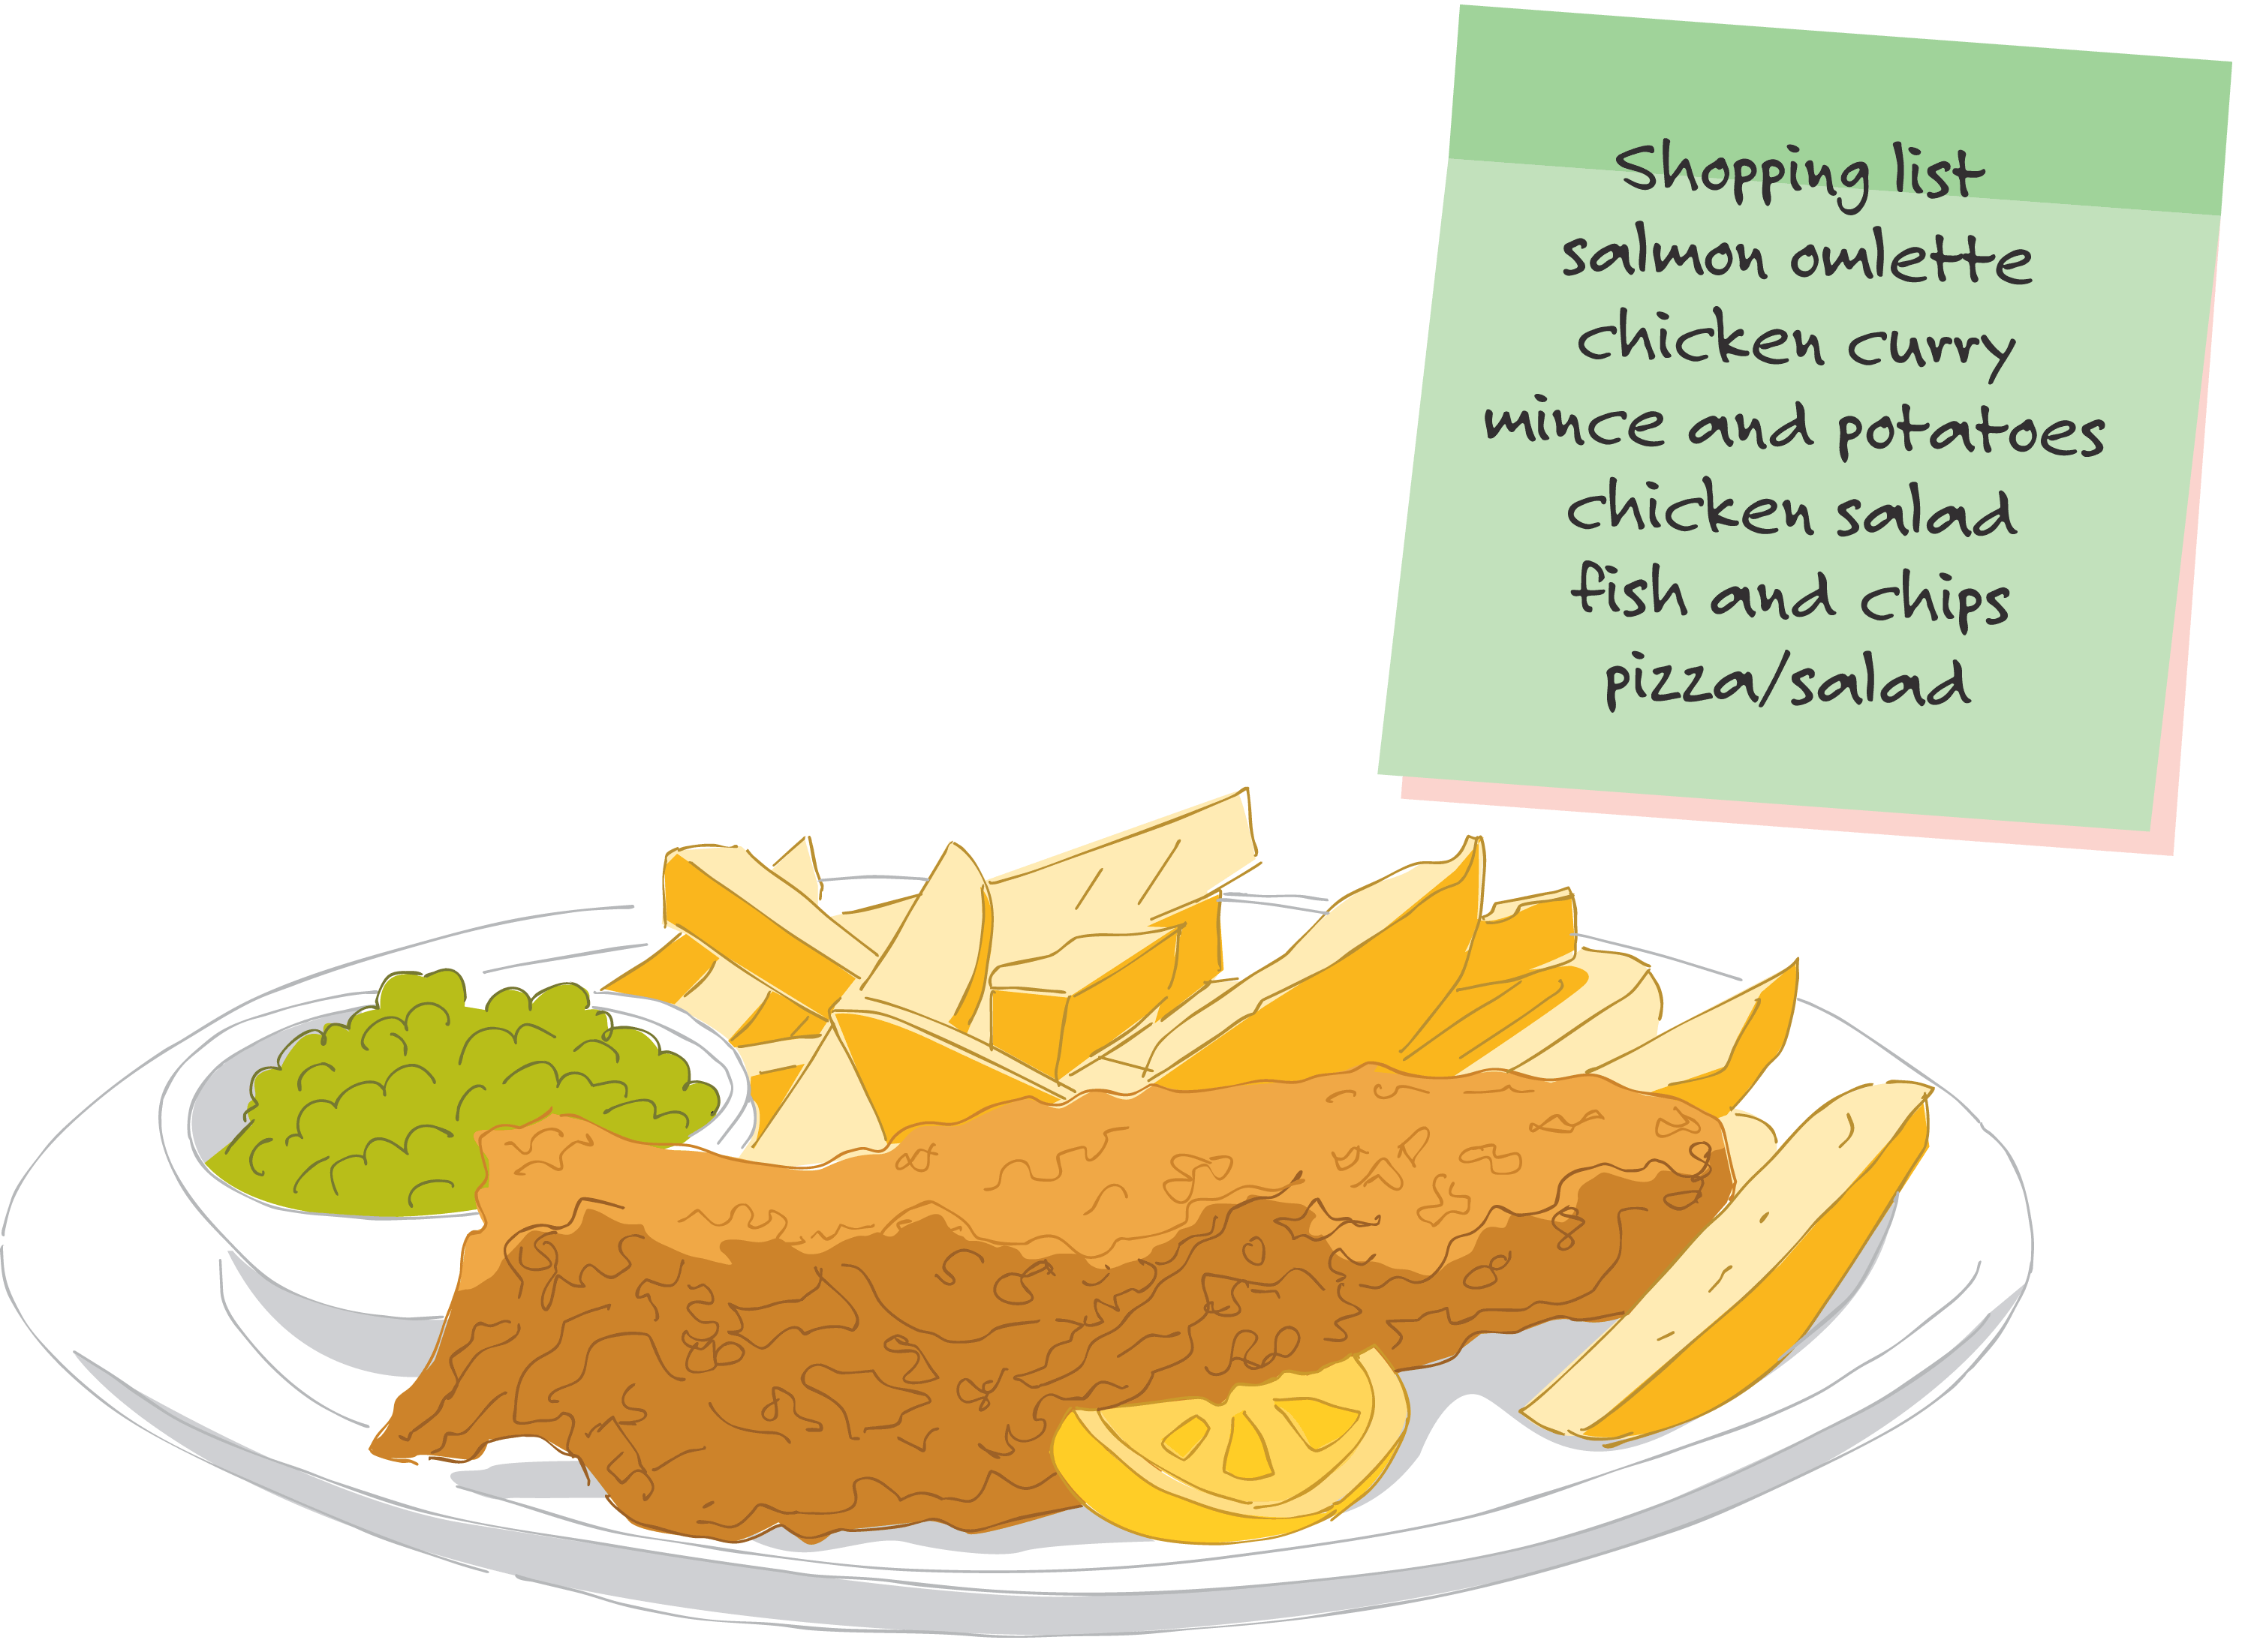
Plan – make lists so we know what meals we are having this week and how we'll use everything up.

Slide 4
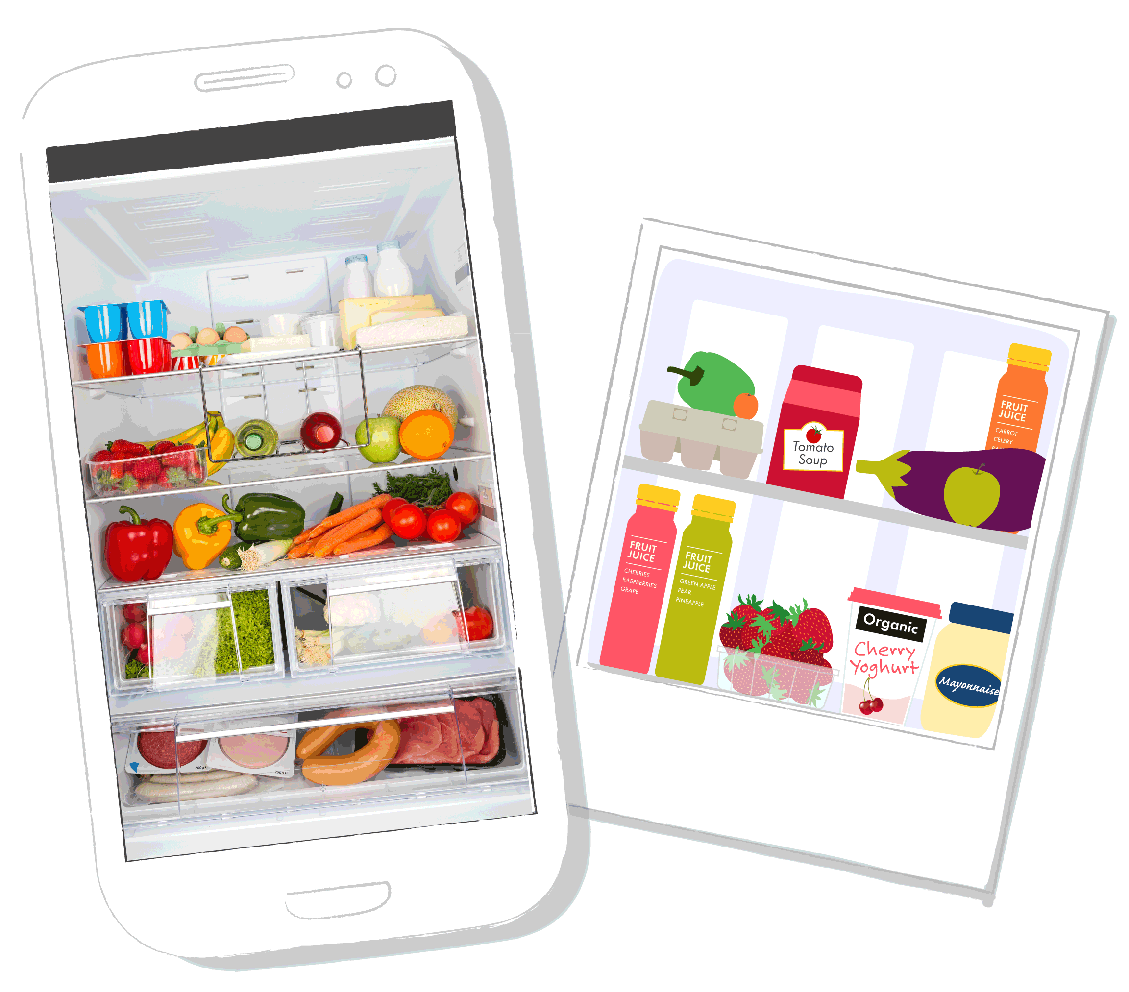
Check – look in your
cupboards and shelves before going shopping…
...why not take a photo of your fridge so you don't end up with too much?
Notes:
Ask learners if they’ve ever made a shopping list at home?
Do they know what’s at the back of their cupboard?

Slide 5
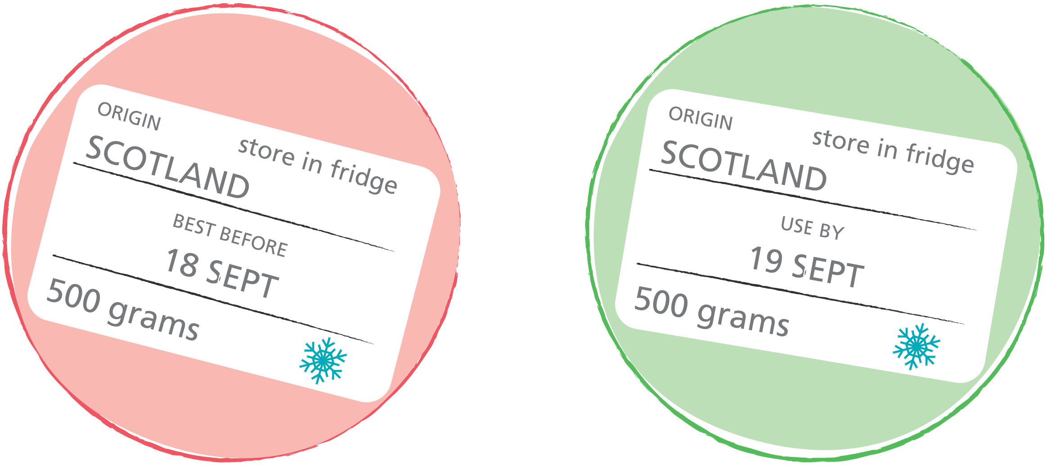
Date labels – 'best before’ is about the quality of the food rather than the safety…
'Use by' tells you when food is not safe to eat anymore.
But with ‘best before'– use your senses and decide!
Notes:
Other date labels sometimes found on food include:
Display Until
Sell By
Both of these labels are for the supermarket staff and not relevant in our own kitchens. You can eat food past the Display Until and Sell By dates.
For further information on date labels please see:
http://www.foodstandards.gov.scot/foodlabels/
Remind learners that food should not be eaten past the ‘use by’ date.

Slide 6
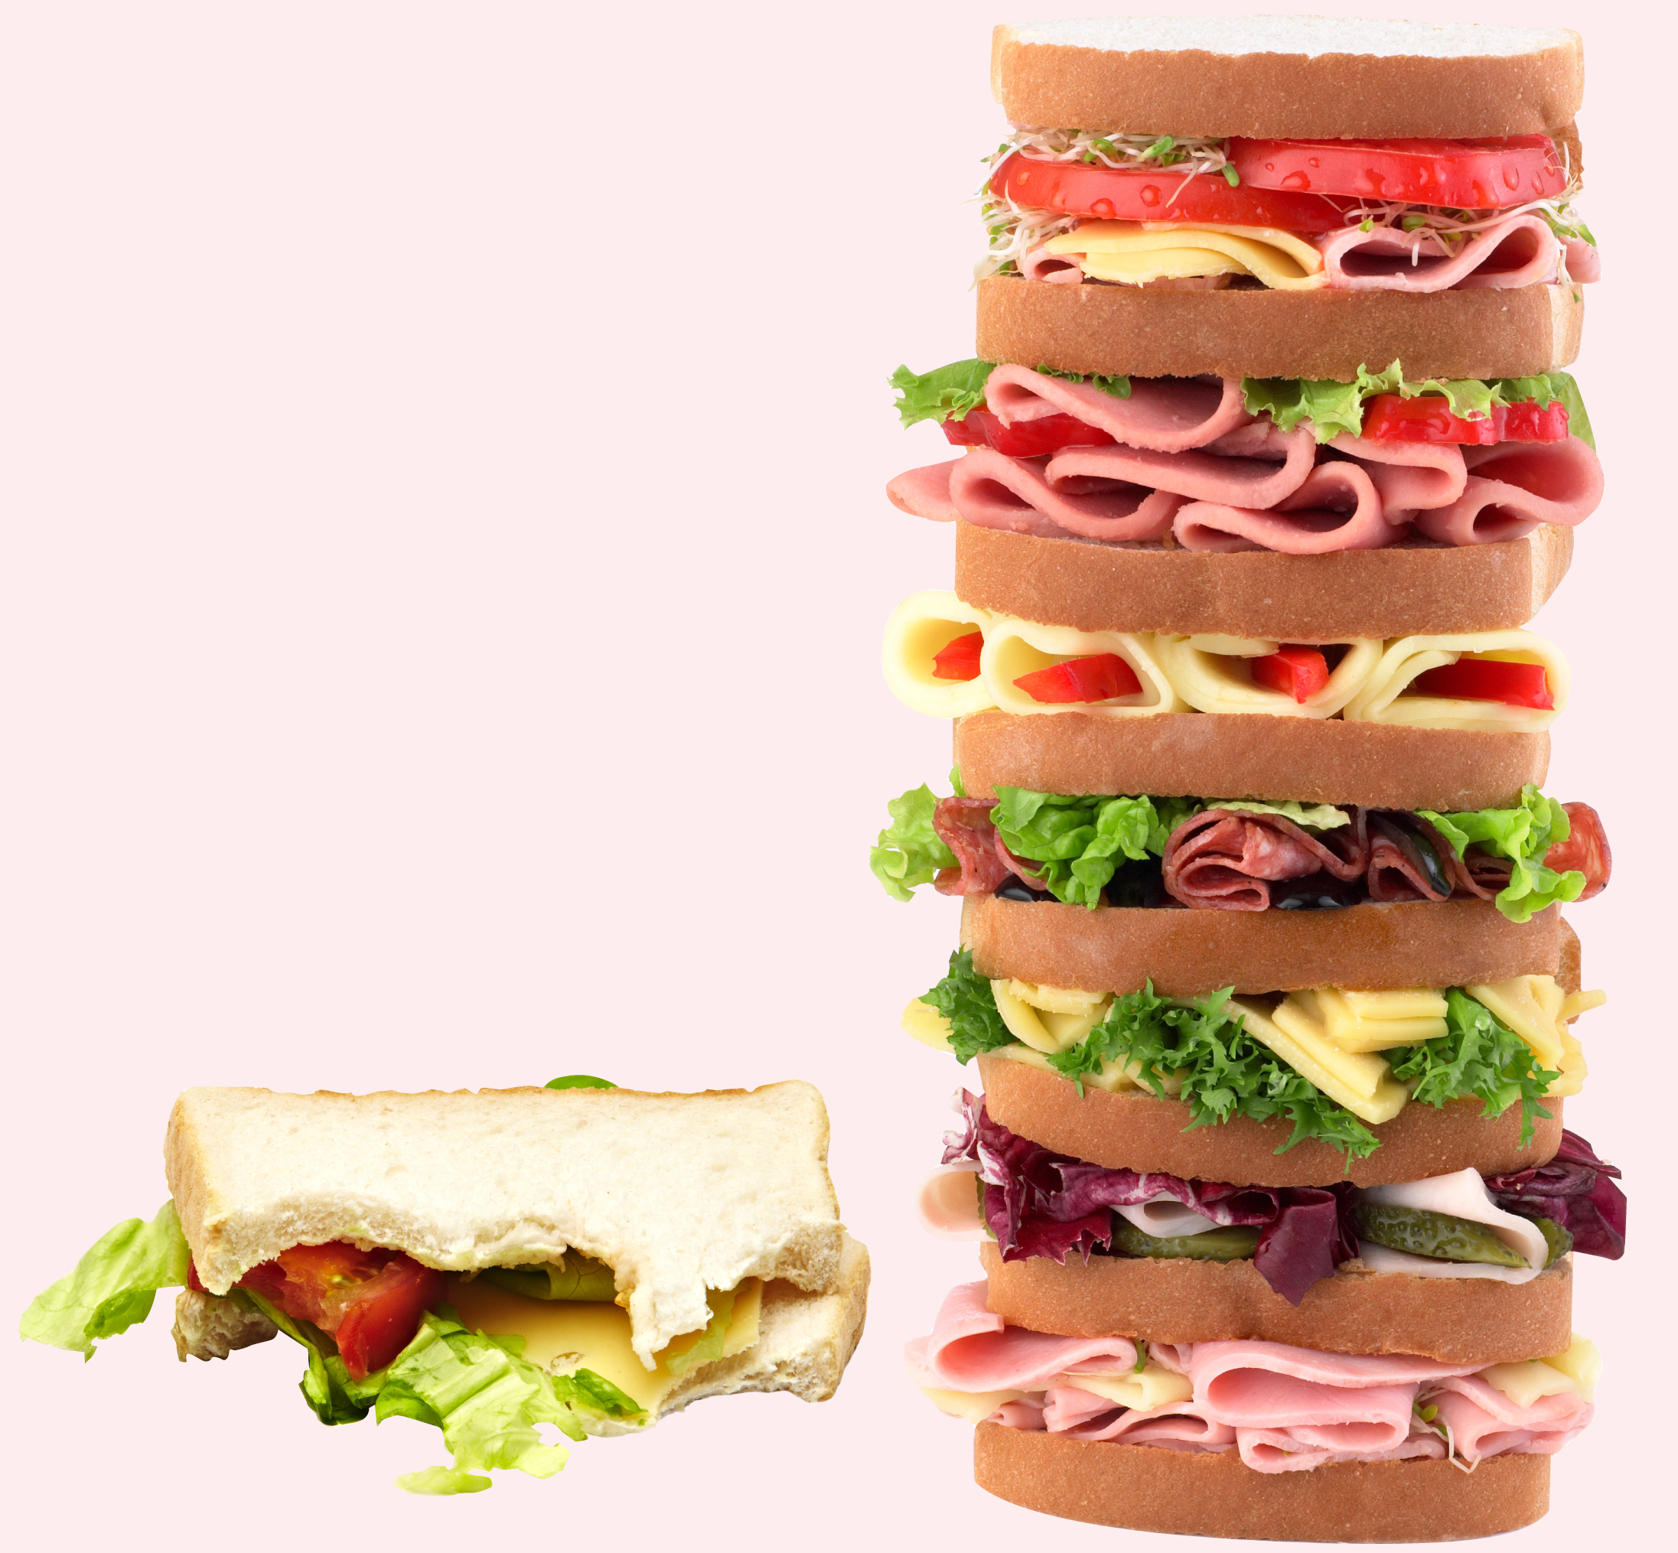
Portion – don't take what you can't finish.

Slide 7
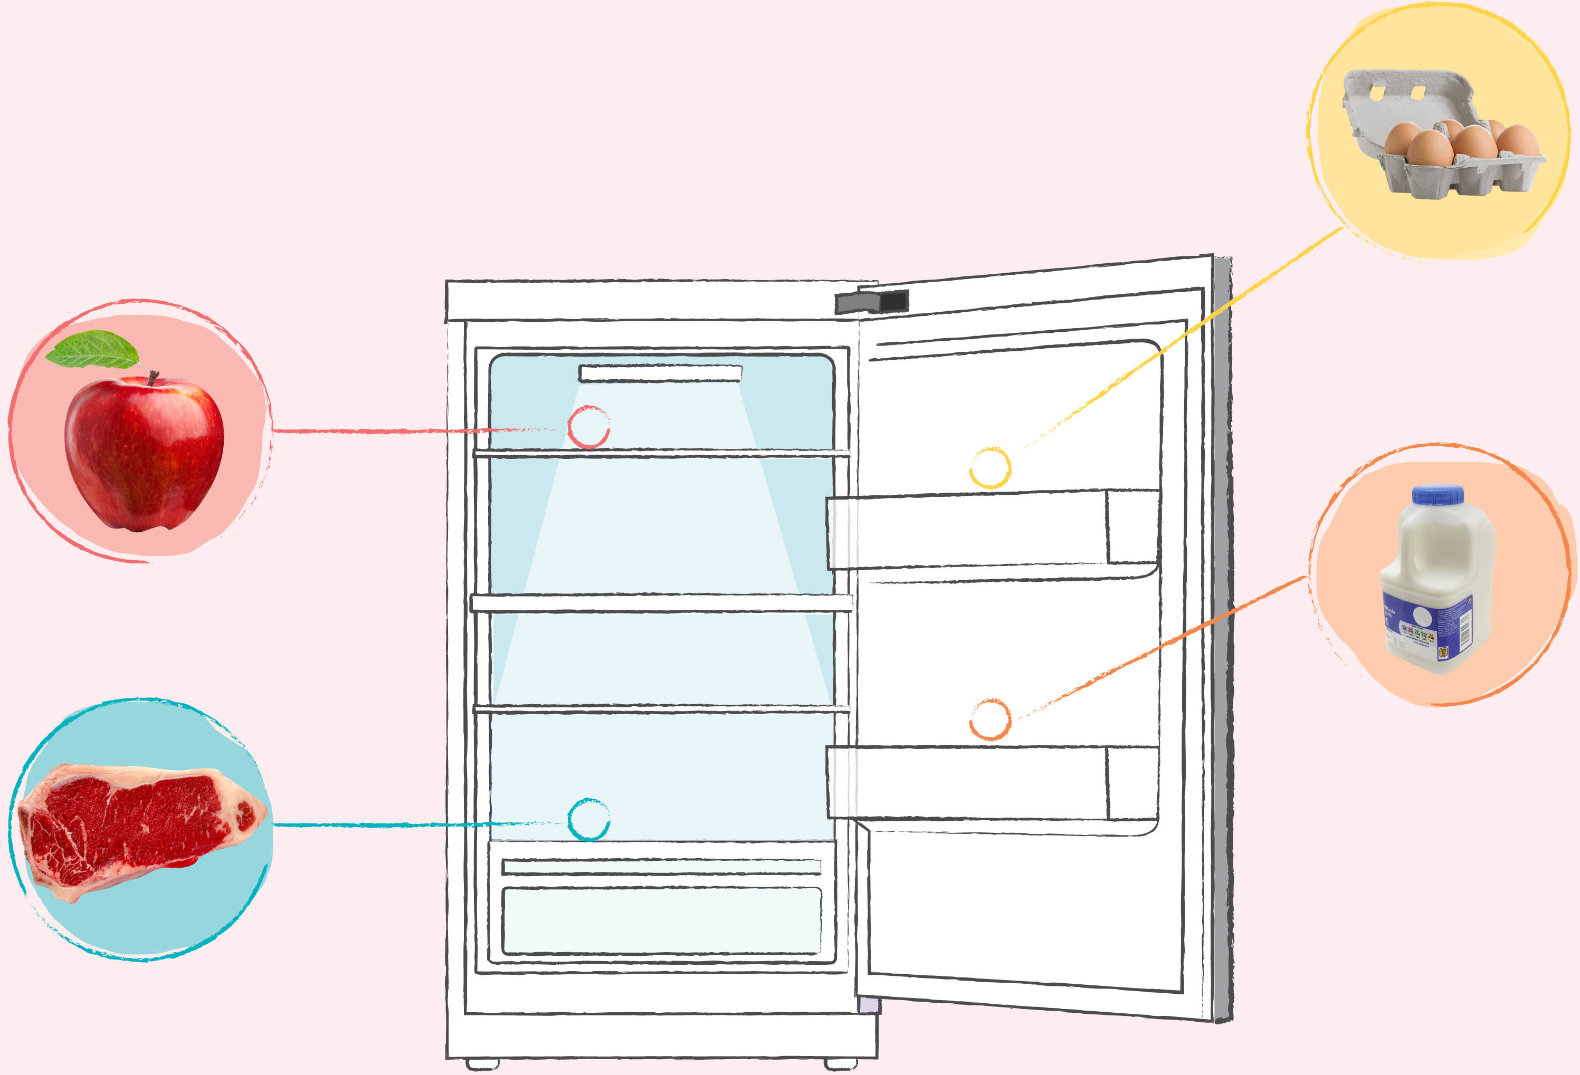
Store – put food in the right places to keep it fresher for longer.
Notes:
Ask learners if they knew that apples are best stored in the fridge? They can last up to two weeks longer.
Some people store eggs in the cupboard but the fridge is best for keeping them at a constant temperature.
Have a discussion with learners about where they store food in their own homes.

Slide 8
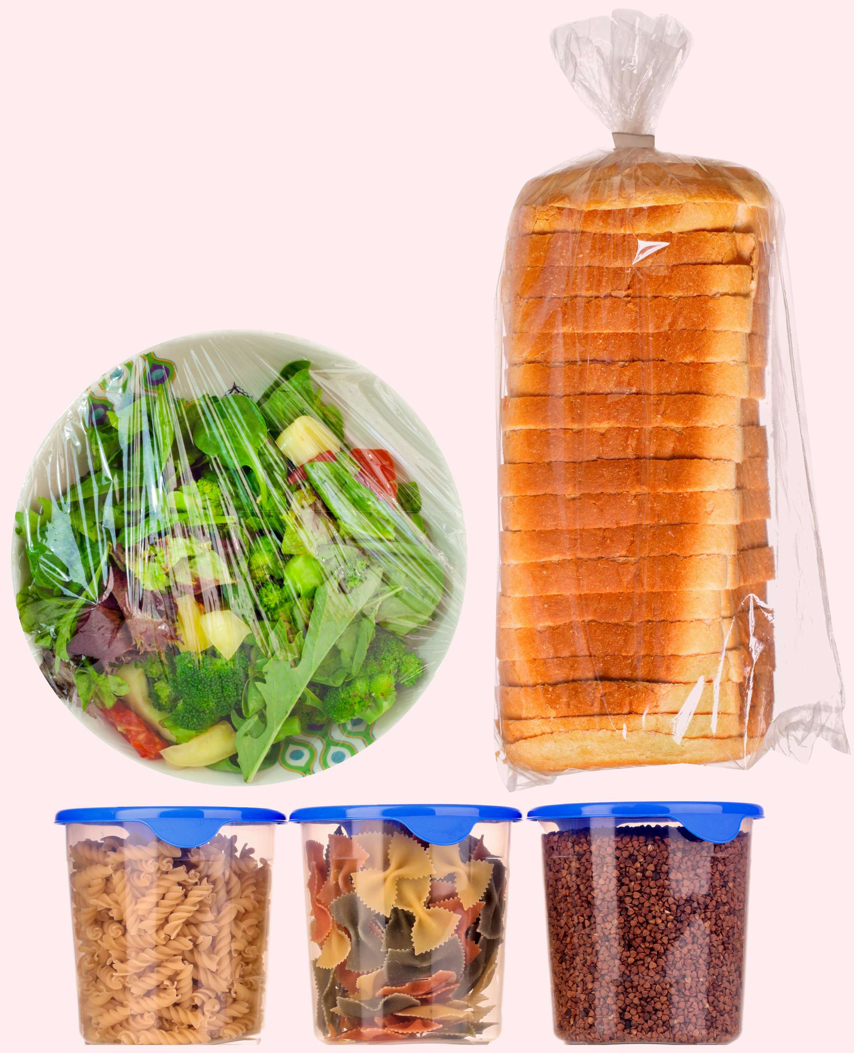
Wrap – protect food that needs a little extra help...
...don't leave open packets uncovered!
Notes:
What food needs to be wrapped up? Ask your learners for examples. Leftovers are always better kept in sealed containers or in clingfilm to keep fresh. Often keeping food in the original packaging it came in can help food to last longer.

Slide 9
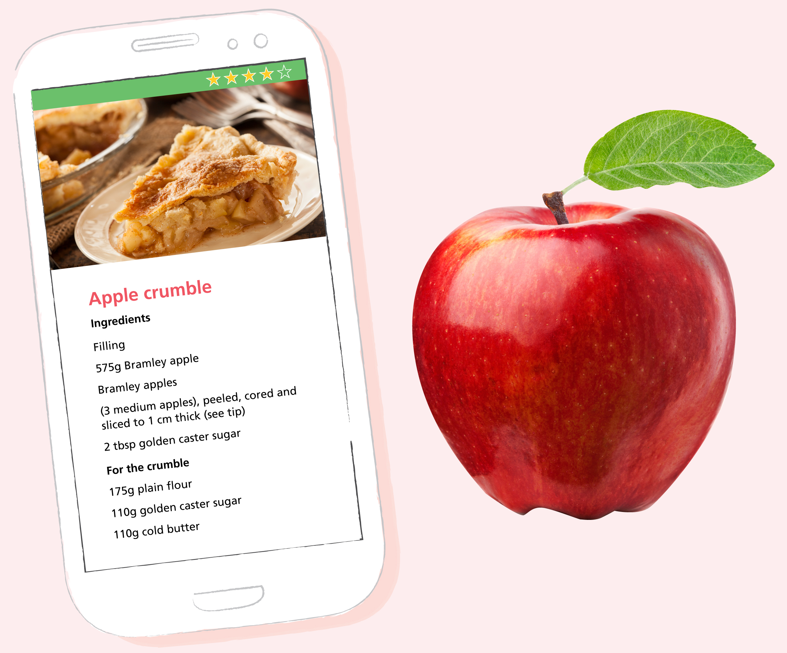
Use up – turn food into many tasty meals...
...reimagine your leftovers.
Notes:
You may wish to list examples here of common ways to use up food including soups, smoothies, omelettes, pancakes (both sweet and savoury), pastas and salads.
Why not ask your learners if they have any examples of how they use up food at home?

Slide 10
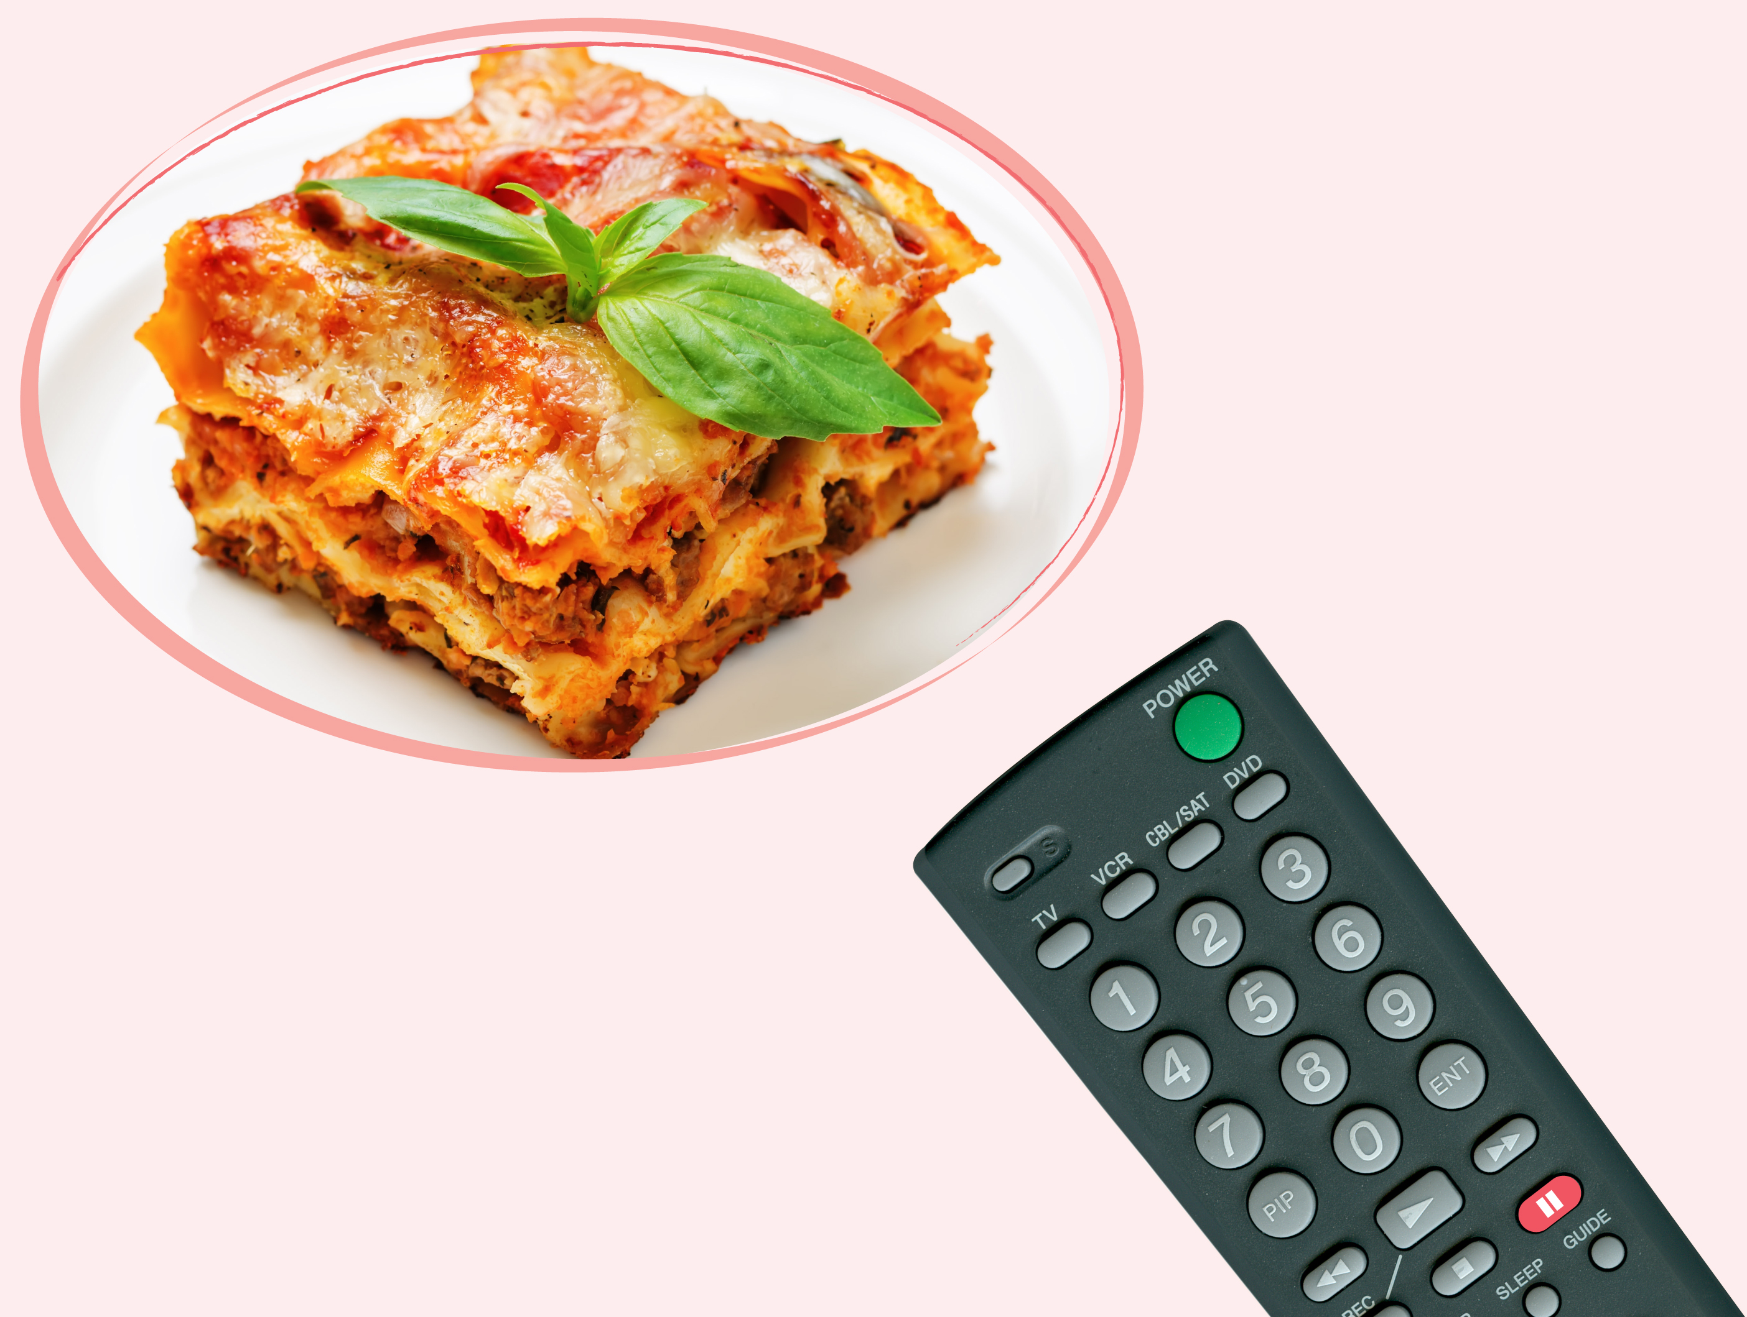
Freeze – put food in the freeze if you think you’ll not eat it in time
...the freezer is like pressing pause on food...
...it stops it going off and keeps it fresh for us to eat another day!
Notes:
Ask learners how often they use their freezer at home if they have one?
Tell them that a whole range of things can be frozen – including bread, milk and cheese.

Slide 11
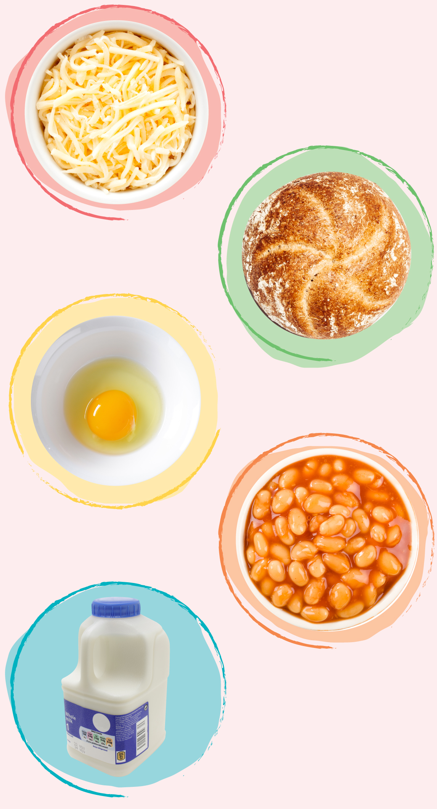
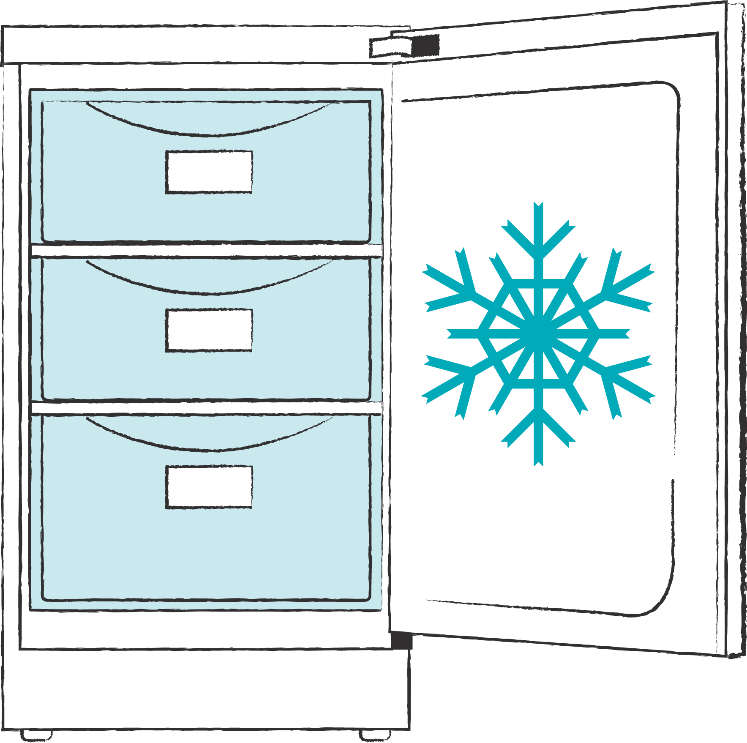
Did you know you can freeze most meals...
...even baked beans!

