Slide 1
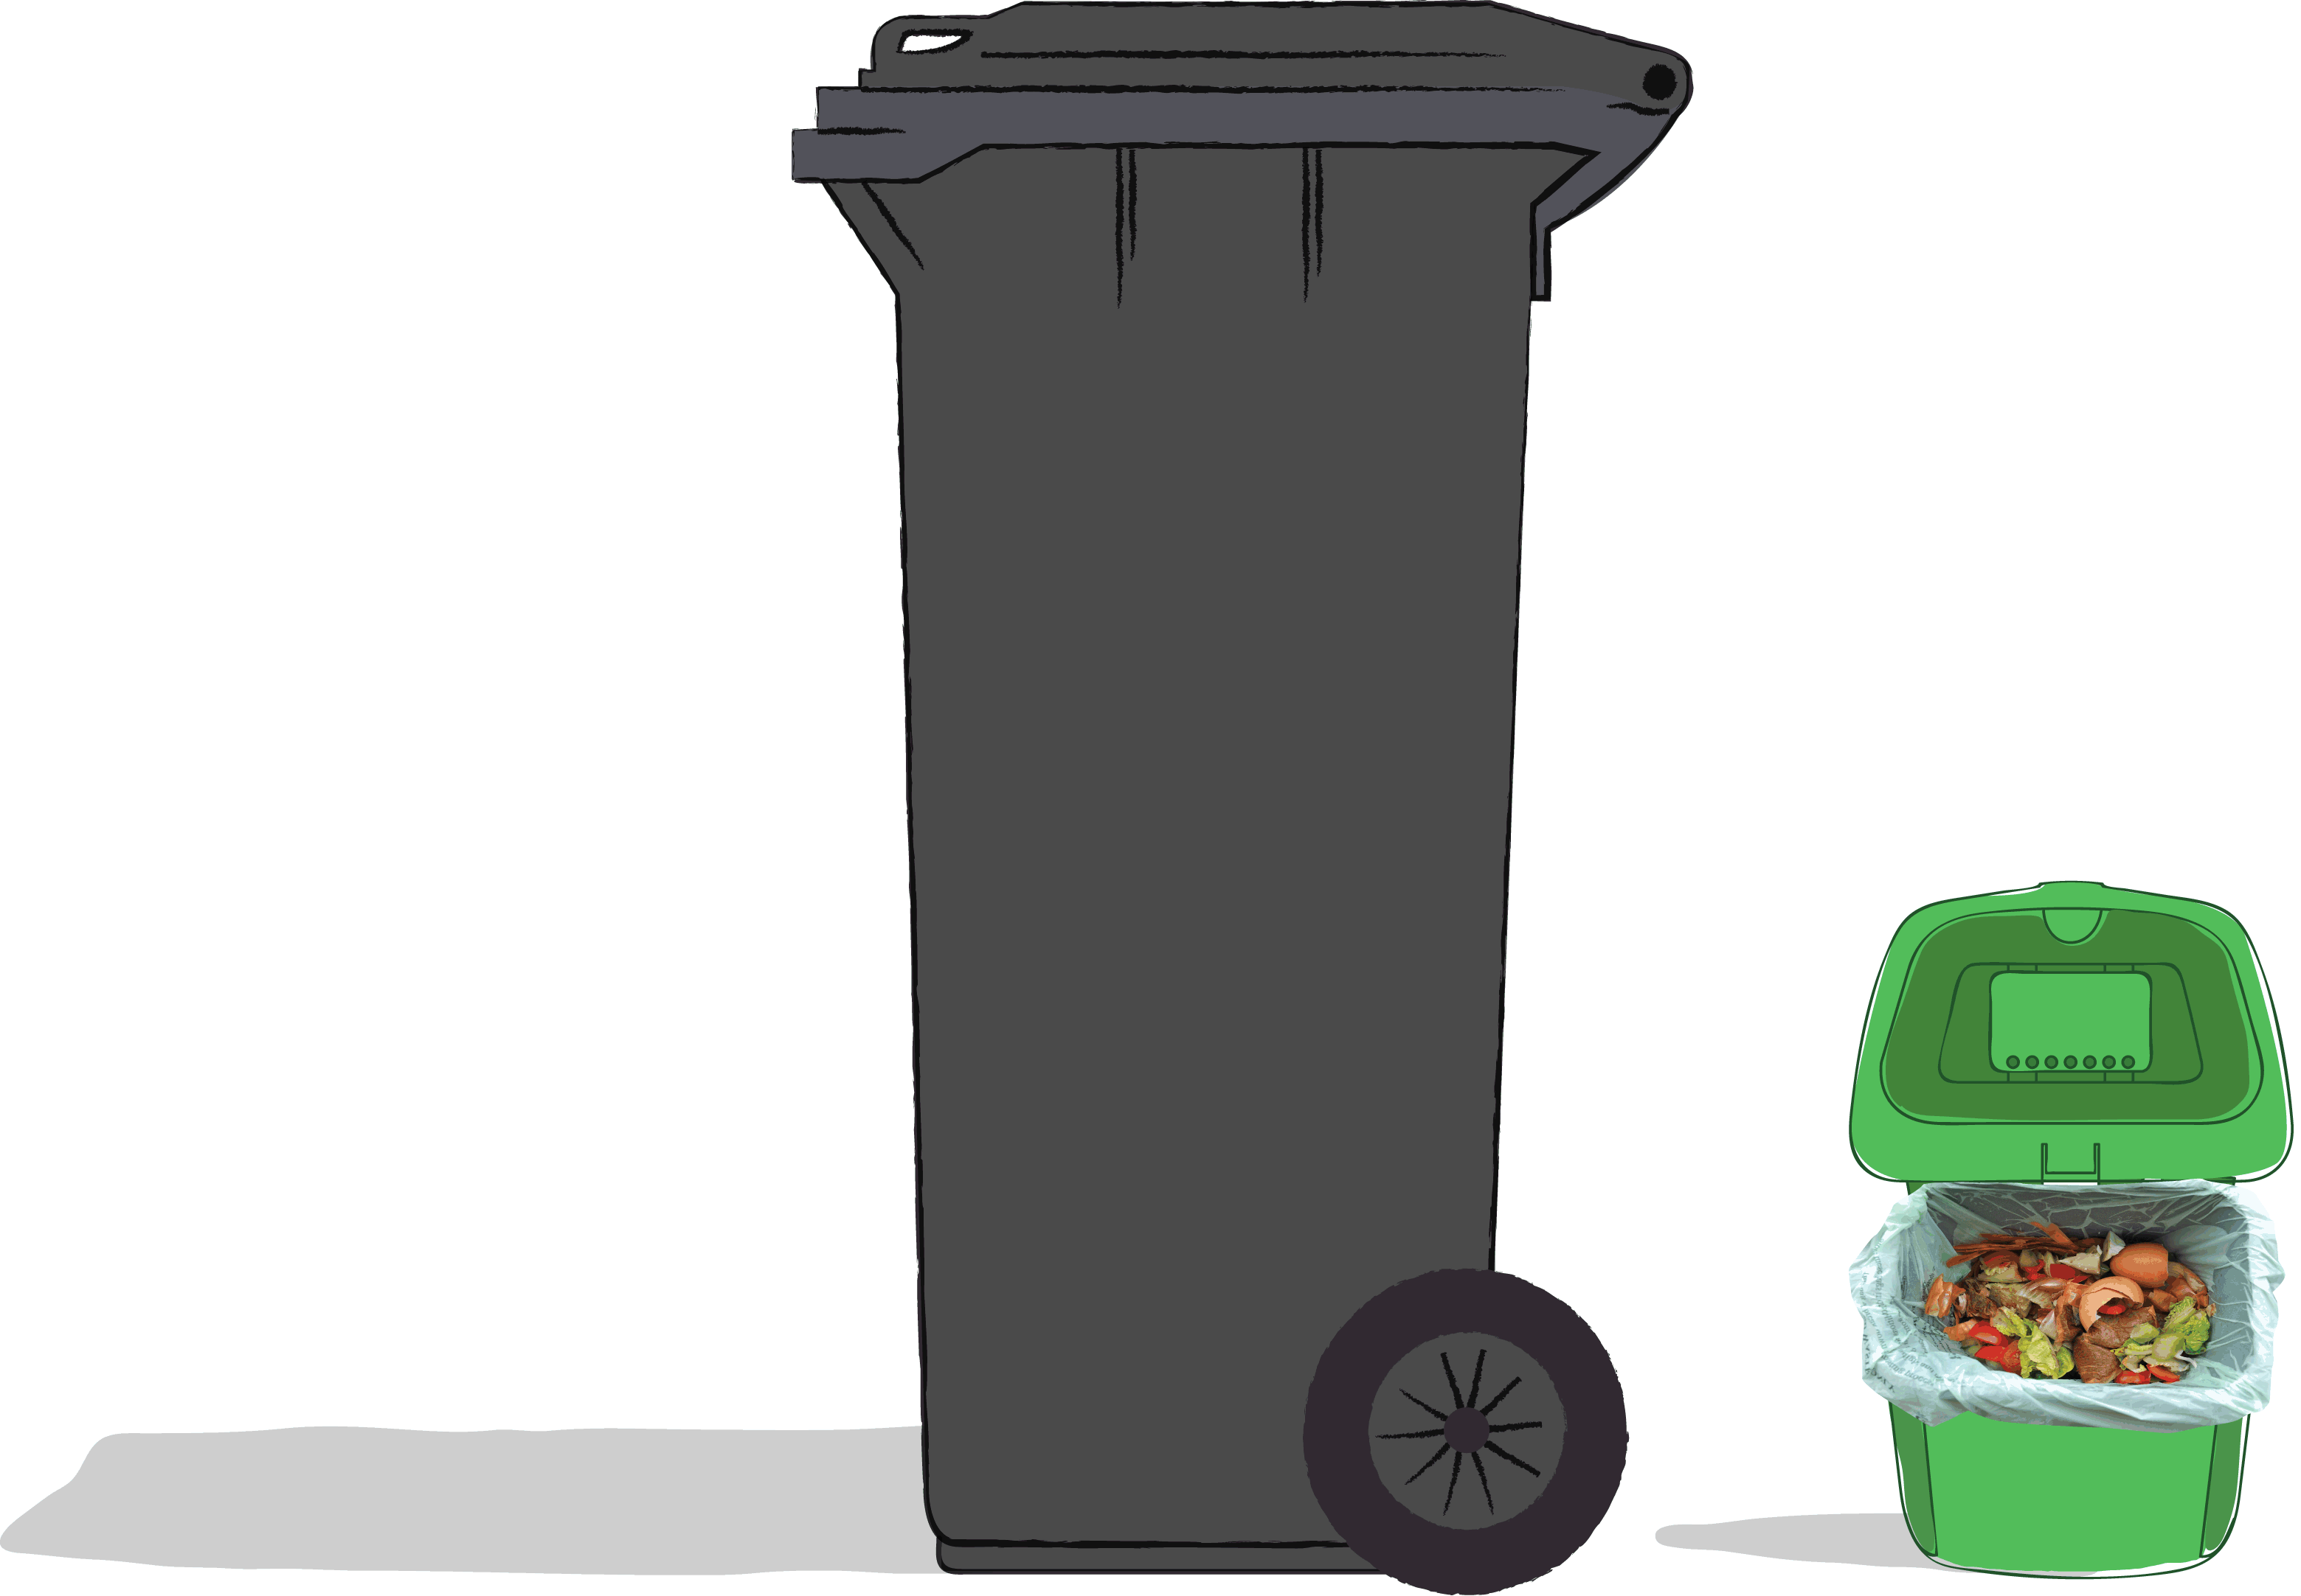


Where does food go when you throw it in the rubbish bin?
What about in the recycling bin?
Notes:
Starter
Depending on your council area, you will have different bins and collections. Use this slide as an opportunity to discuss how things are set up at home.
Do they have a food waste recycling bin or caddy? Is it wee like the picture or bigger? What colour is it? Do they use it in their homes?
Tell learners that if they put food that couldn’t have been eaten in the wee recycling bin it can be used for other things – just in the same way that if they recycle a bottle the plastic can be used again.
(Further food waste recycling resources are available from Recycle for Scotland here: http://zerowastepartners.org.uk/collections/128/ – the focus of this pack is preventing food waste outright.)
But if food goes in the rubbish bin…

Slide 2
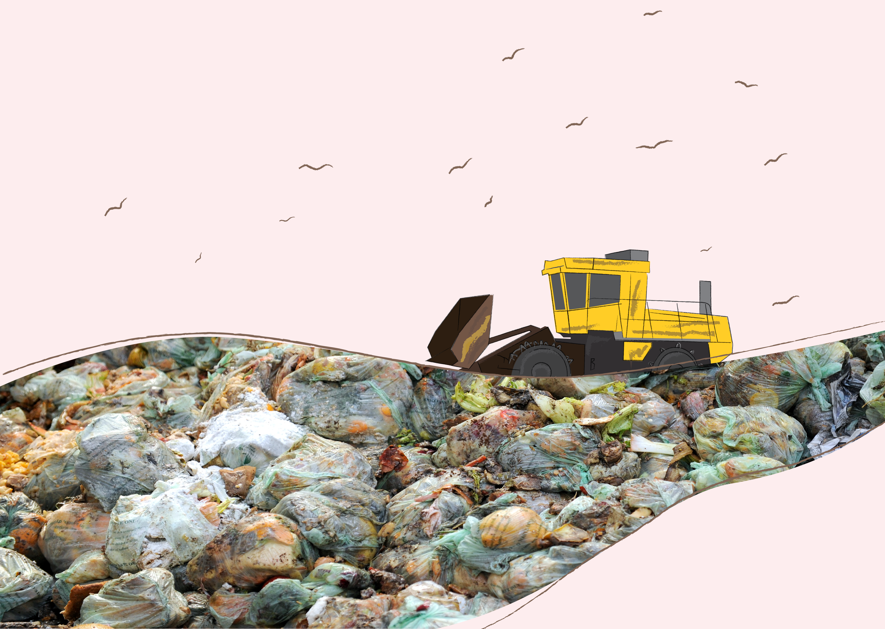
If you throw food into the rubbish bin it goes to landfill…
Notes:
Use this slide to introduce the idea of a landfill site to your learners. Have they ever seen one before? Is there a local example? What things would they expect to see in a landfill site?
Tell learners that in landfill, food is trapped and releases nasty gases that smell bad… Tell learners they will be exploring more about the gases throughout the rest of the lesson.

Slide 3
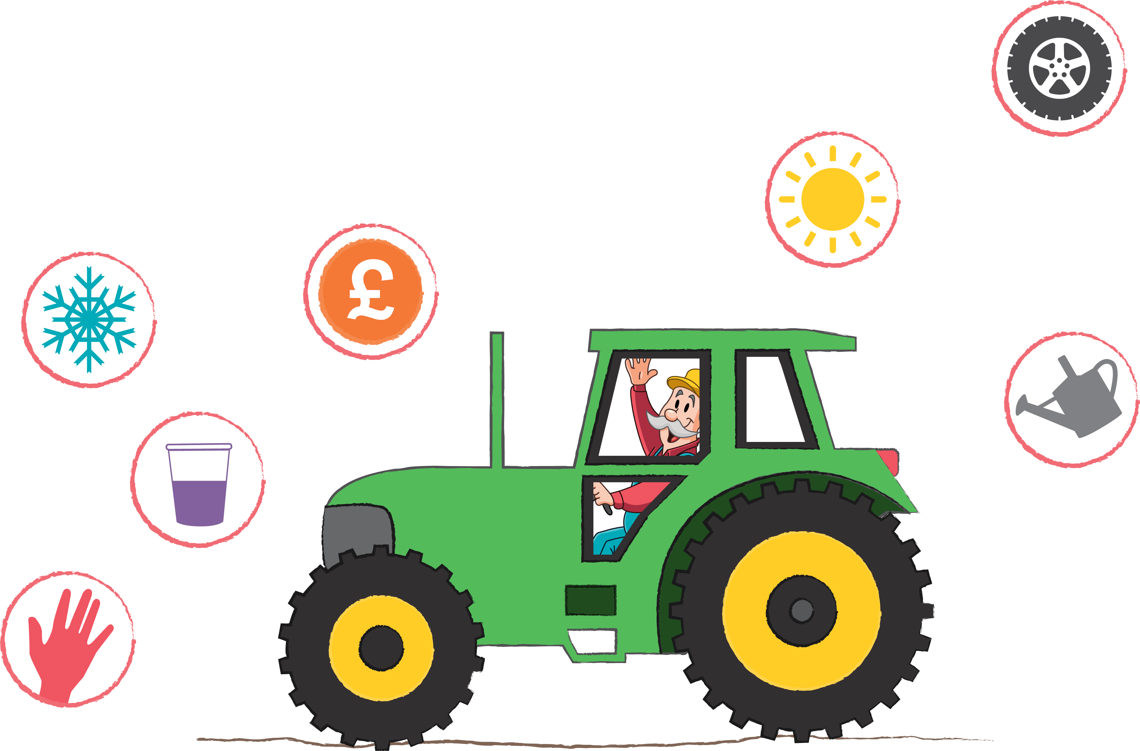
A lot of effort goes into getting food from the farm to your fork.
Notes:
Lesson 1.
Continue on to the Main activity and revisit the following slides as you go.
Show this slide after you have watched the YouTube link (The Extraordinary Life and Times of a Strawberry).
Do any of the symbols correlate with things they saw in the video?
For instance – the wheel with travel? The hand with the strawberries being picked? Why not show them real life photos or examples that correspond with the symbols?
The symbols are designed to show the different types of ‘effort’ that are required to get food from the farm to our forks.
Move on to the ‘Life of strawberry’ worksheet.
Lesson 2.
Explore what each symbol means with your learners. You may wish to remind them of answers they gave in lesson 1.

Slide 4
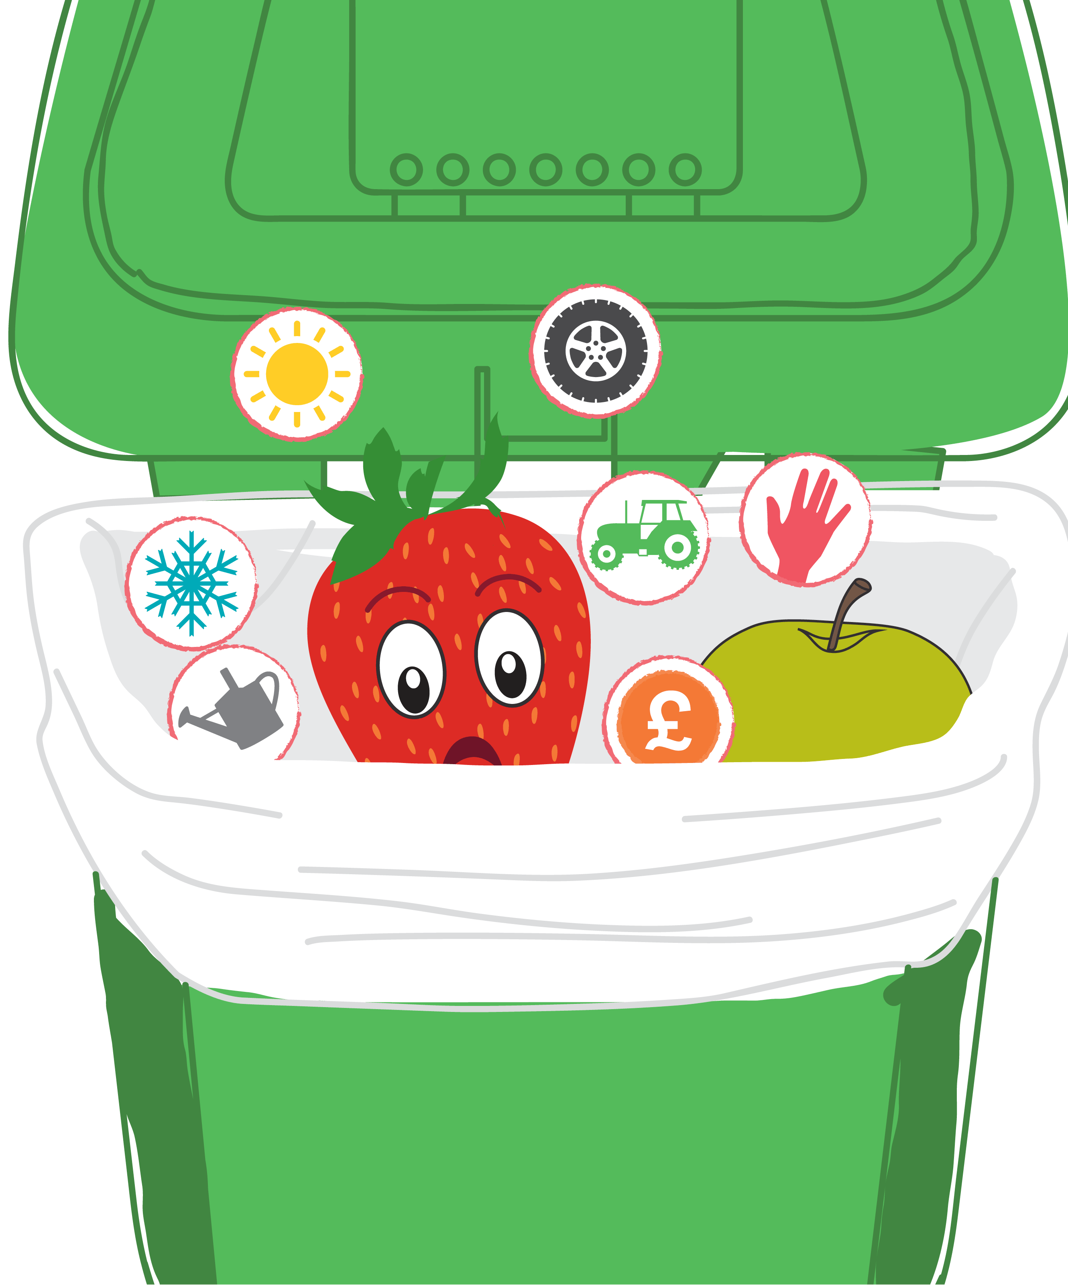
Notes:
Show this slide after the ‘Life of a strawberry’ worksheet has been completed.

Slide 5

When you waste food you waste all the effort that has gone into making it.
Notes:
Show this slide after the ‘Build a roll’ worksheet.

Slide 6
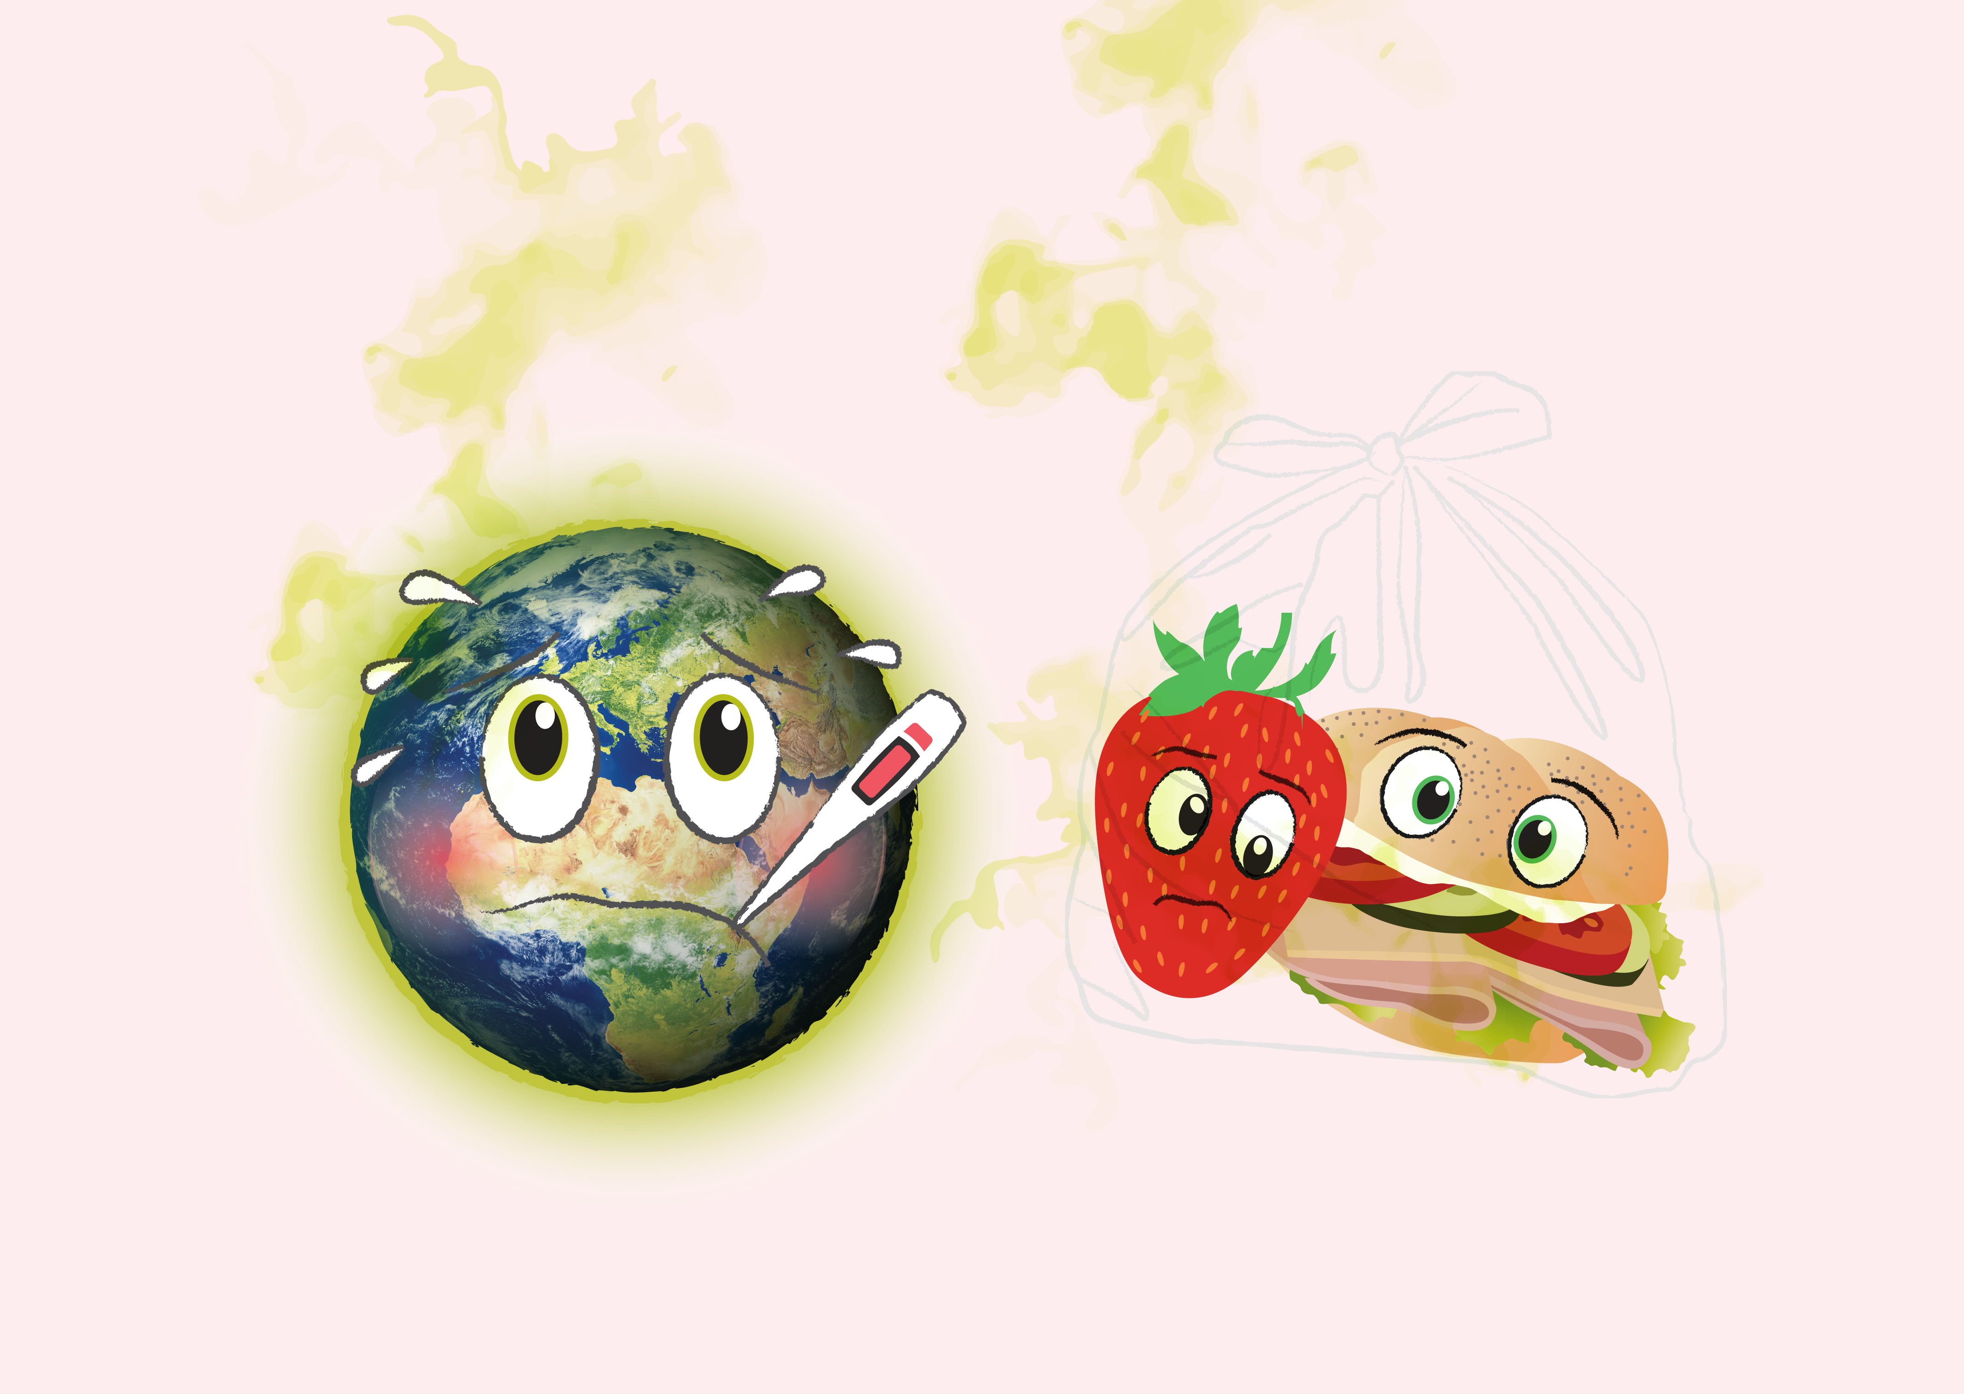
When food goes to landfill it releases nasty gases which are bad for the planet.
Notes:
Tell learners that these nasty gases can make the planet hotter and harder for us to live on.
If your learners have had previous teaching about climate change and other environmental topics it might be worth bringing this into the discussion to enhance their understanding.
Emphasise that if wasted food is put in the recycling bin these nasty gases are contained and used for other things but if wasted food is put in the rubbish bin the gases can escape into the atmosphere where they can cause harm.

Slide 7
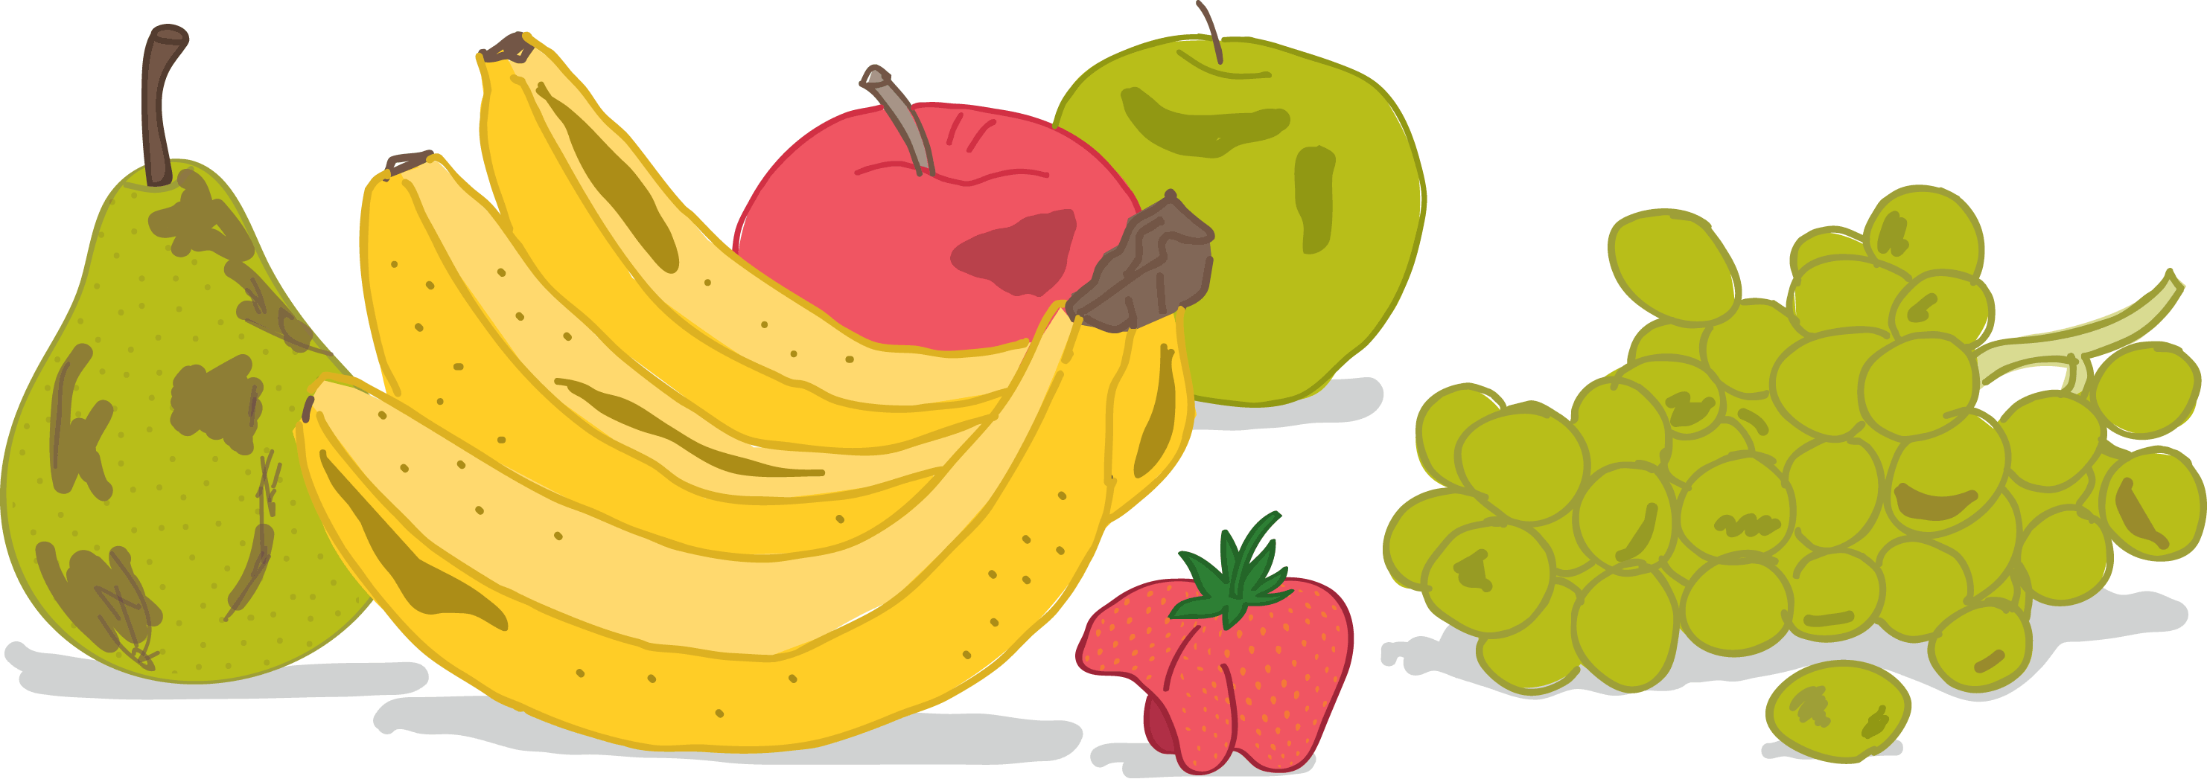
Click here to check out these 'ugly' fruits and vegetables
Notes:
This slide is required for lesson 2. Food Transformers

