Slide 1

Zero Waste Scotland
Get #LitterLiterate

Slide 2
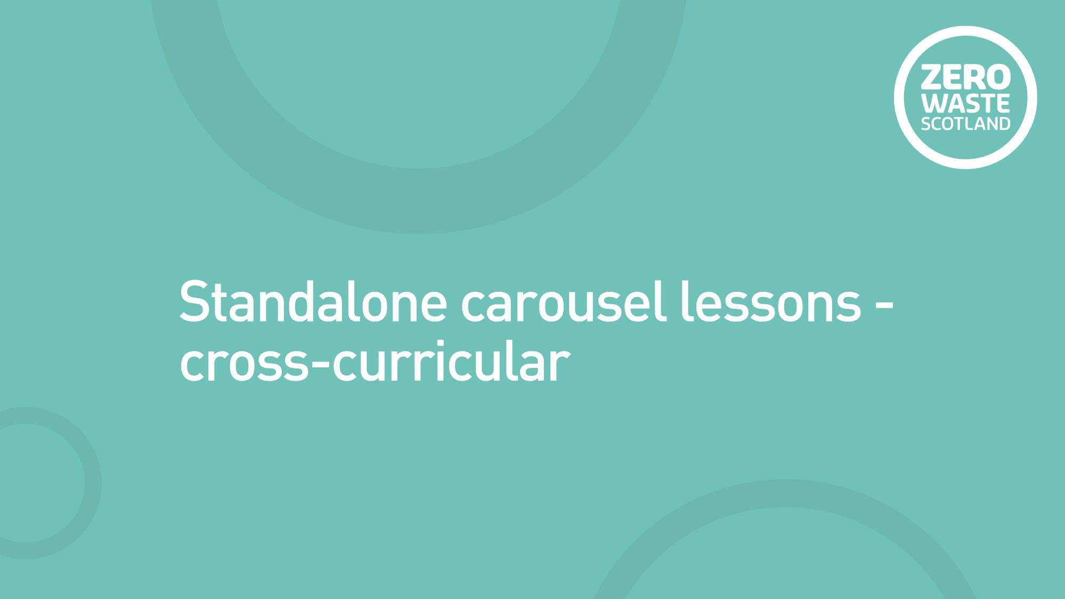
Standalone carousel lessons – cross-curricular

Slide 3
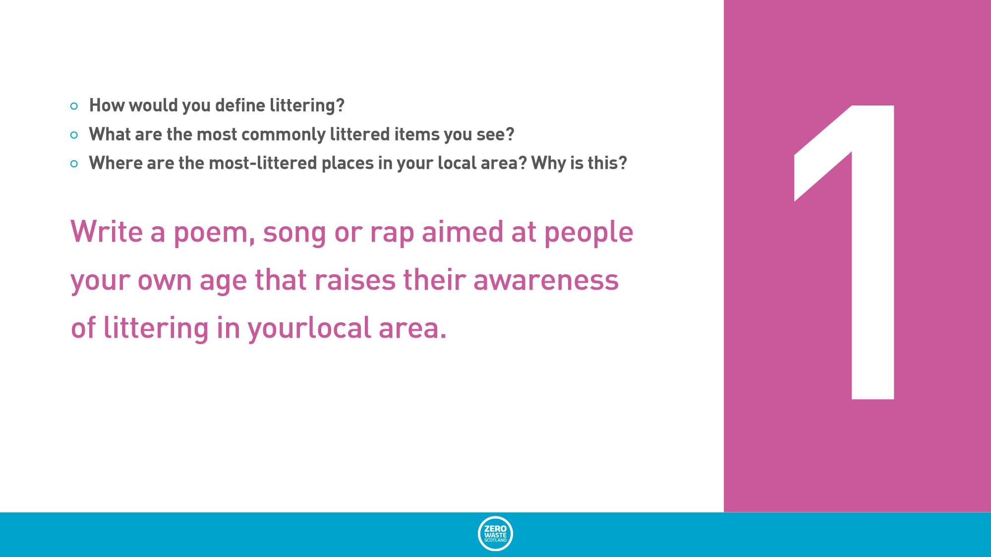
Station 1
How would you define littering?
What are the most commonly littered items you see?
Where are the most-littered places in your local area? Why is this?
Write a poem, song or rap aimed at people your own age that raises their awareness of littering in your local area.

Slide 4
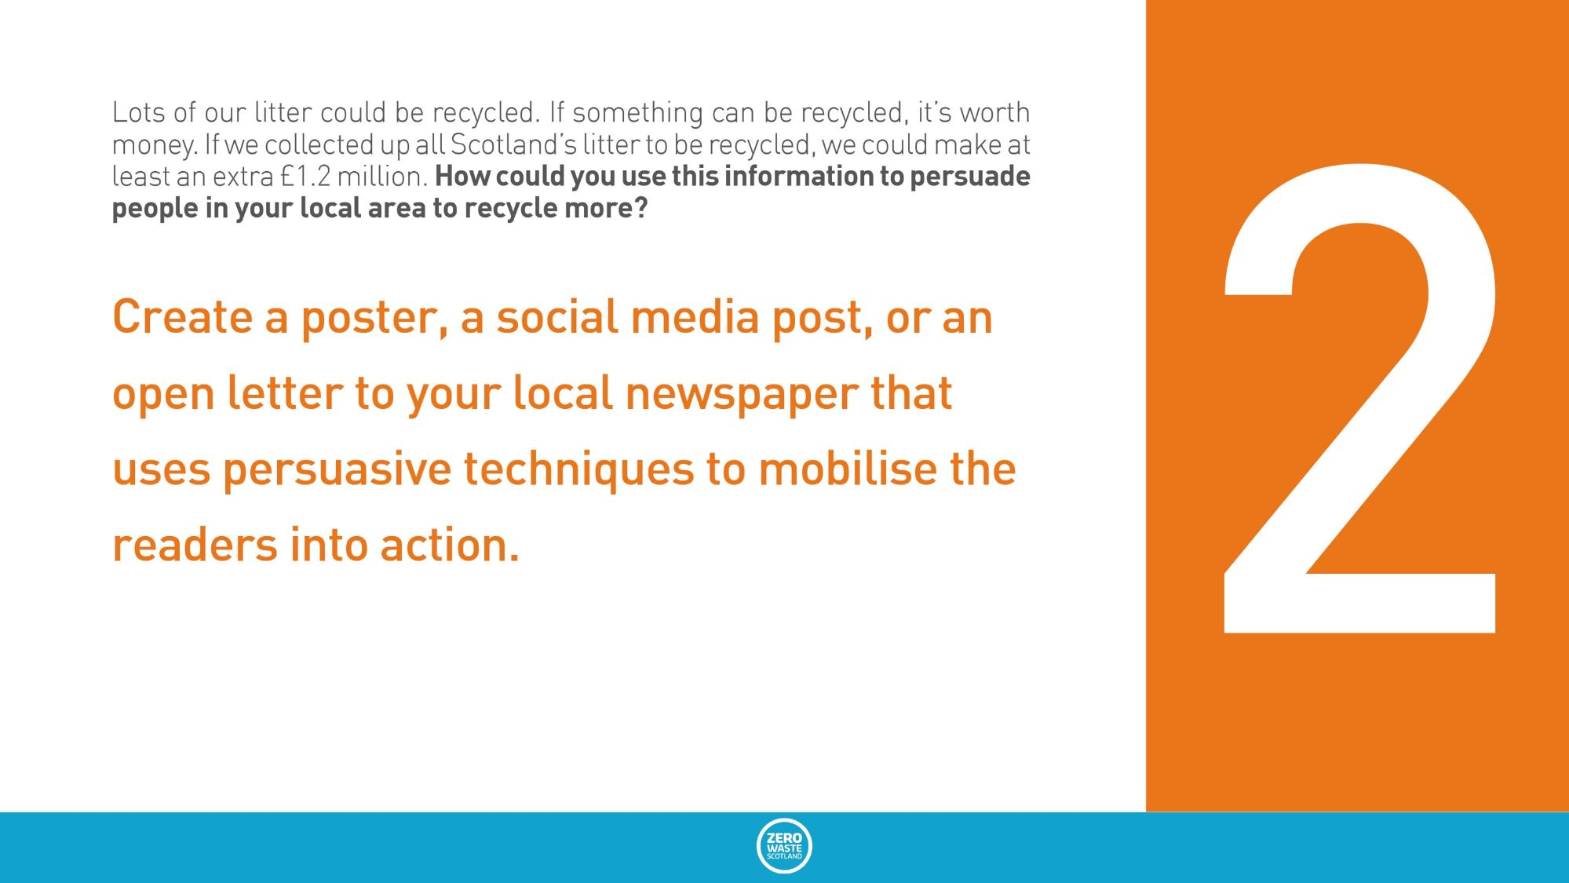
Station 2
Lots of our litter could be recycled. If something can be recycled, it’s worth money. If we collected up all Scotland’s litter to be recycled, we could make at least an extra £1.2 million. How could you use this information to persuade people in your local area to recycle more?
Create a poster, a social media post, or an open letter to your local newspaper that uses persuasive techniques to mobilise the readers into action.

Slide 5
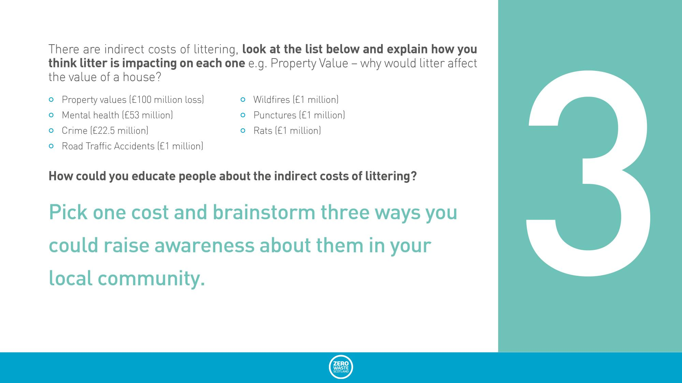
Station 3
There are indirect costs of littering, look at the list below and explain how you think litter is impacting on each one e.g. Property Value – why would litter affect the value of a house?
  Property values (£100 million loss)
  Mental health (£53 million)
  Crime (£22.5 million)
  Road Traffic Accidents (£1 million)
  Wildfires (£1 million)
  Punctures (£1 million)
  Rats (£1 million)
How could you educate people about the indirect costs of littering?
Pick one cost and brainstorm three ways you could raise awareness about them in your local community.

Slide 6
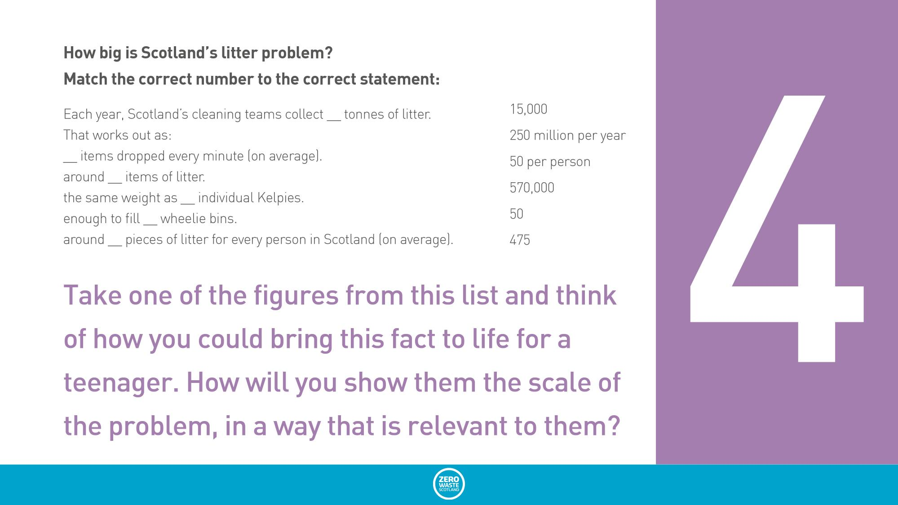
Station 4
15,000
50
250 million
570,000
50
475
How big is Scotland’s litter problem?
Match the correct number to the correct statement:
Each year, Scotland’s cleaning teams collect __ tonnes of litter.
That works out as:
__ items dropped every minute (on average).
around __ items of litter.
the same weight as __ individual Kelpies.
enough to fill __ wheelie bins.
around __ pieces of litter for every person in Scotland (on average).
Take one of the figures from this list and think of how you could bring this fact to life for a teenager. How will you show them the scale of the problem, in a way that is relevant to them?
Notes:
How big is Scotland’s litter problem? Match the correct number to the correct statement https://www.zerowastescotland.org.uk/sites/default/files/ZWS1328%20Litter%20Infographic%20edited%20%28003%29.pdf
Each year, Scotland’s cleaning teams collect 15,000 tonnes of litter. That’s:
the same weight as 50 individual Kelpies.
around 250 million items of litter.
enough to fill 570,000 wheelie bins.
around 50 pieces of litter for every person in Scotland (on average).
475 items dropped every minute (on average).

Slide 7
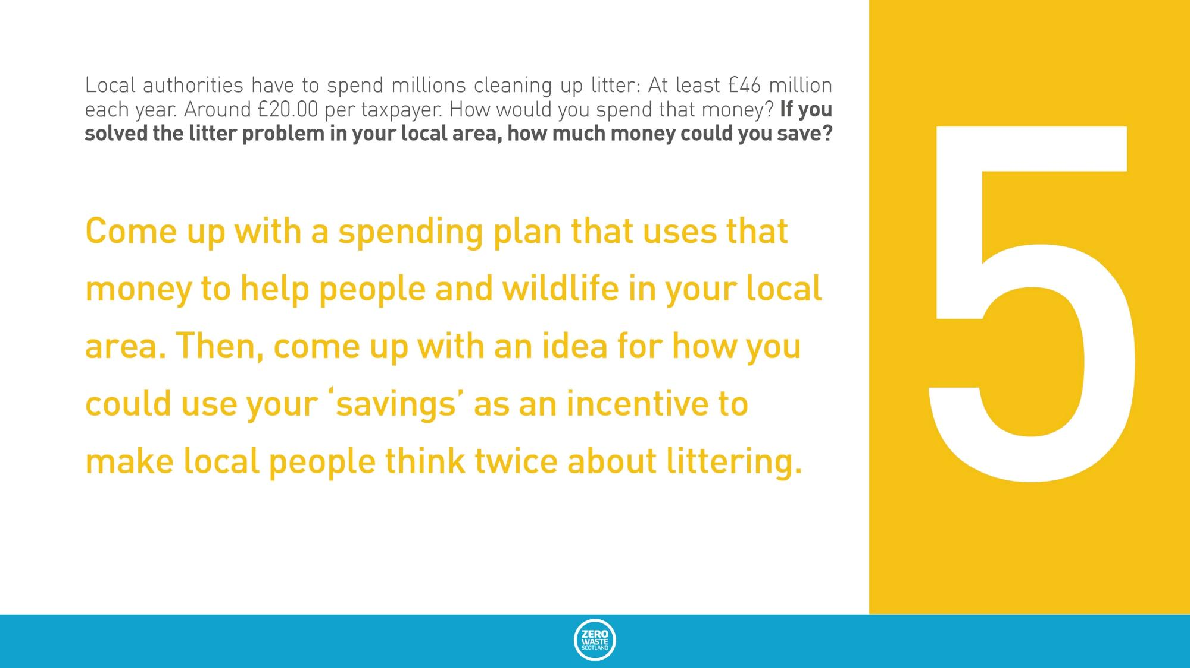
Station 5
Local authorities have to spend millions cleaning up litter: At least £46 million each year. Around £20.00 per taxpayer. How would you spend that money? If you solved the litter problem in your local area, how much money could you save?
Come up with a spending plan that uses that money to help people and wildlife in your local area. Then, come up with an idea for how you could use your ‘savings’ as an incentive to make local people think twice about littering.

Slide 8
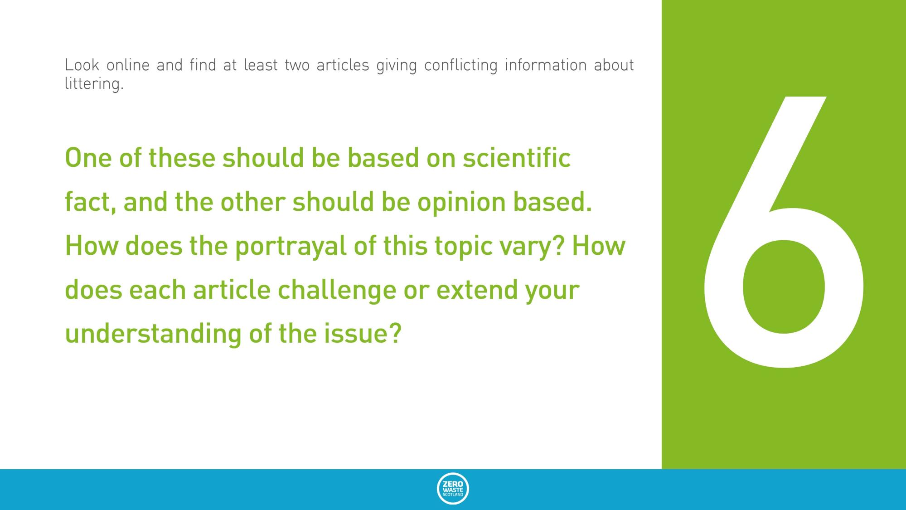
Station 6
Look online and find at least two articles giving conflicting information about littering.
One of these should be based on scientific fact, and the other should be opinion based. How does the portrayal of this topic vary? How does each article challenge or extend your understanding of the issue?
Notes:
Look at the 11 things you can do right now https://www.zerowastescotland.org.uk/litter-flytipping/things-you-can-do. Rank them according to which you think would have the biggest immediate impact on our school/local community. Pick the one you think is most needed and plan a campaign to promote this around school.

Slide 9
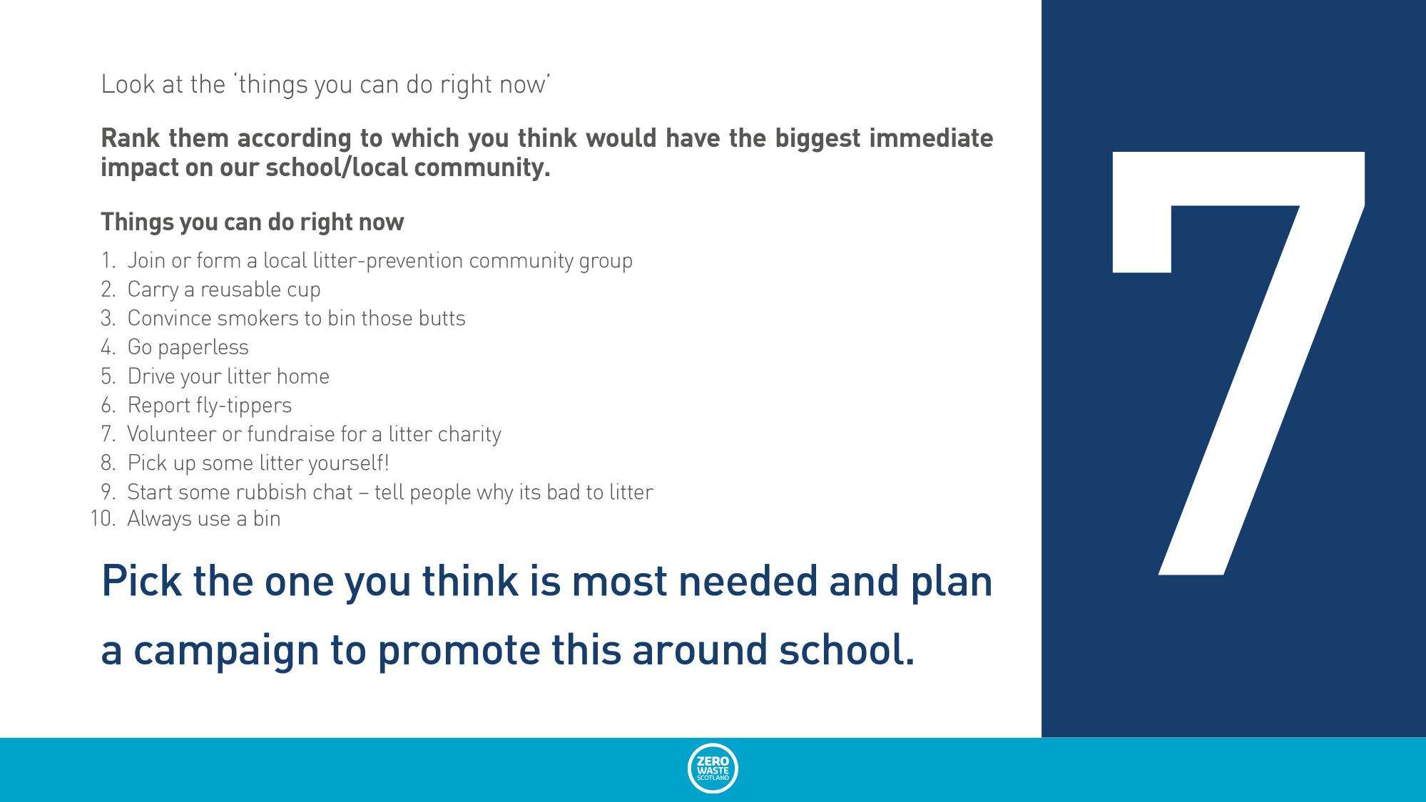
Station 7
Look at the ‘things you can do right now’
Rank them according to which you think would have the biggest immediate impact on our school/local community.
Pick the one you think is most needed and plan a campaign to promote this around school.
Things you can do right now
Join or form a local litter-prevention community group
Carry a reusable cup
Convince smokers to bin those butts
Go paperless
Drive your litter home
Report fly-tippers
Volunteer or fundraise for a litter charity
Pick up some litter yourself!
Start some rubbish chat – tell people why its bad to litter
Always use a bin

Slide 10
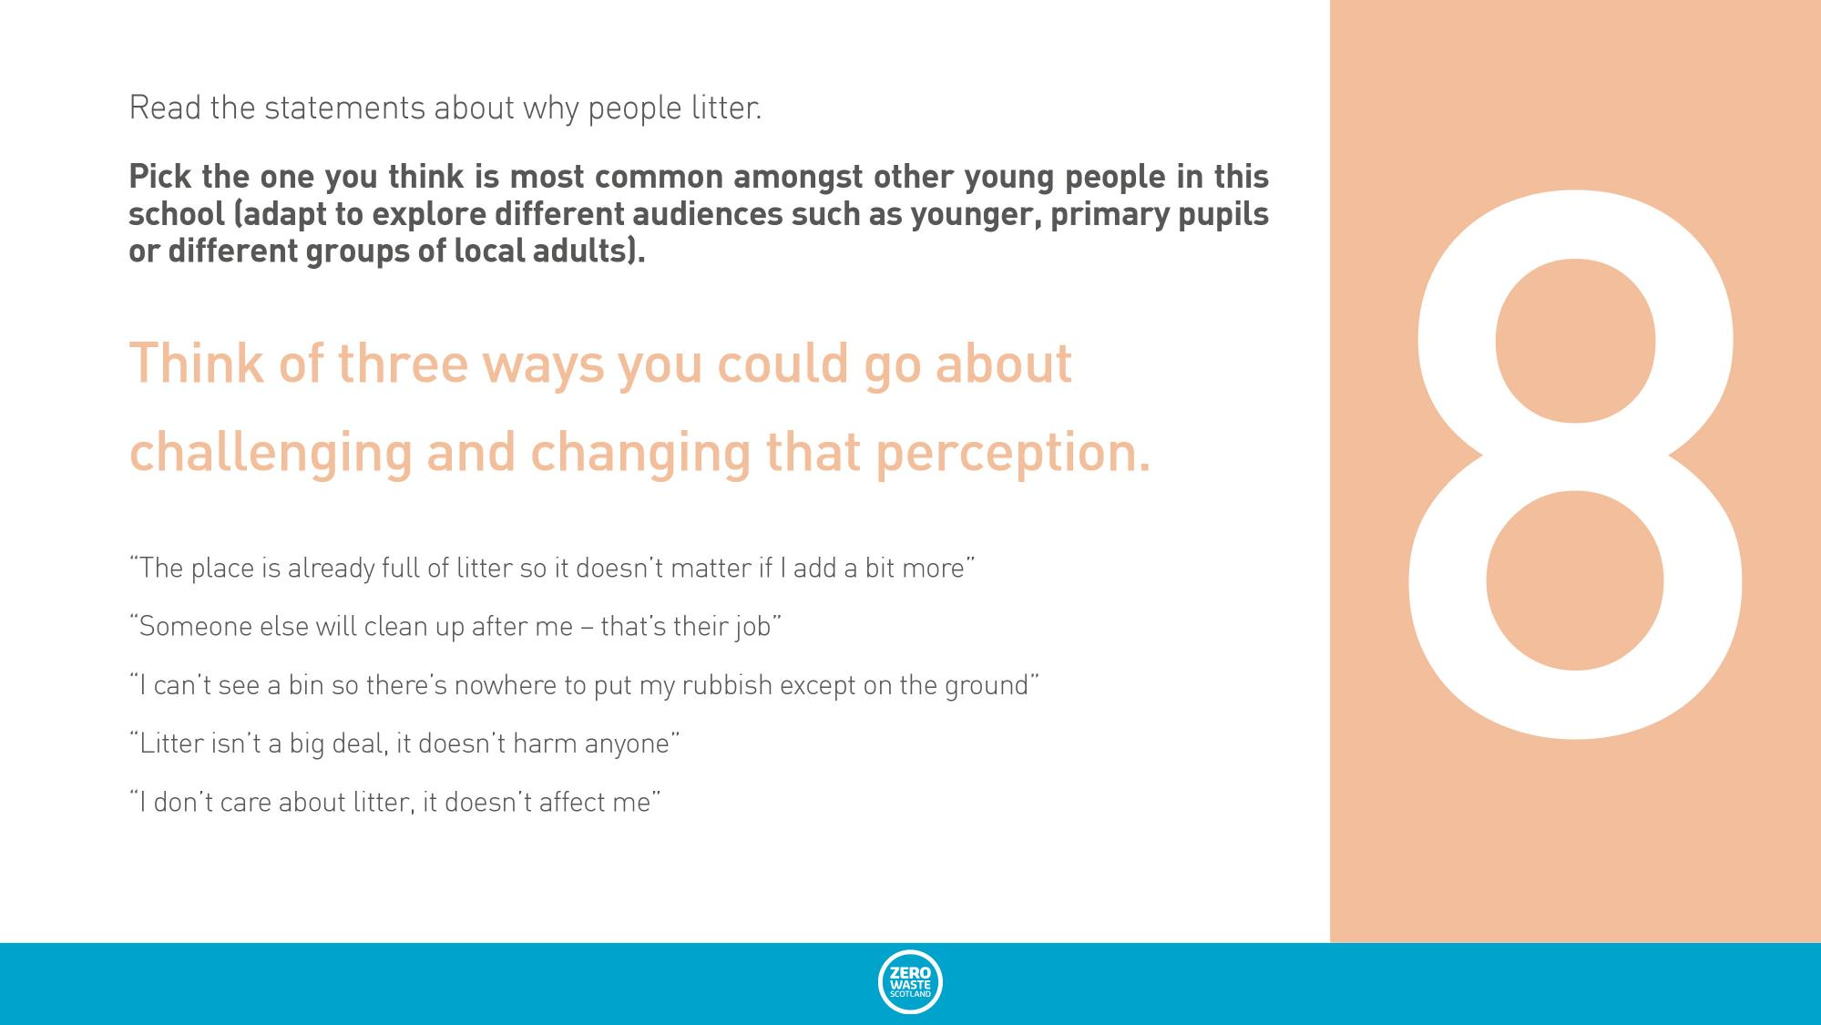
Station 8
Read the statements about why people litter.
Pick the one you think is most common amongst other young people in this school (adapt to explore different audiences such as younger, primary pupils or different groups of local adults).
Think of three ways you could go about challenging and changing that perception.
“The place is already full of litter so it doesn’t matter if I add a bit more”
“Someone else will clean up after me – that’s their job”
“I can’t see a bin so there’s nowhere to put my rubbish except on the ground”
“Litter isn’t a big deal, it doesn’t harm anyone”
“I don’t care about litter, it doesn’t affect me”

Slide 11
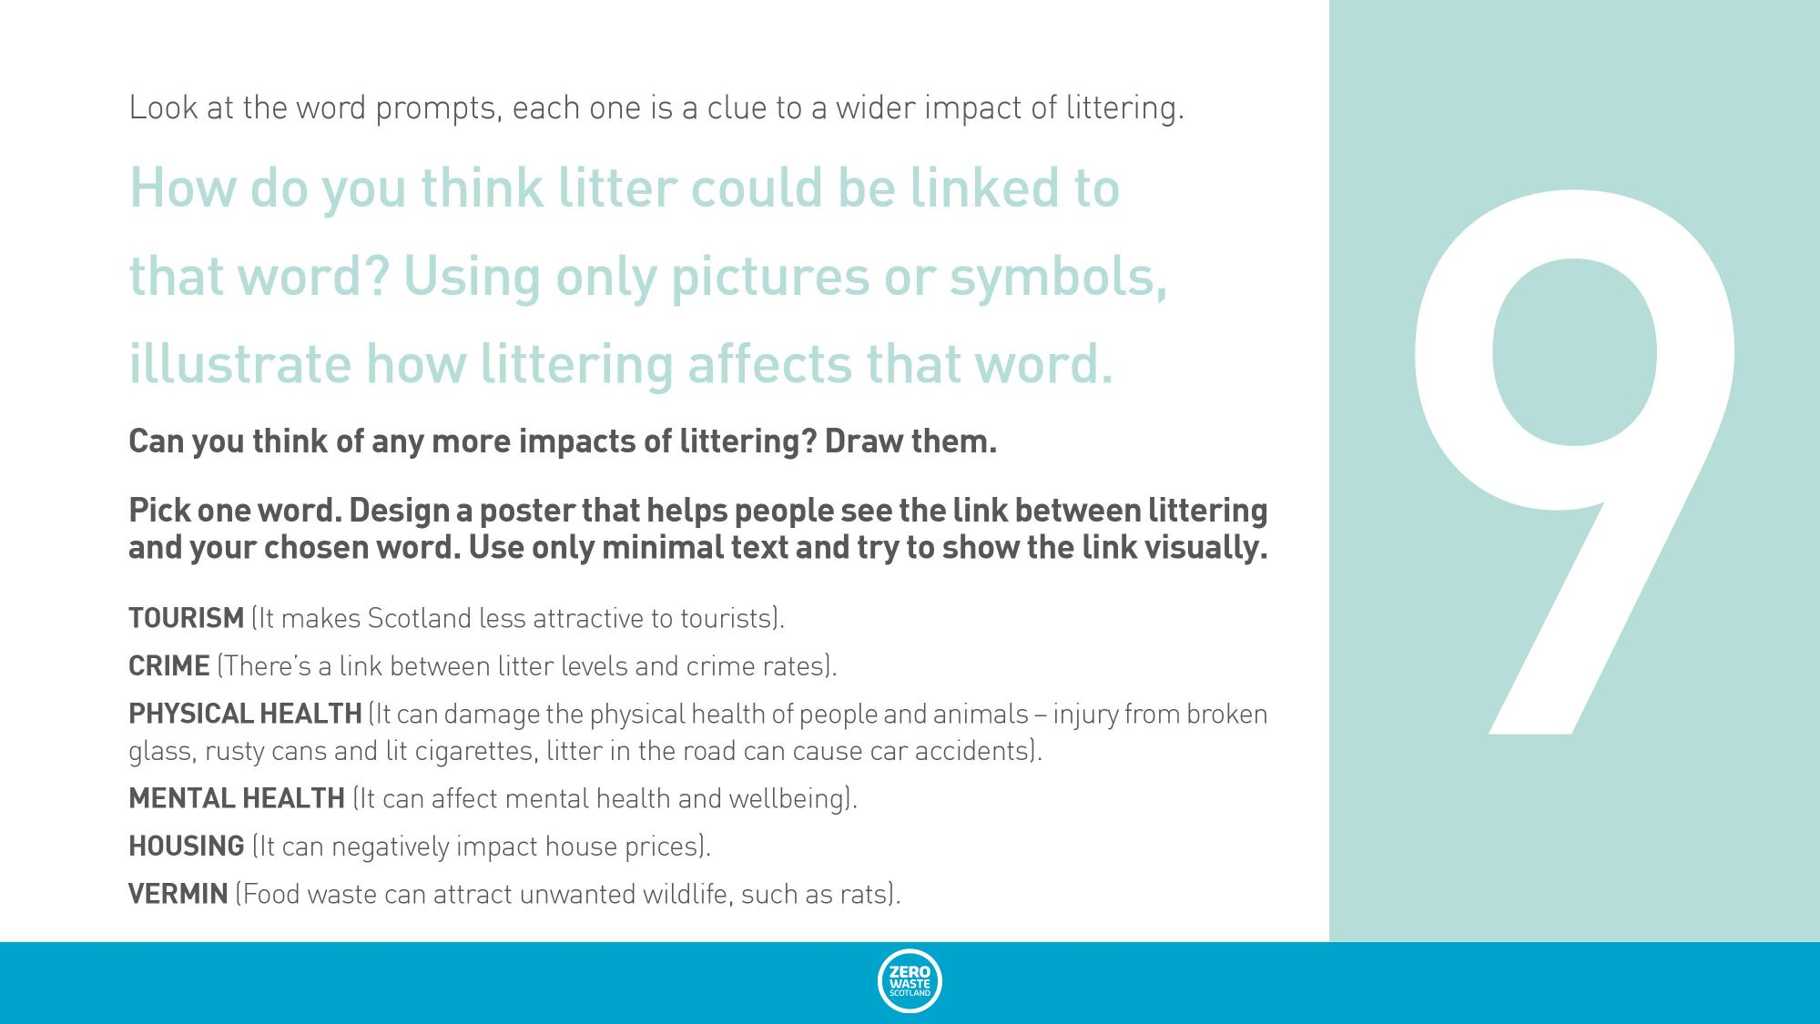
Station 9
Look at the word prompts, each one is a clue to a wider impact of littering. How do you think litter could be linked to that word? Using only pictures or symbols, illustrate how littering affects that word.
Can you think of any more impacts of littering? Draw them.
Pick one word. Design a poster that helps people see the link between littering and your chosen word. Use only minimal text and try to show the link visually.
  TOURISM (It makes Scotland less attractive to tourists).
  CRIME (There’s a link between litter levels and crime rates).
  PHYSICAL HEALTH (It can damage the physical health of people and animals – injury from broken glass, rusty cans and lit cigarettes, litter in the road can cause car accidents).
  MENTAL HEALTH (It can affect mental health and wellbeing).
  HOUSING (It can negatively impact house prices).
  VERMIN (Food waste can attract unwanted wildlife, such as rats).

Slide 12

Stimuli for discussion

Slide 13
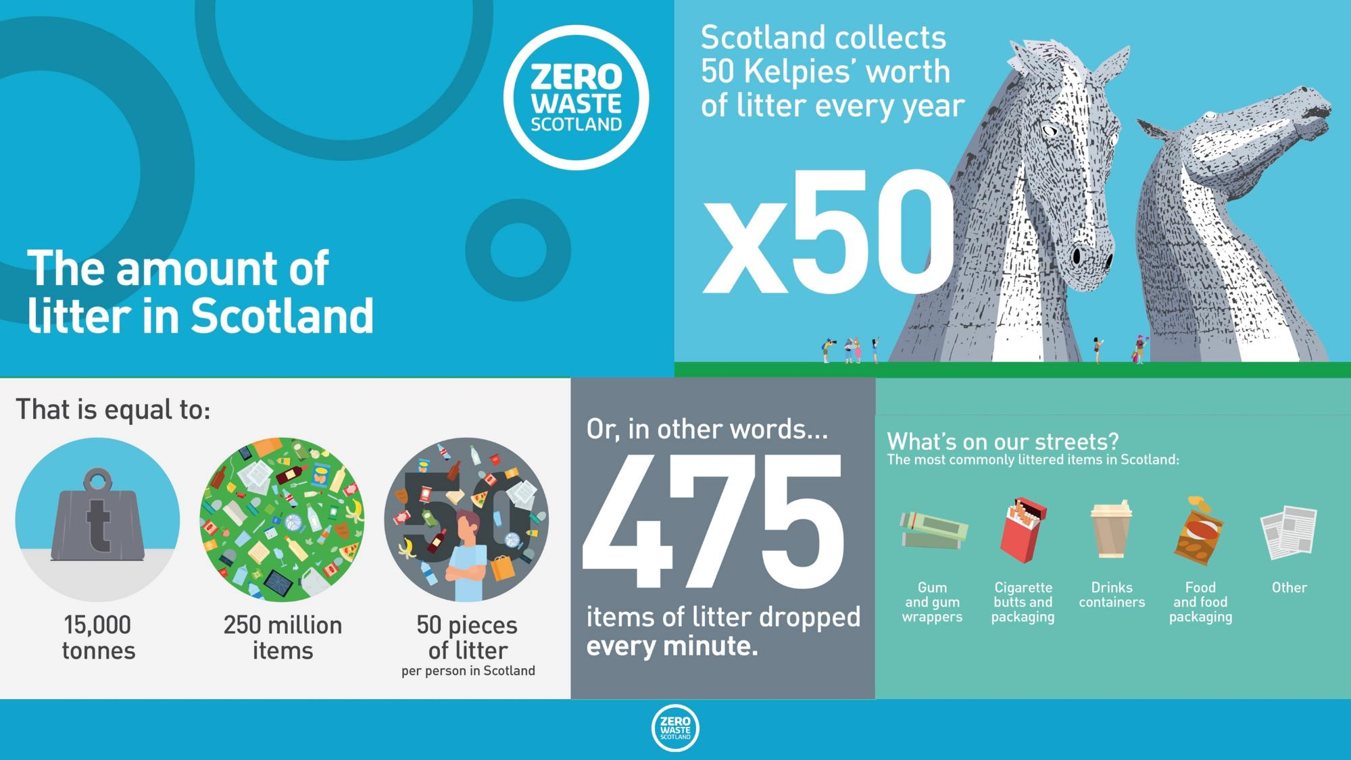
Edit to fit the slide
Taken from https://www.zerowastescotland.org.uk/litter-flytipping/facts

Slide 14
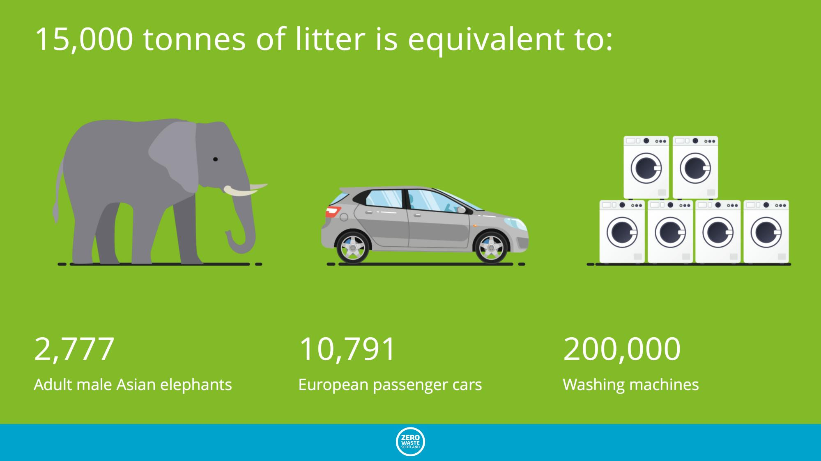

Slide 15
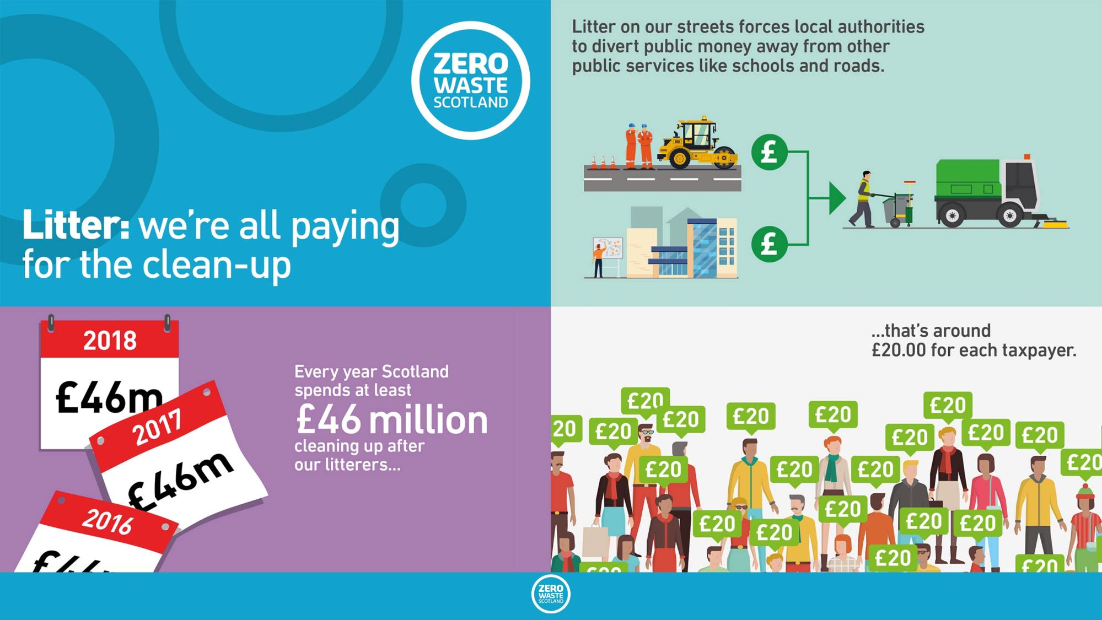

Slide 16
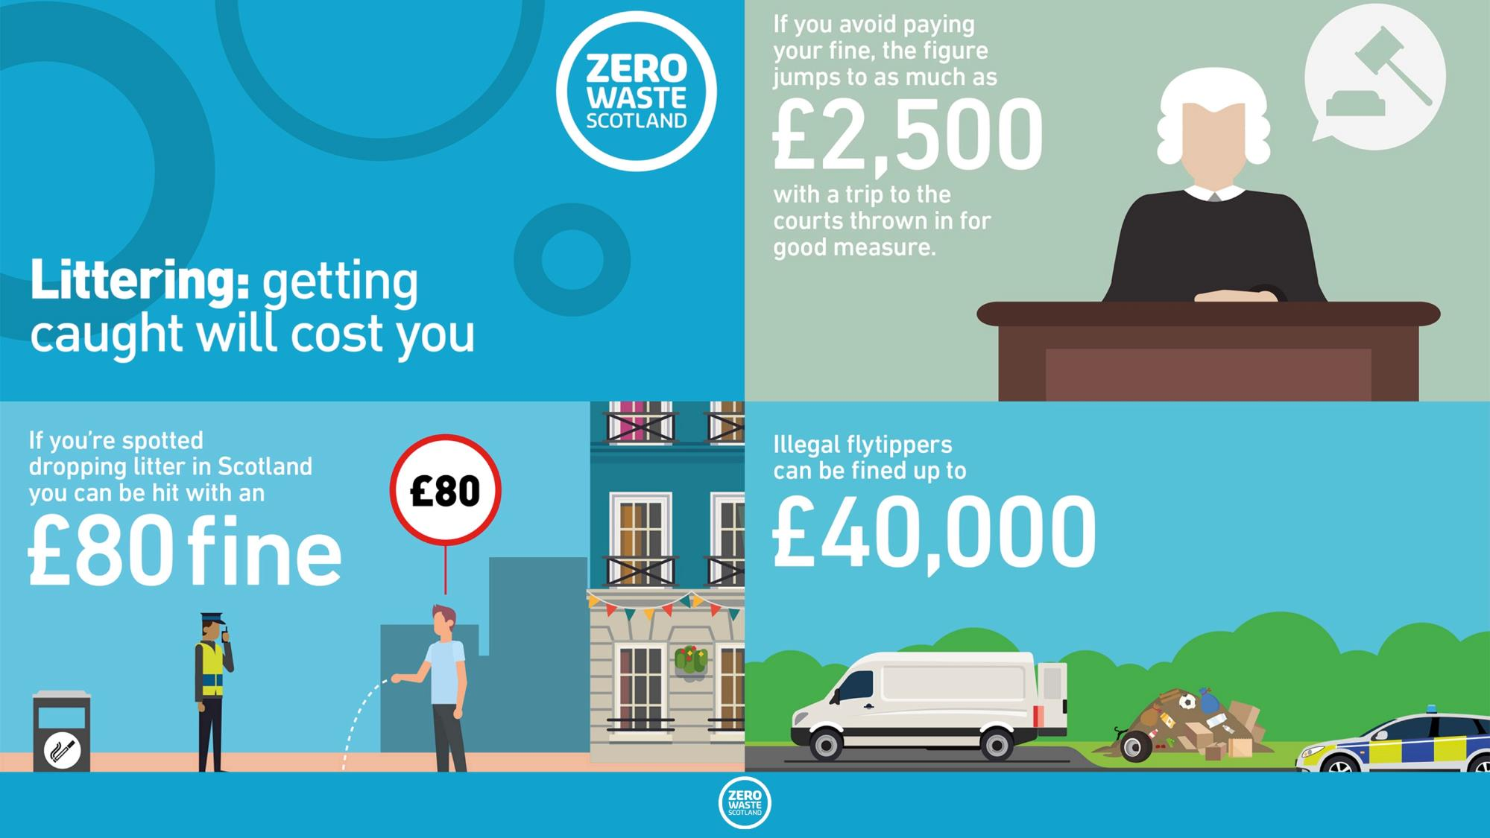

Slide 17
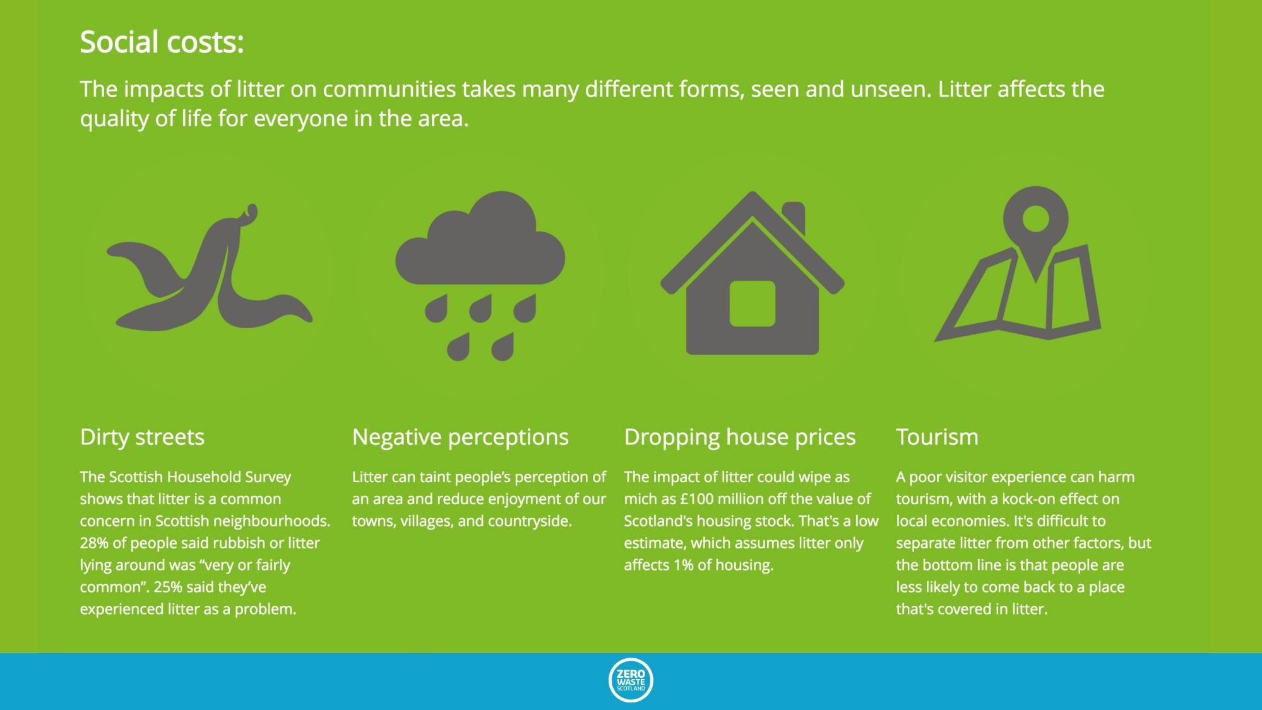

Slide 18
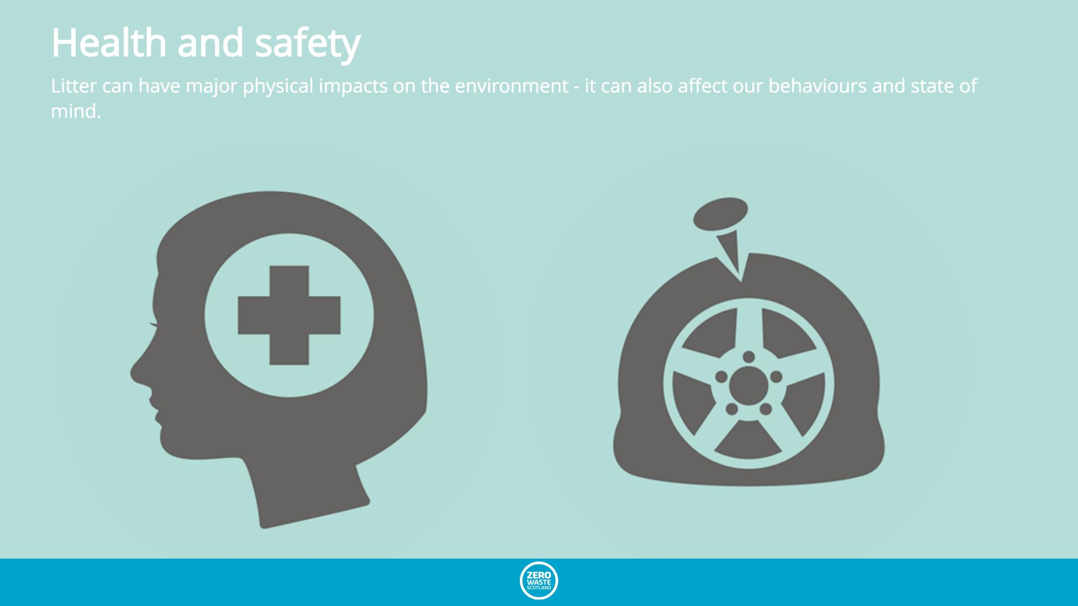

Slide 19
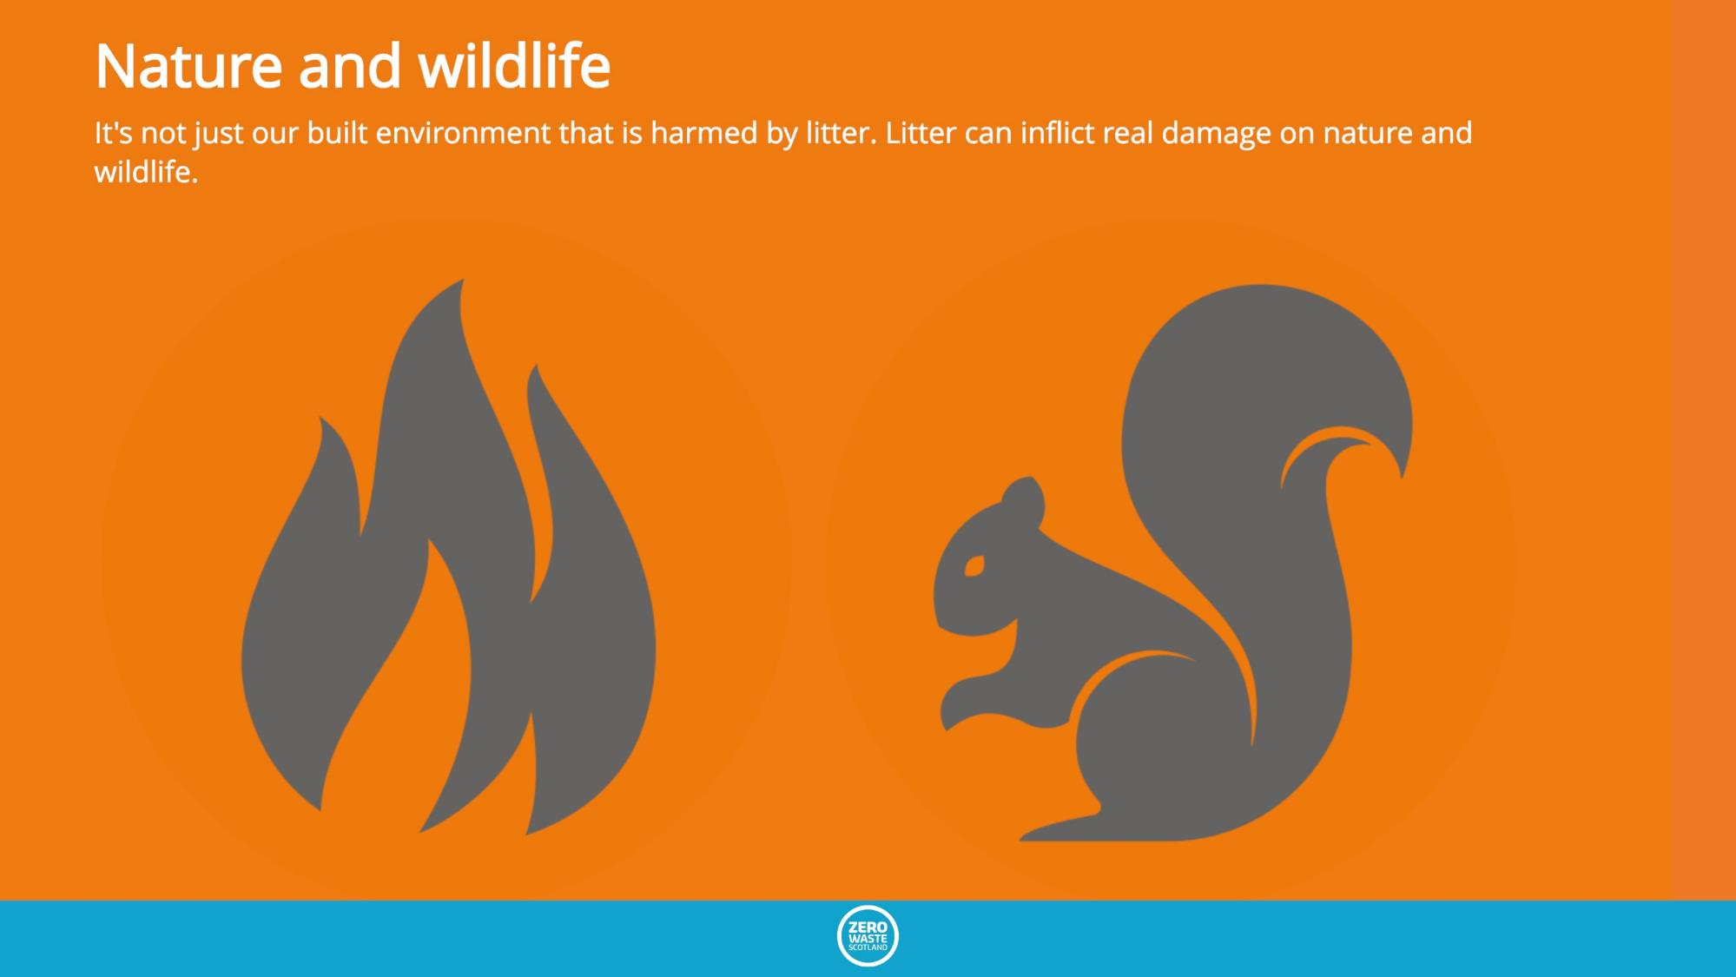

Slide 20
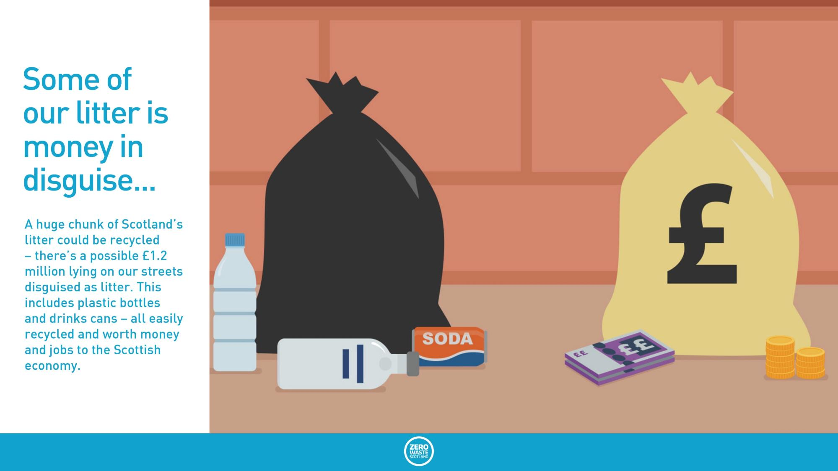
Some of our litter is money in disguise
A huge chunk of Scotland’s litter could be recycled – there’s a possible £1.2 million lying on our streets disguised as litter. This includes plastic bottles and drinks cans – all easily recycled and worth money and jobs to the Scottish economy.
Notes:
https://www.zerowastescotland.org.uk/litter-flytipping/facts

Slide 21
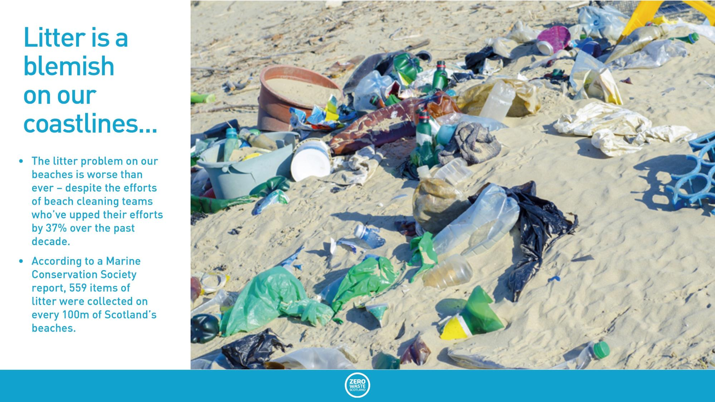
Litter is a blemish on our coastlines
The litter problem on our beaches is worse than ever – despite the efforts of beach cleaning teams who’ve upped their efforts by 37% over the past decade.
According to a Marine Conservation Society survey, litter-pickers now collect an average of 1,963 pieces of litter per kilometre.
Notes:
https://www.zerowastescotland.org.uk/litter-flytipping/facts

Slide 22
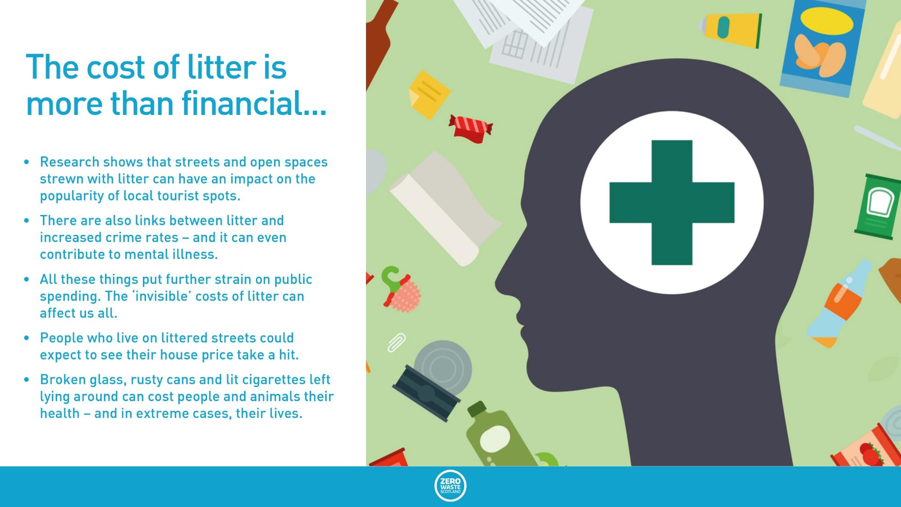
The cost of litter is more than financial
Research shows that streets and open spaces strewn with litter can have an impact on the popularity of local tourist spots.
There are also links between litter and increased crime rates – and it can even contribute to mental illness.
All these things put further strain on public spending. The ‘invisible’ costs of litter can affect us all.
People who live on littered streets could expect to see their house price take a hit.
Broken glass, rusty cans and lit cigarettes left lying around can cost people and animals their health – and in extreme cases, their lives.
Notes:
https://www.zerowastescotland.org.uk/litter-flytipping/facts

Slide 23
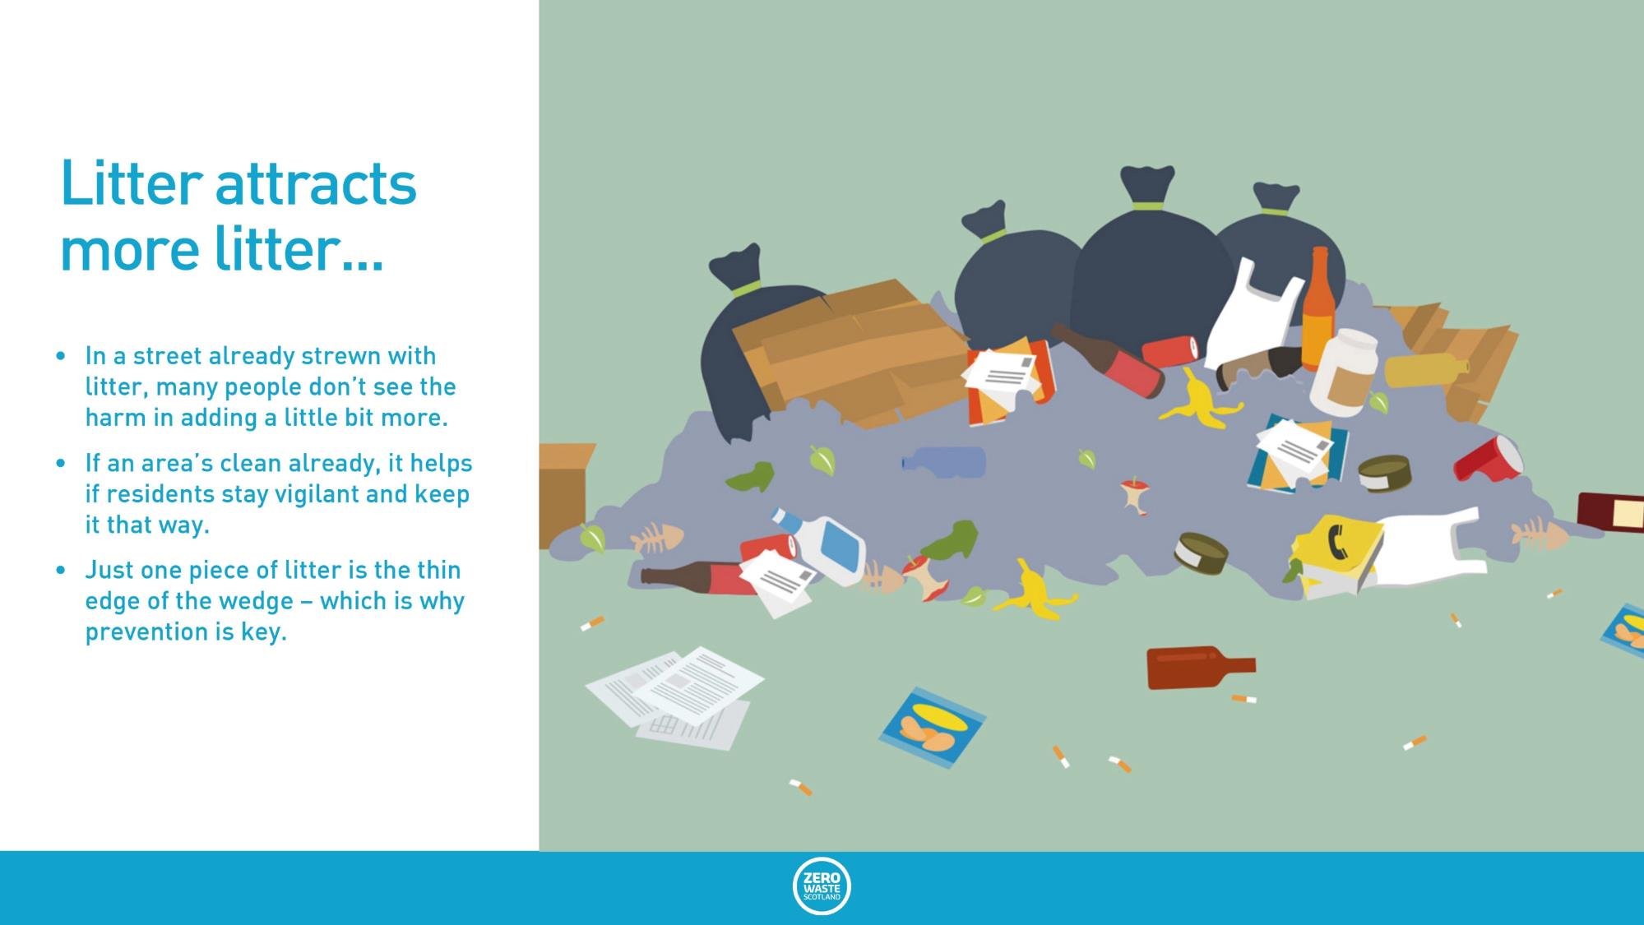
Litter attracts more litter
In a street already strewn with litter, many people don’t see the harm in adding a little bit more.
If an area’s clean already, it helps if residents stay vigilant and keep it that way.
Just one piece of litter is the thin edge of the wedge – which is why prevention is key.
Notes:
https://www.zerowastescotland.org.uk/litter-flytipping/facts

Slide 24
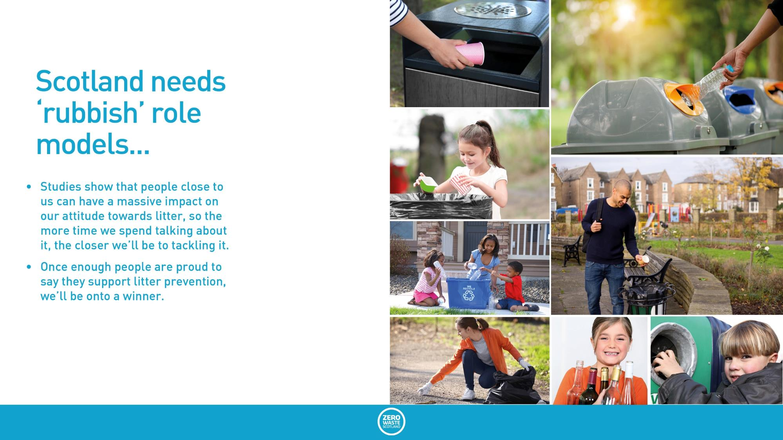
Scotland needs rubbish role models
Studies show that people close to us can have a massive impact on our attitude towards litter, so the more time we spend talking about it, the closer we’ll be to tackling it.
Once enough people are proud to say they support litter prevention, we’ll be onto a winner.
Notes:
Insert picture
https://www.zerowastescotland.org.uk/litter-flytipping/facts

Slide 25
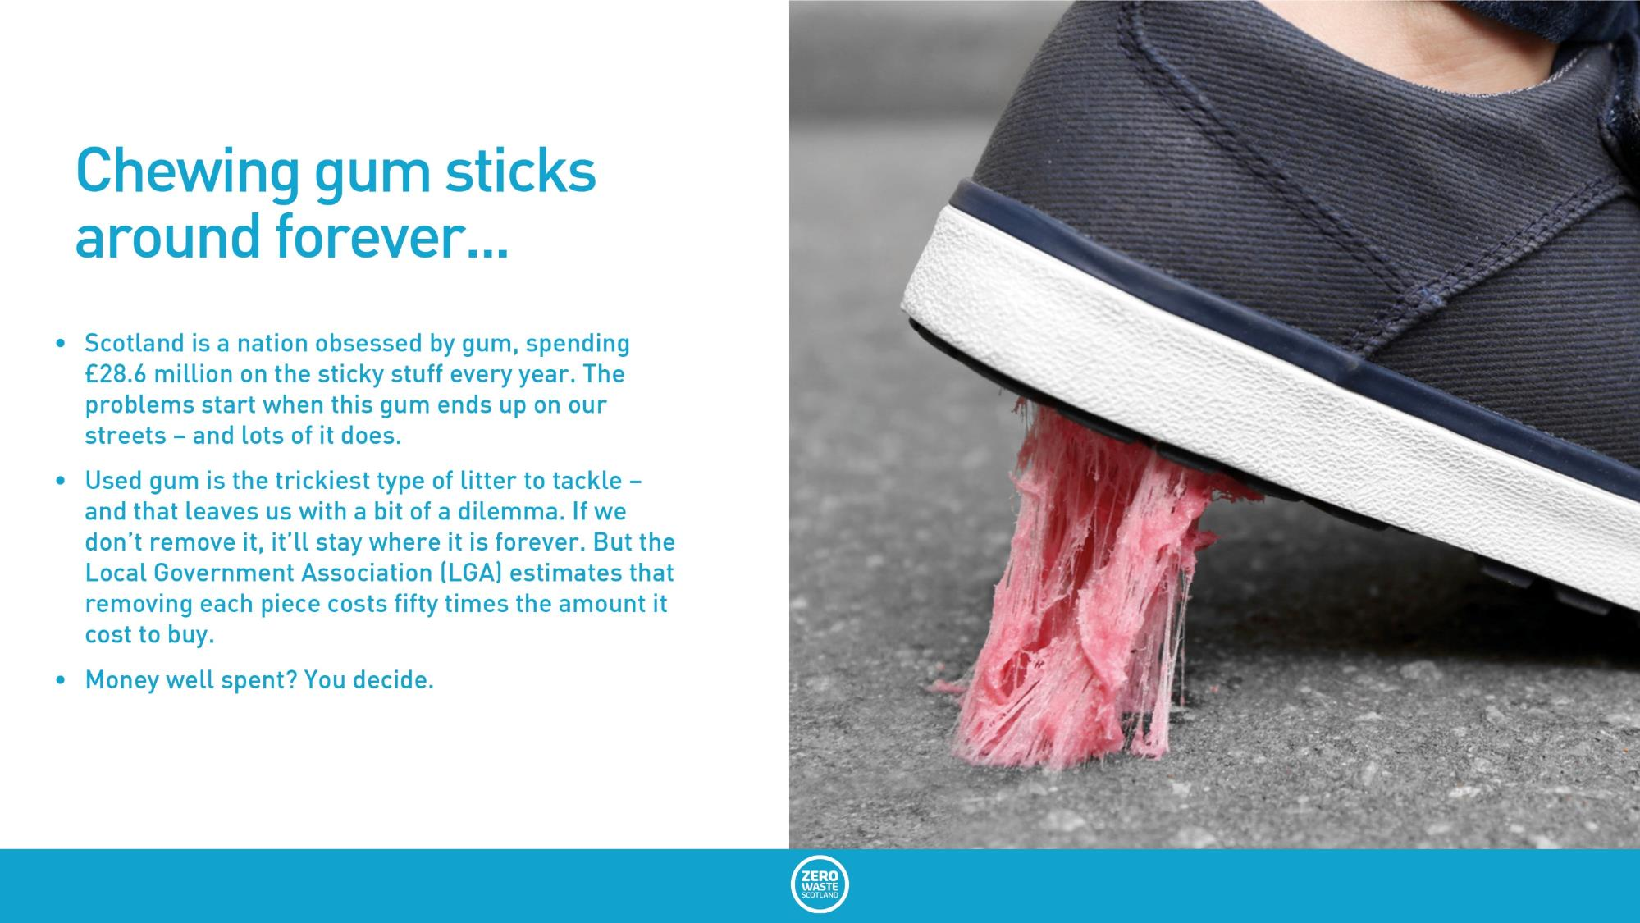
Chewing gum sticks around forever
Scotland is a nation obsessed by gum, spending £28.6 million on the sticky stuff every year. The problems start when this gum ends up on our streets – and lots of it does.
Used gum is the trickiest type of litter to tackle – and that leaves us with a bit of a dilemma. If we don’t remove it, it’ll stay where it is forever. But the Local Government Association (LGA) estimates that removing each piece costs fifty times the amount it cost to buy.
Money well spent? You decide.
Notes:
https://www.zerowastescotland.org.uk/litter-flytipping/facts

Slide 26
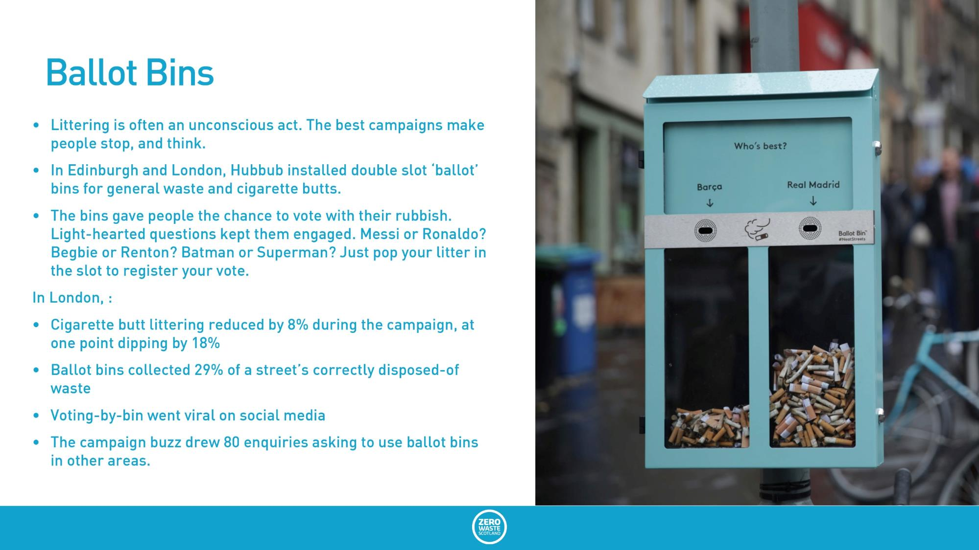
Ballot Bins
Littering is often an unconscious act. The best campaigns make people stop, and think.
In Edinburgh and London, Hubbub installed double slot ‘ballot’ bins for general waste and cigarette butts.
The bins gave people the chance to vote with their rubbish. Light-hearted questions kept them engaged. Messi or Ronaldo? Begbie or Renton? Batman or Superman? Just pop your litter in the slot to register your vote.
In London, :
  Cigarette butt littering reduced by 8% during the campaign, at one point dipping by 18%
  Ballot bins collected 29% of a street’s correctly disposed-of waste
  Voting-by-bin went viral on social media
  The campaign buzz drew 80 enquiries asking to use ballot bins in other areas.
Notes:
https://www.zerowastescotland.org.uk/litter-flytipping/facts

Slide 27
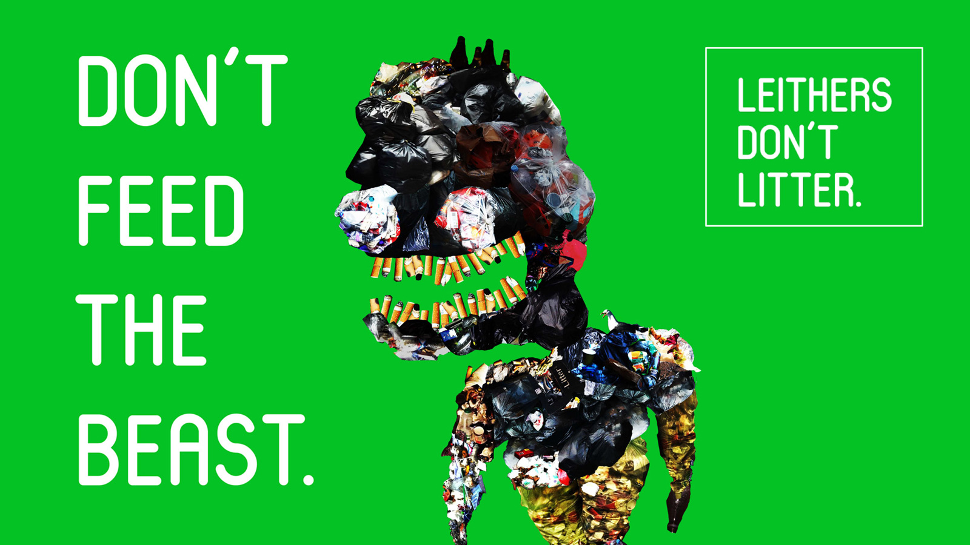

Slide 28
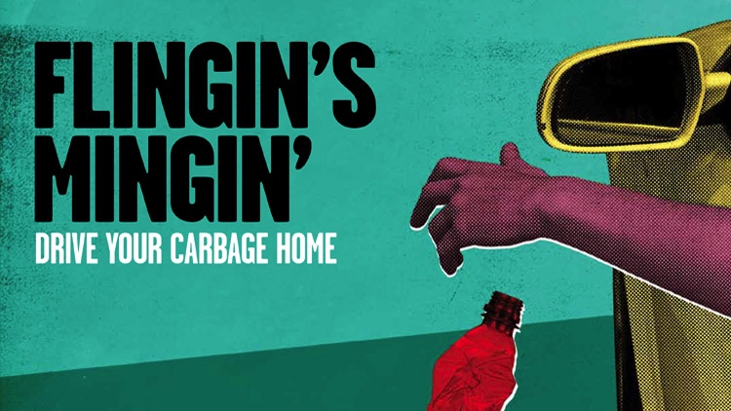

Slide 29
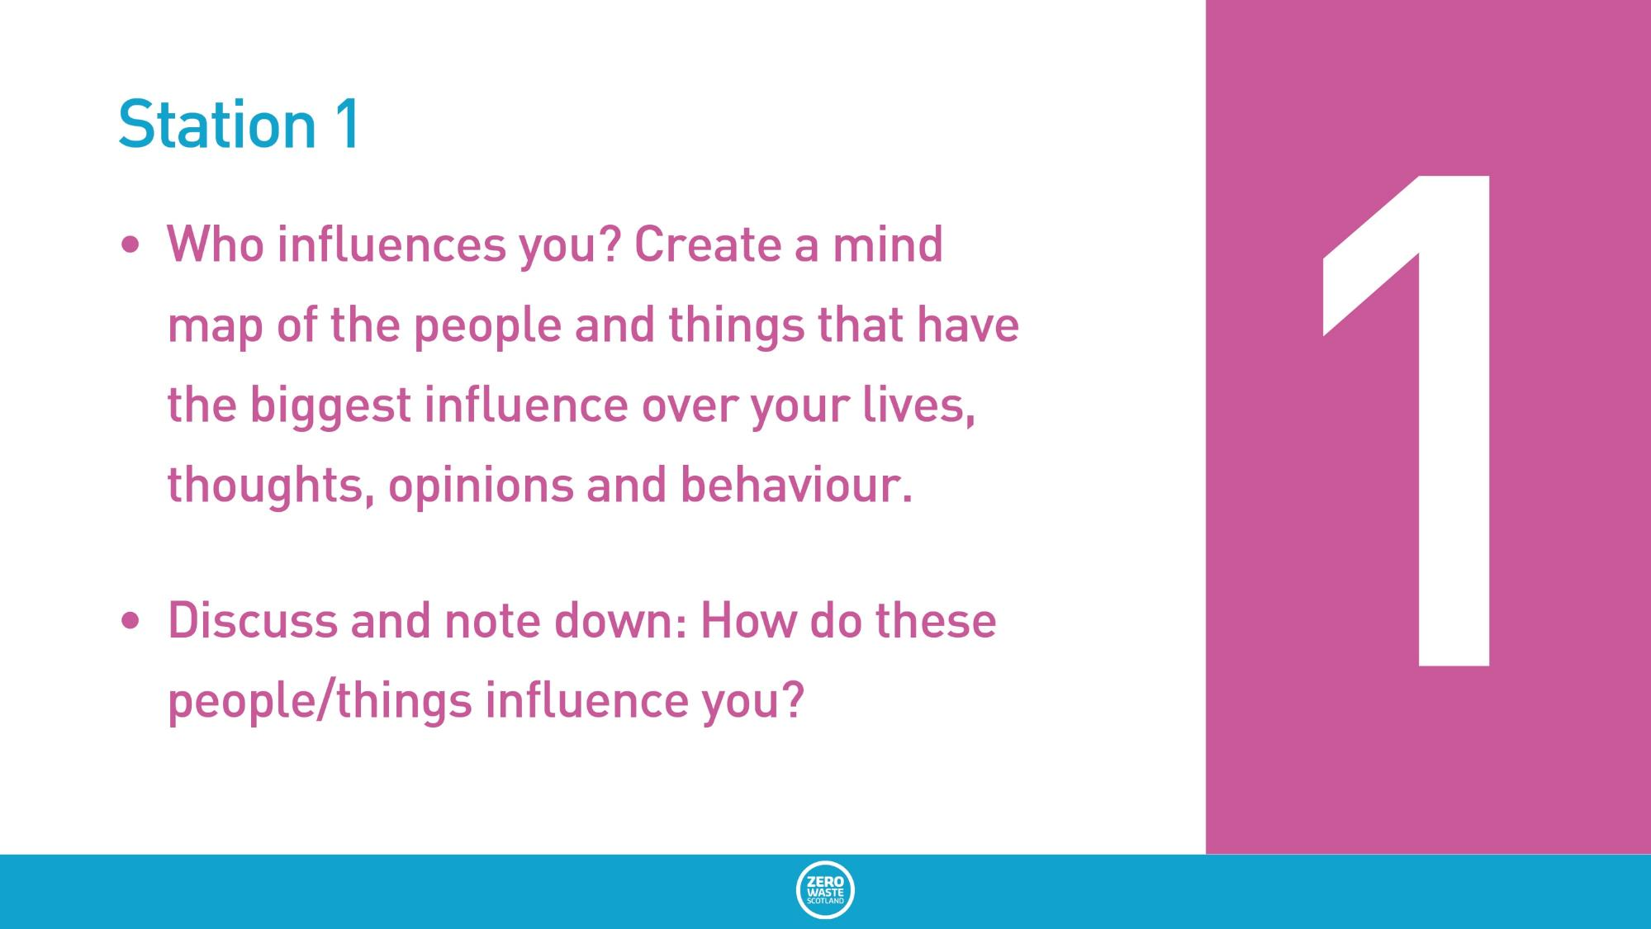
Station 1
Who influences you? Create a mind map of the people and things that have the biggest influence over your lives, thoughts, opinions and behaviour.
Discuss and note down: How do these people/things influence you?

Slide 30
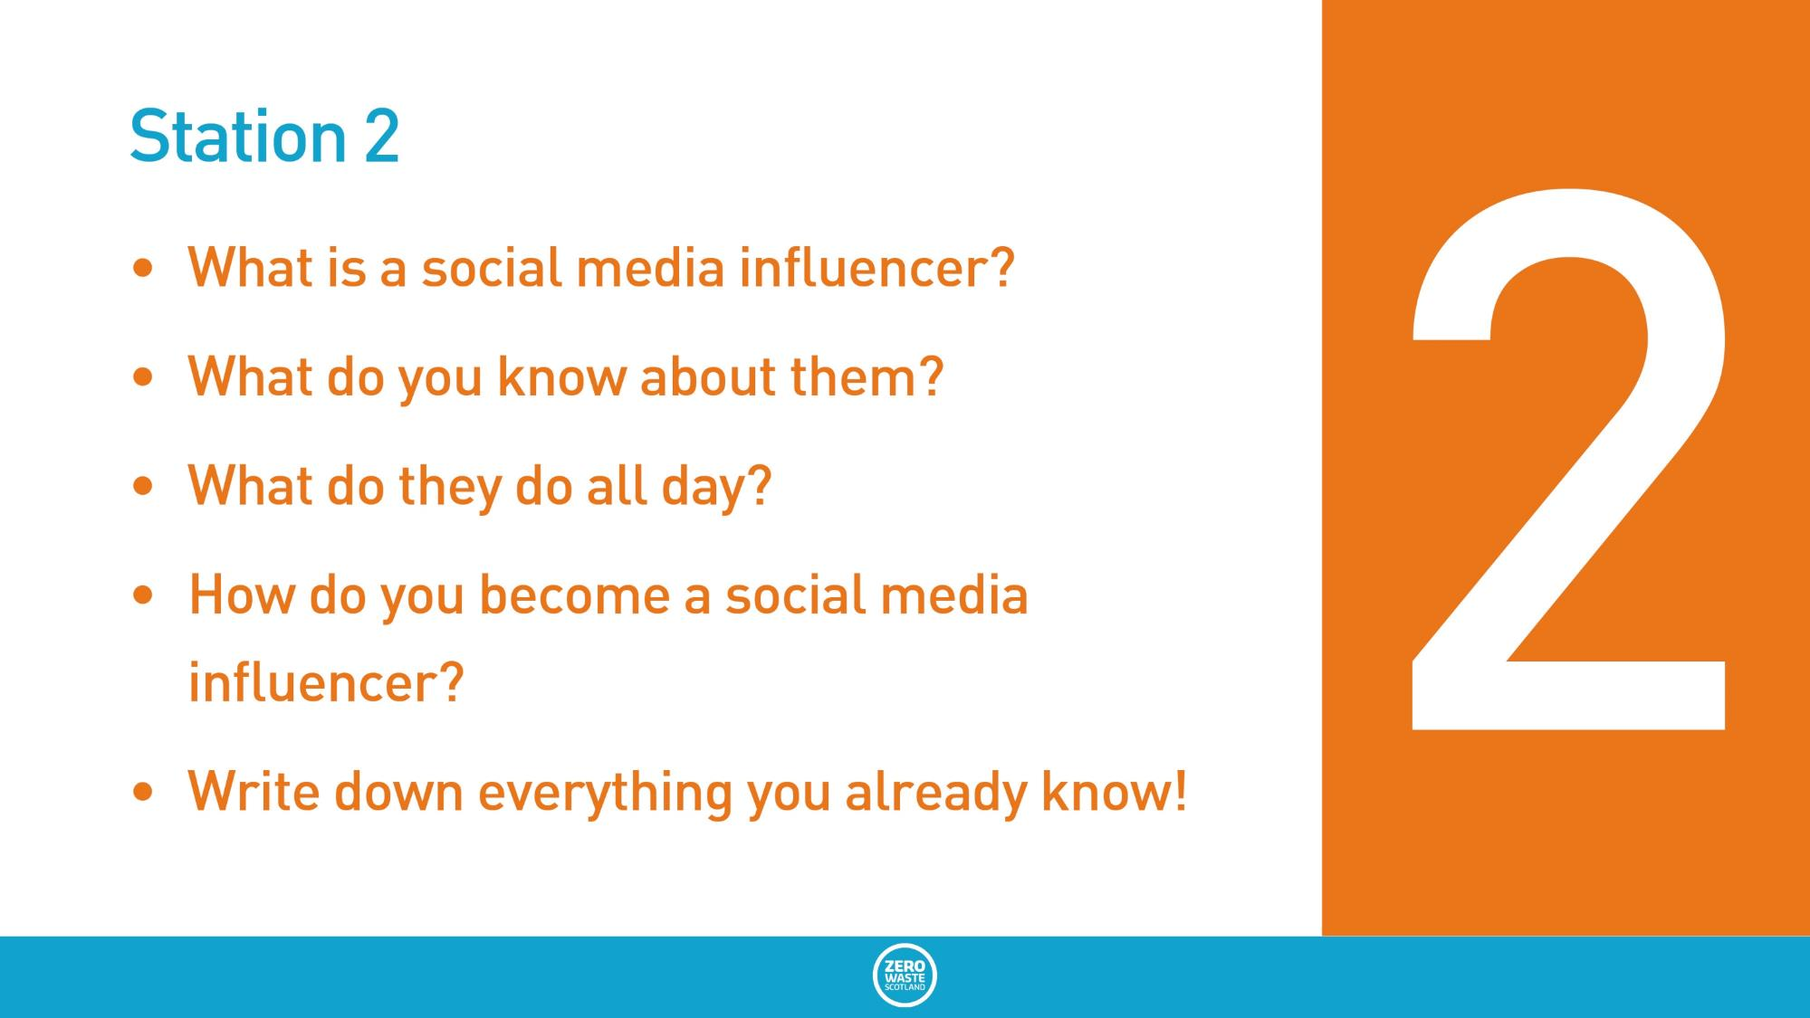
Station 2
What is a social media influencer?
What do you know about them?
What do they do all day?
How do you become a social media influencer?
Write down everything you already know!

Slide 31
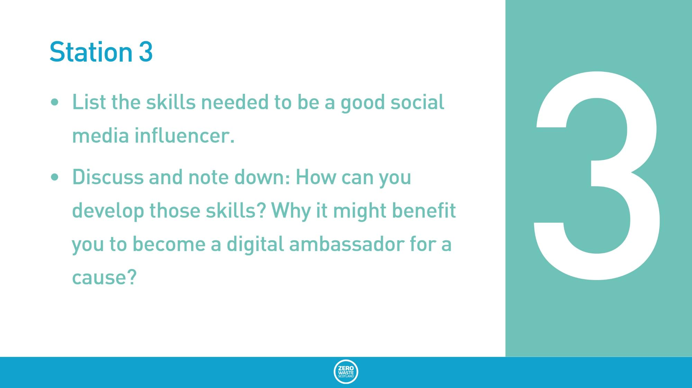
Station 3
List the skills needed to be a good social media influencer.
Discuss and note down: How can you develop those skills? Why it might benefit you to become a digital ambassador for a cause?

Slide 32
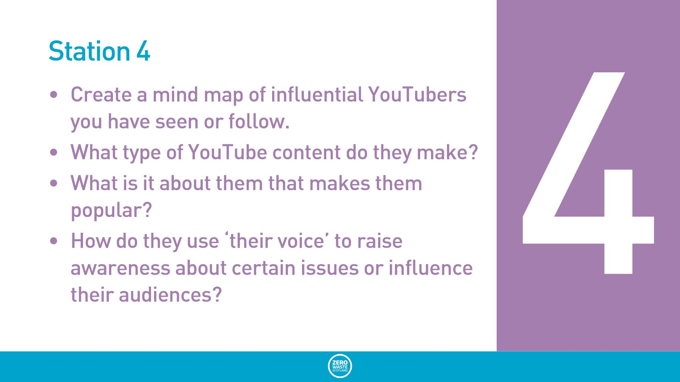
Station 4
Create a mind map of influential YouTubers you have seen or follow.
What type of YouTube content do they make?
What is it about them that makes them popular?
How do they use ‘their voice’ to raise awareness about certain issues or influence their audiences?

Slide 33
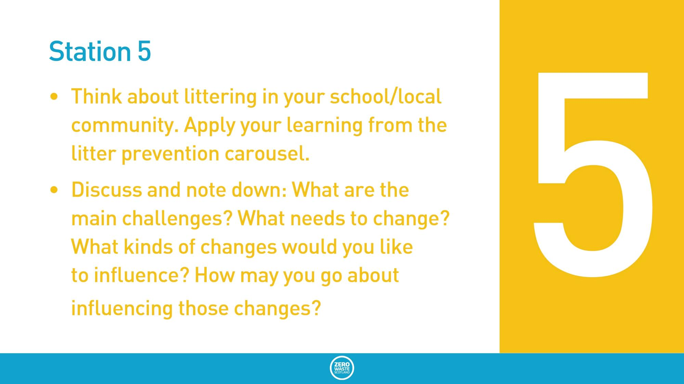
Station 5
Think about littering in your school/local community. Apply your learning from the litter prevention carousel.
Discuss and note down: What are the main challenges? What needs to change? What kinds of changes would you like to influence? How may you go about influencing those changes?

Slide 34
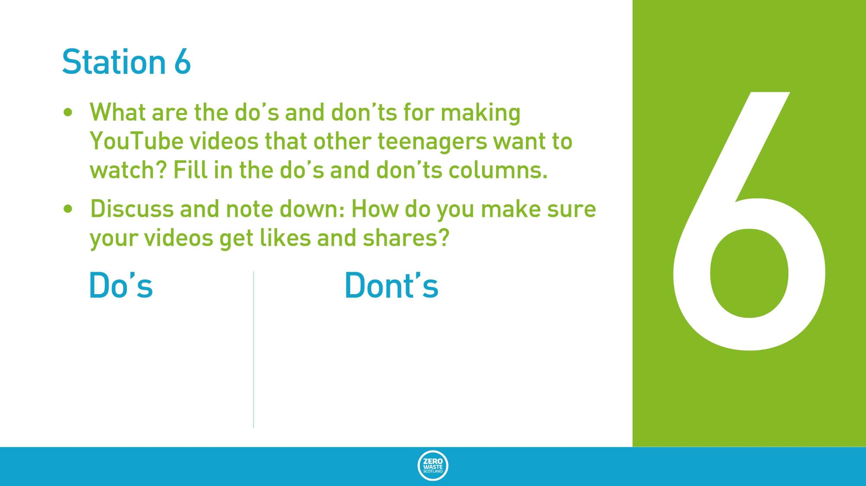
Station 6
What are the do’s and don’ts for making YouTube videos that other teenagers want to watch? Fill in the do’s and don’ts columns.
Discuss and note down: How do you make sure your videos get likes and shares?
Do’s
Don’ts

Slide 35
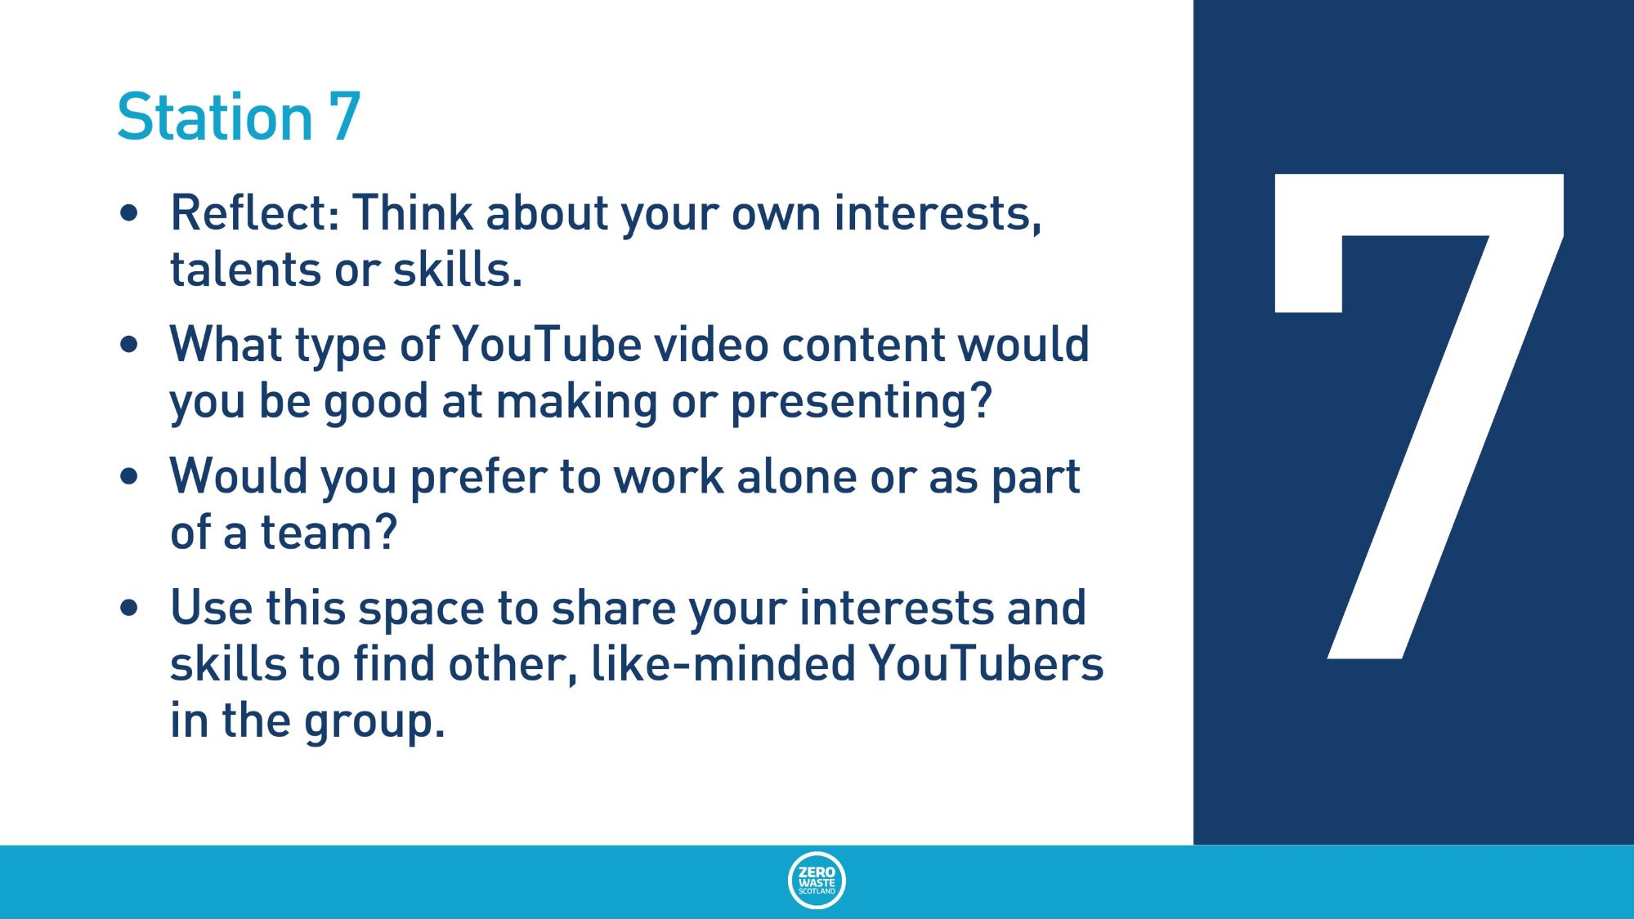
Station 7
Reflect: Think about your own interests, talents or skills.
What type of YouTube video content would you be good at making or presenting?
Would you prefer to work alone or as part of a team?
Use this space to share your interests and skills to find other, like-minded YouTubers in the group.

Slide 36
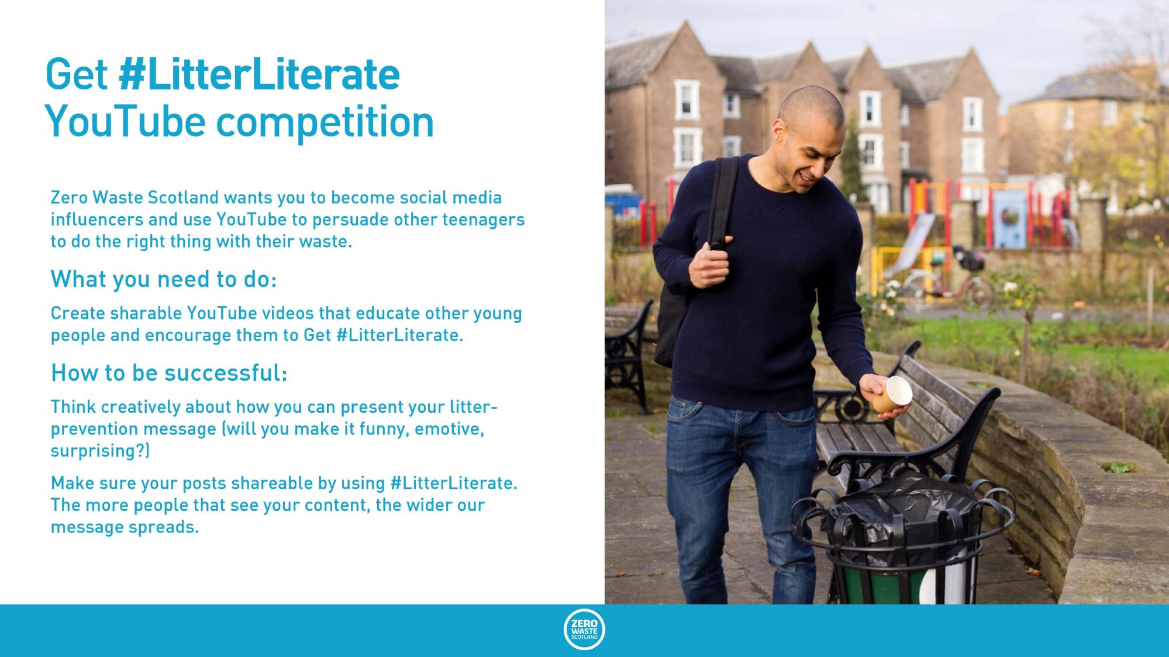
Get #LitterLiterate YouTube competition
Zero Waste Scotland wants you to become social media influencers and use YouTube to persuade other teenagers to do the right thing with their waste.
What you need to do:
Create sharable YouTube videos that educate other young people and encourage them to Get #LitterLiterate.
How to be successful:
Think creatively about how you can present your litter-prevention message (will you make it funny, emotive, surprising?)
Make sure your posts shareable by using #LitterLiterate. The more people that see your content, the wider our message spreads.

Slide 37
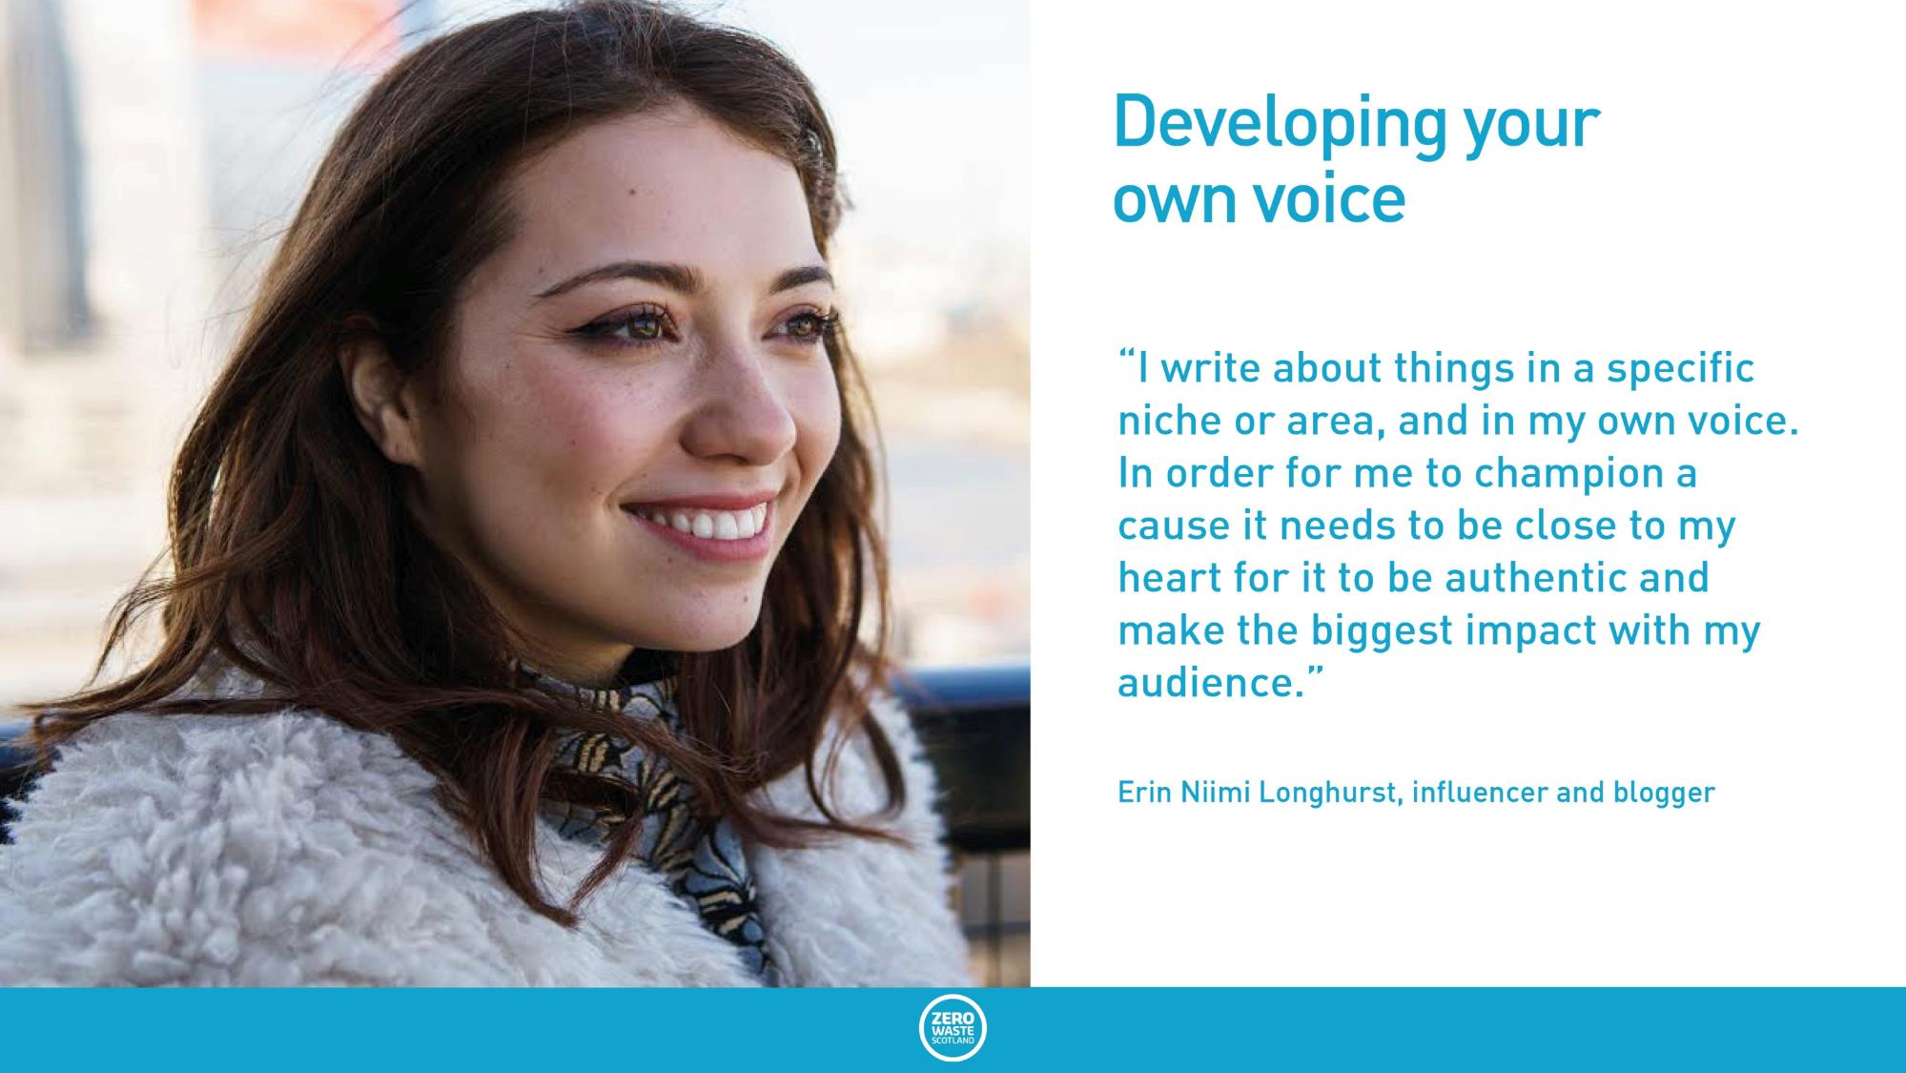
Developing your own voice
“I write about things in a specific niche or area, and in my own voice. In order for me to champion a cause it needs to be close to my heart for it to be authentic and make the biggest impact with my audience.”
Erin Niimi Longhurst, influencer and blogger

Slide 38
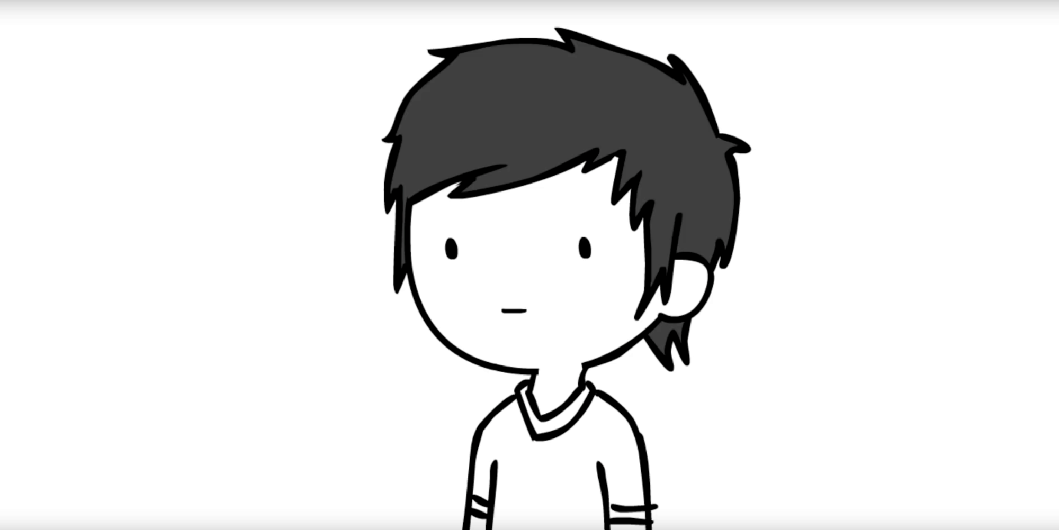
Litter-prevention YouTube videos (to be embedded)
https://www.youtube.com/watch?v=CHIWmCuGSJo Domics: A Canadian animator on littering.

Slide 39
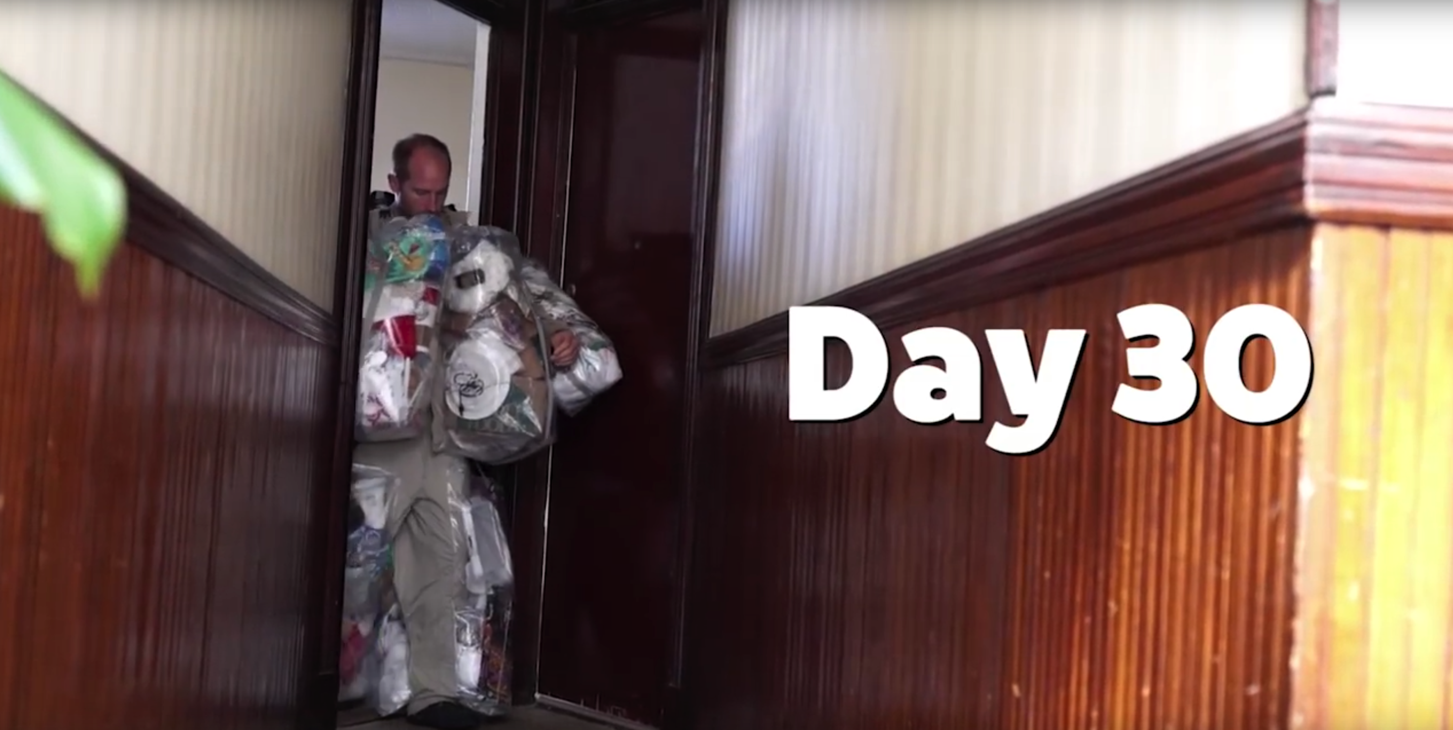
Litter-prevention YouTube videos (to be embedded)
https://youtu.be/9vCstrZ7ilk 30 Days of Trash: Rob Greenfield decided to wear every bit of rubbish he produced – for 30 days.

Slide 40
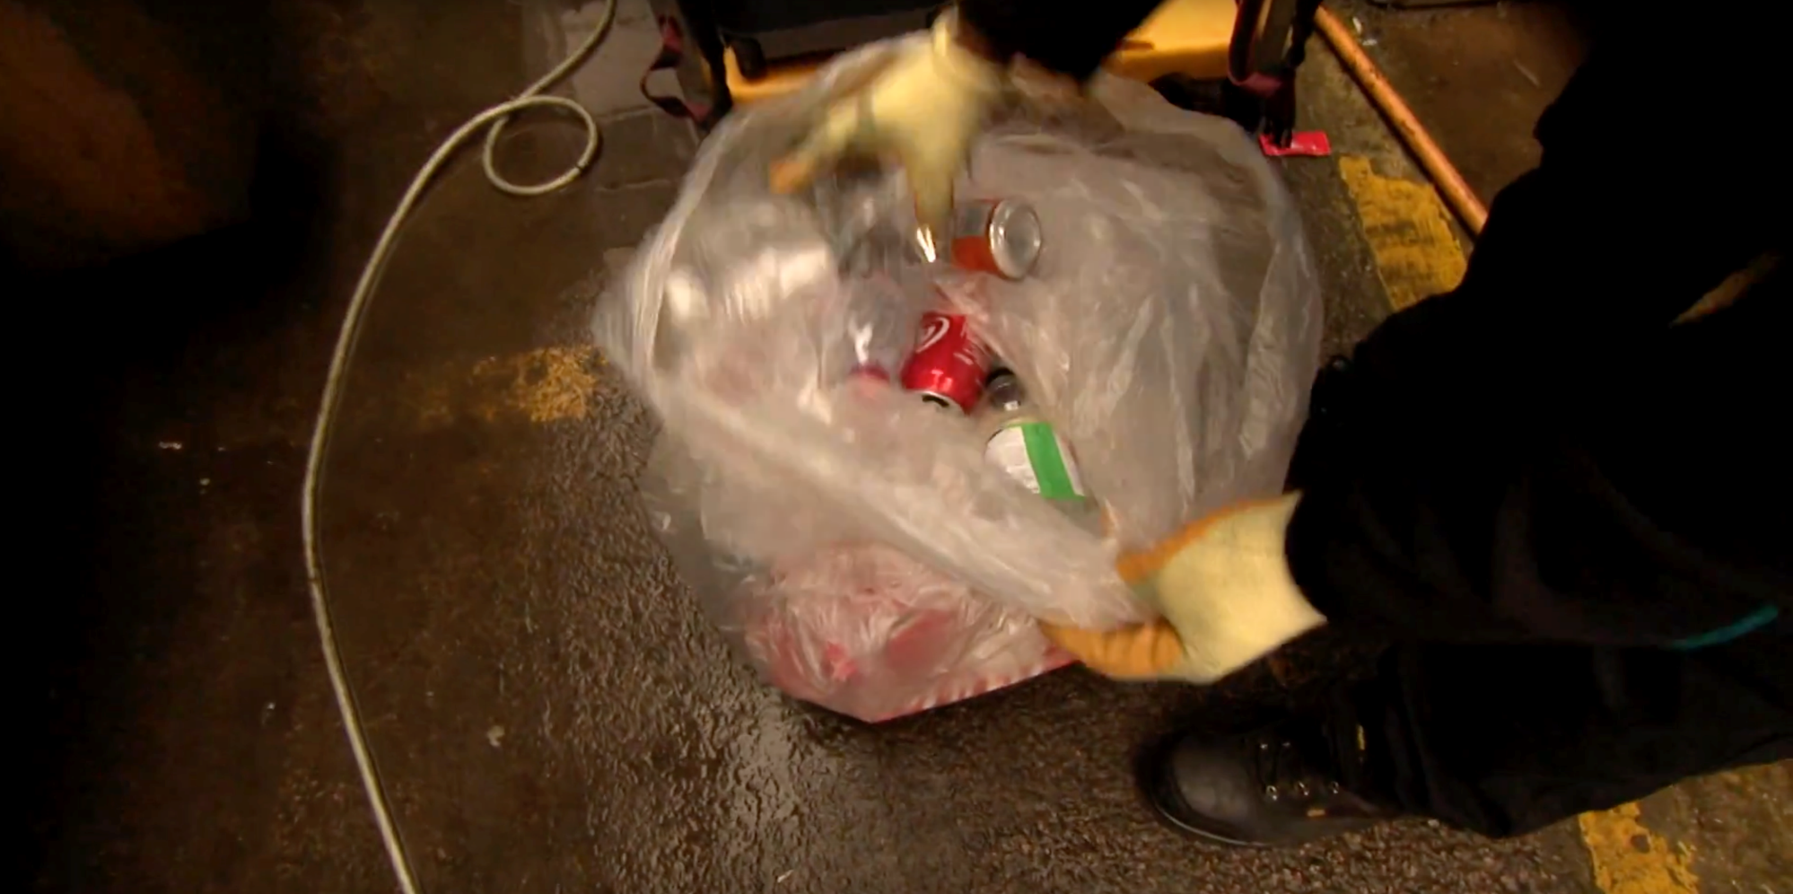
Litter-prevention YouTube videos (to be embedded)
https://www.youtube.com/watch?v=jCjeNZquEPU Factual Sky News Report

Slide 41
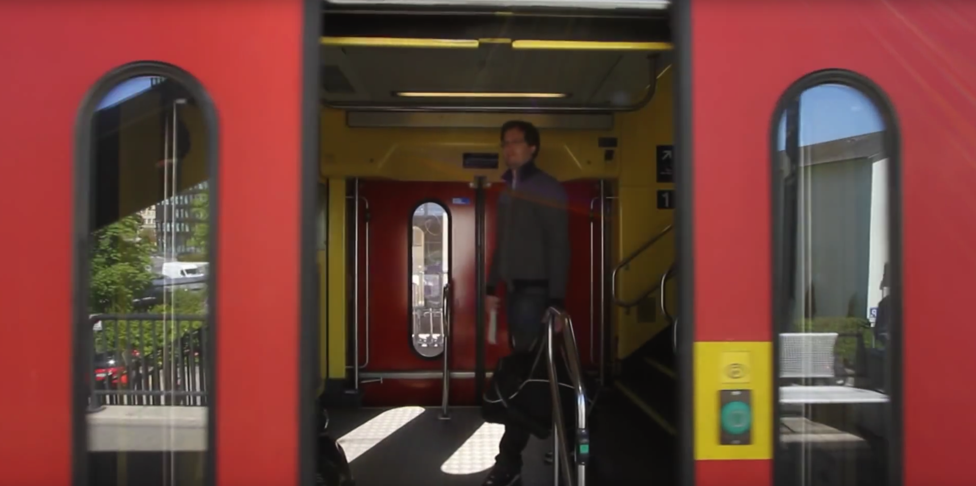
Litter-prevention YouTube videos (to be embedded)
https://www.youtube.com/watch?v=aHU3DLTa6_w amazing ball tricks using litter

Slide 42
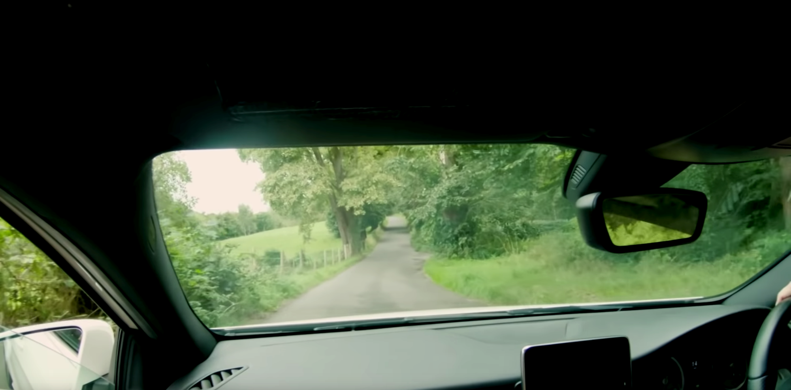
Litter-prevention YouTube videos (to be embedded)
https://www.youtube.com/watch?v=h4ezUvevjr4 A litter-loathing puppet in an anti-litter campaign from Northern Ireland

Slide 43
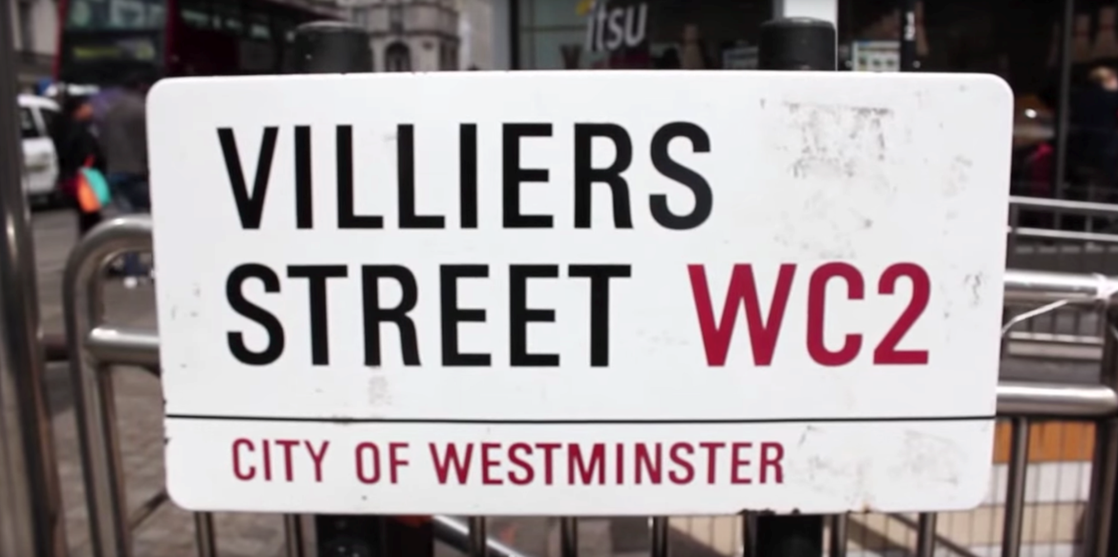
Litter-prevention YouTube videos (to be embedded)
https://www.youtube.com/watch?v=er3VhHtN_p0 'Neat Streets' campaign in central London, using the latest thinking on behaviour change and awareness raising from around the world to trial a new approach to tackling littering on Villiers Street, Westminster.

Slide 44
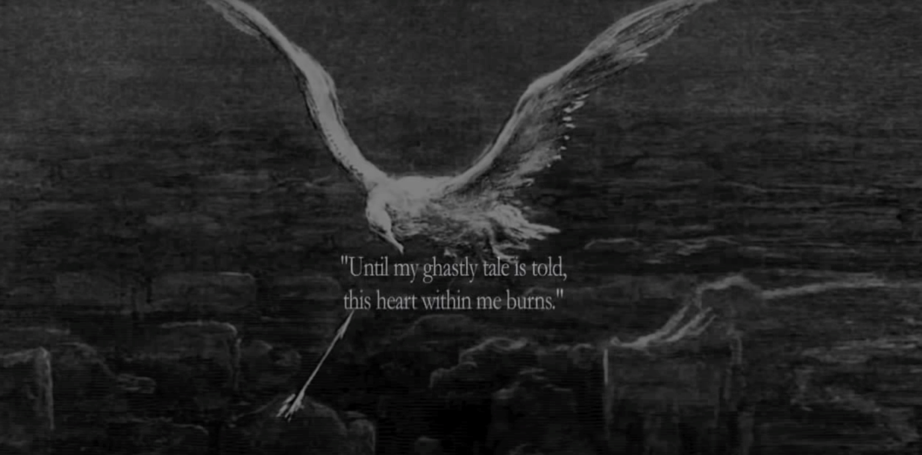
Litter-prevention YouTube videos (to be embedded)
https://www.youtube.com/watch?v=Q2Prz45rdOw hard-hitting video showing effect of plastic littering on birds and wildlife

Slide 45

Litter-prevention YouTube videos (to be embedded)
https://www.youtube.com/watch?v=_6xlNyWPpB8 Ted-Ed traces the life cycles of three different plastic bottles, shedding light on the dangers these disposables present to our world.

Slide 46
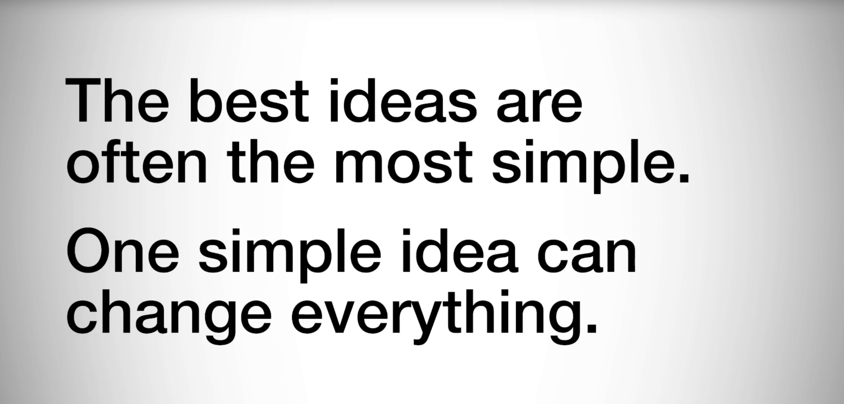
Litter-prevention YouTube videos (to be embedded)
https://www.youtube.com/watch?v=pF72px2R3Hg TedXTeen talk. Lauren is an Environmental Studies graduate from NYU and the amount of trash that she has produced over the past three years can fit inside a 16 oz. jar.

Slide 47
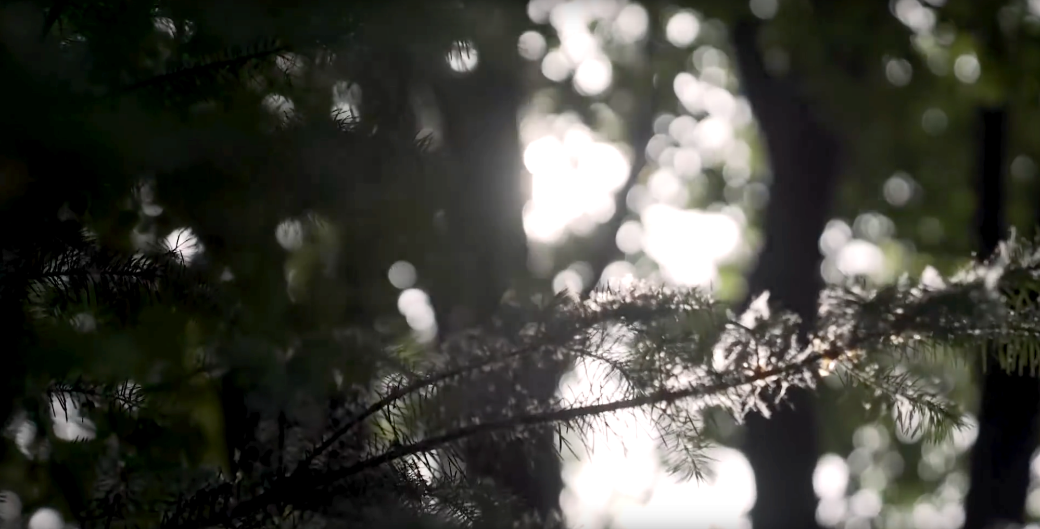
Litter-prevention YouTube videos (to be embedded)
https://www.youtube.com/watch?v=kQnkaYhE6ow Plogging – a craze for combining jogging and littering from Sweden.

Slide 48


