Slide 1
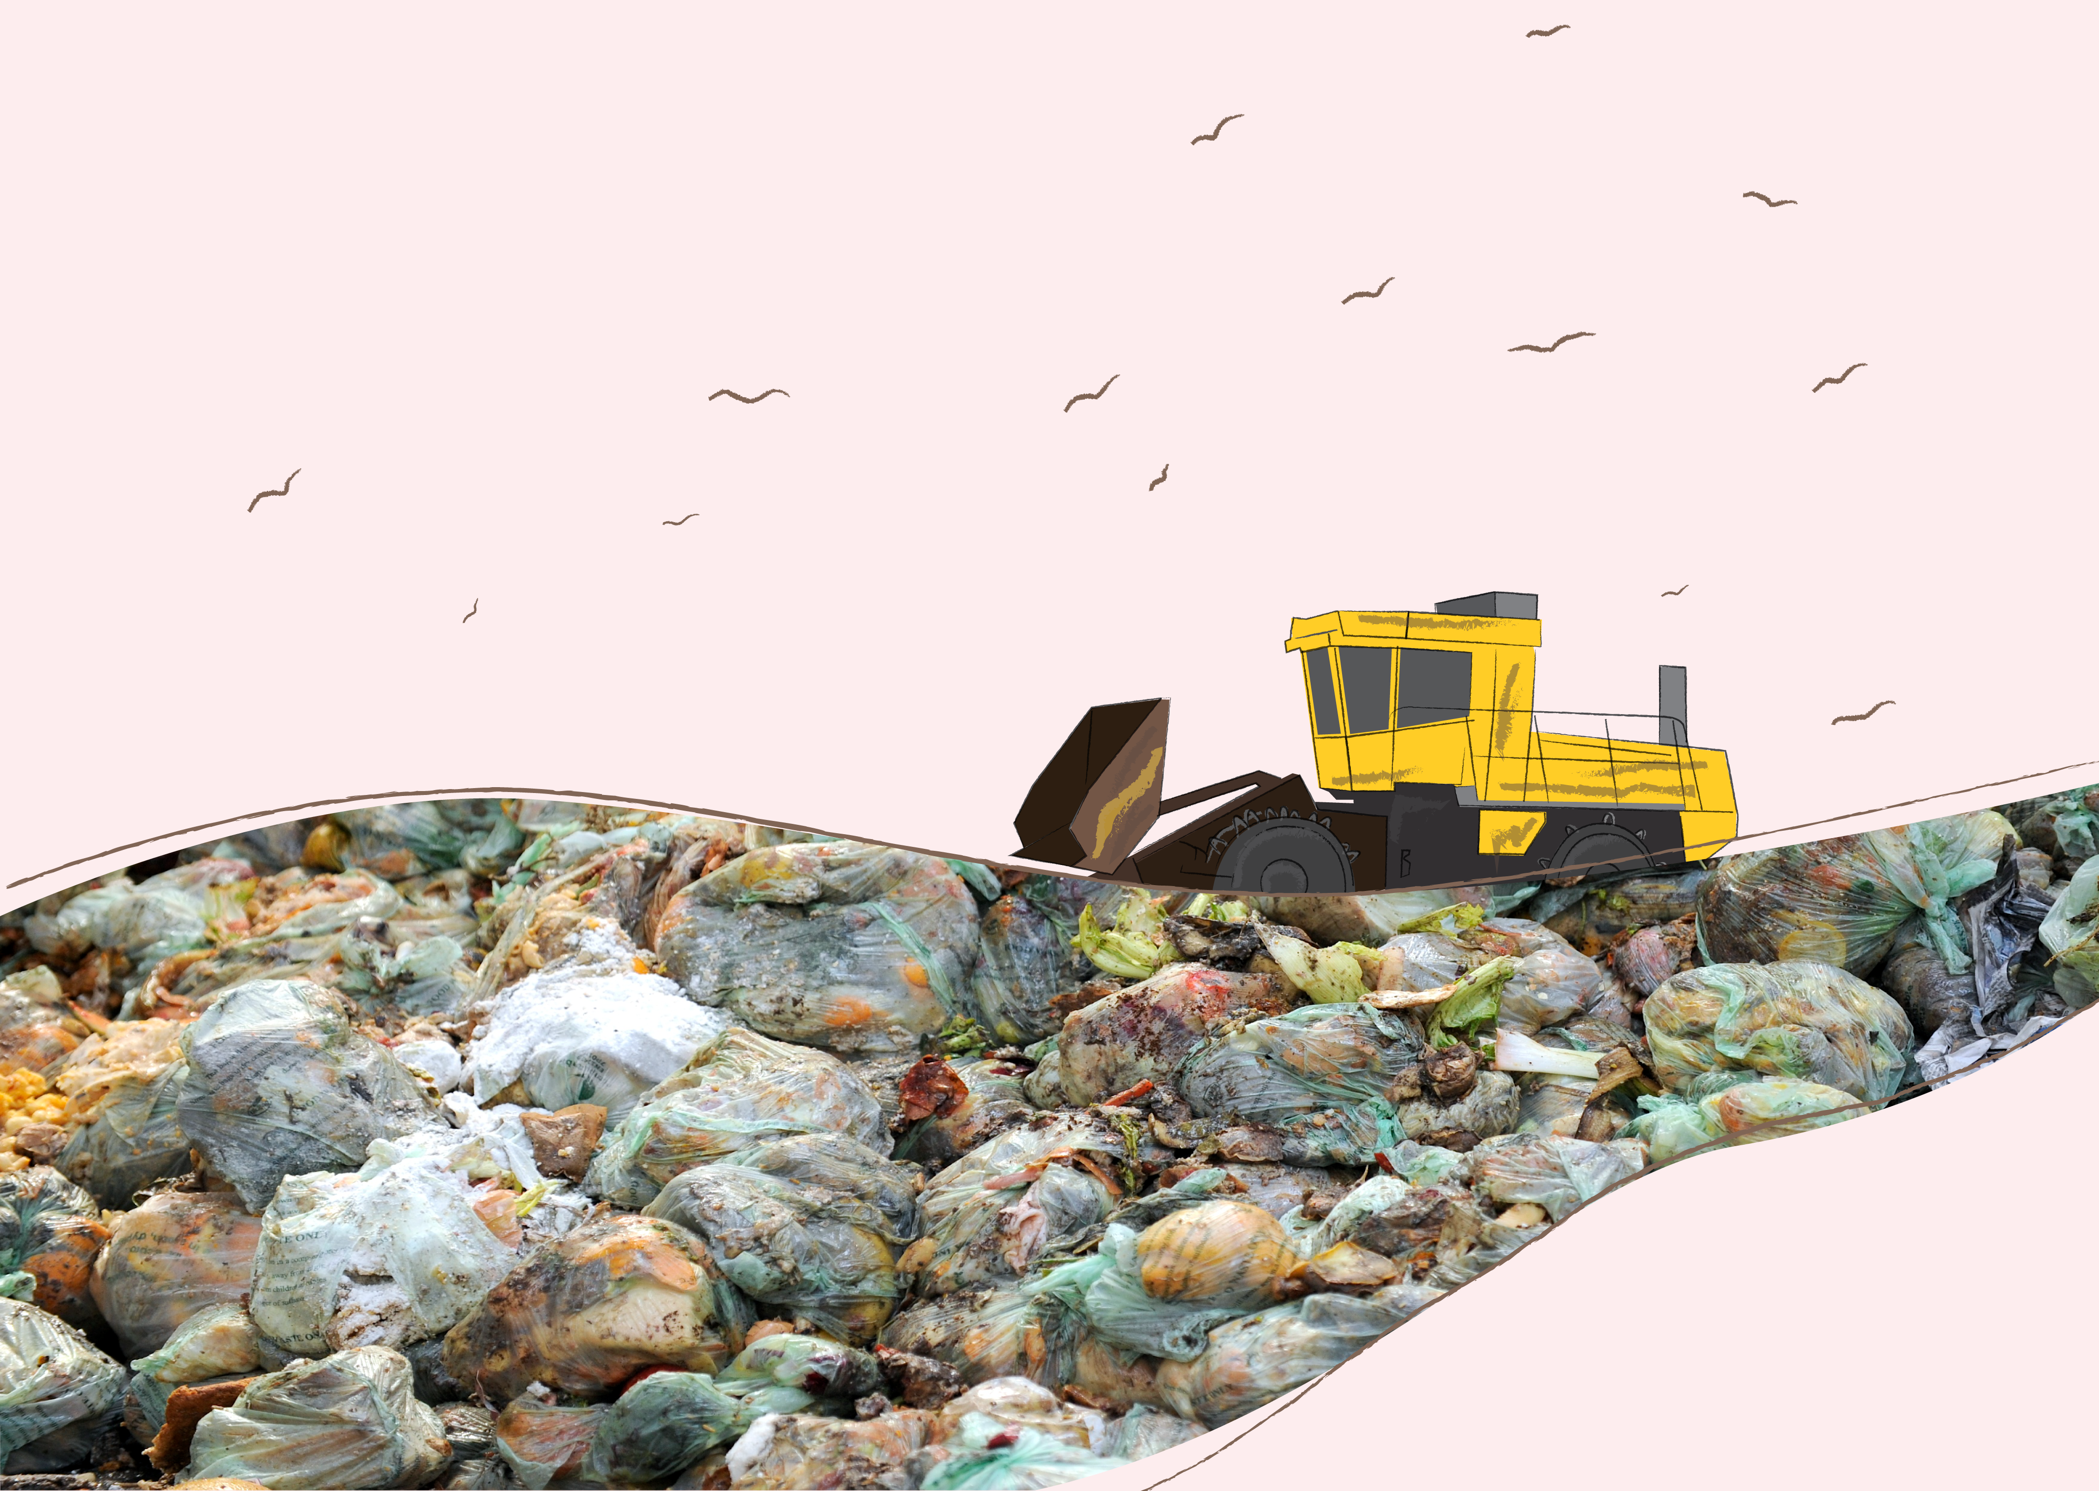

Insert your school name here

Slide 2
Why not put pictures here of your autopsy or activity in your classrooms on food waste?
This PowerPoint is here for you to personalise. The key facts from the other lessons are listed if useful.
Don’t forget to share your results on our Glow yammer group!

Slide 3

In Scotland we throw away 600,000 tonnes of food every year from our homes

Slide 4
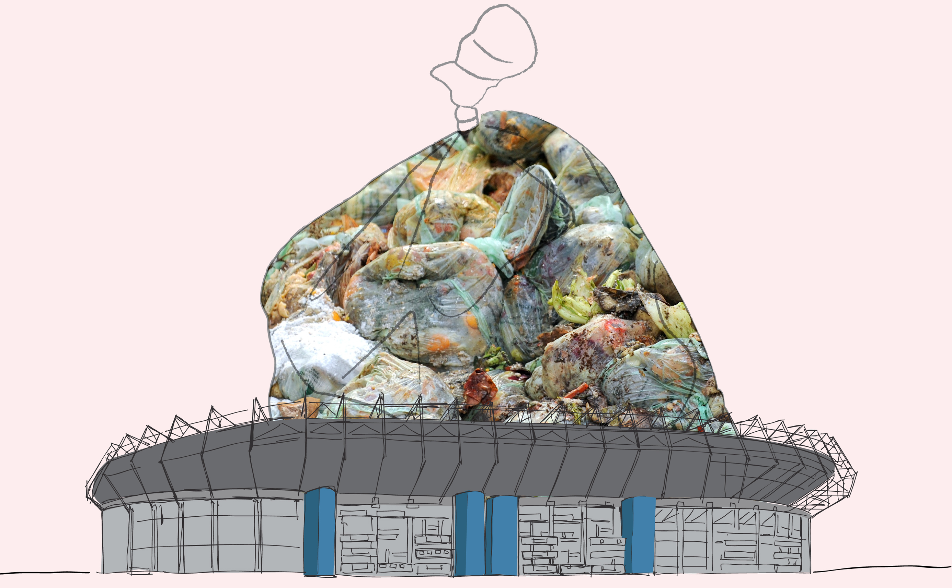
This is enough to fill up Murrayfield stadium 4 times...
...more than half of this is food that could have been eaten

Slide 5
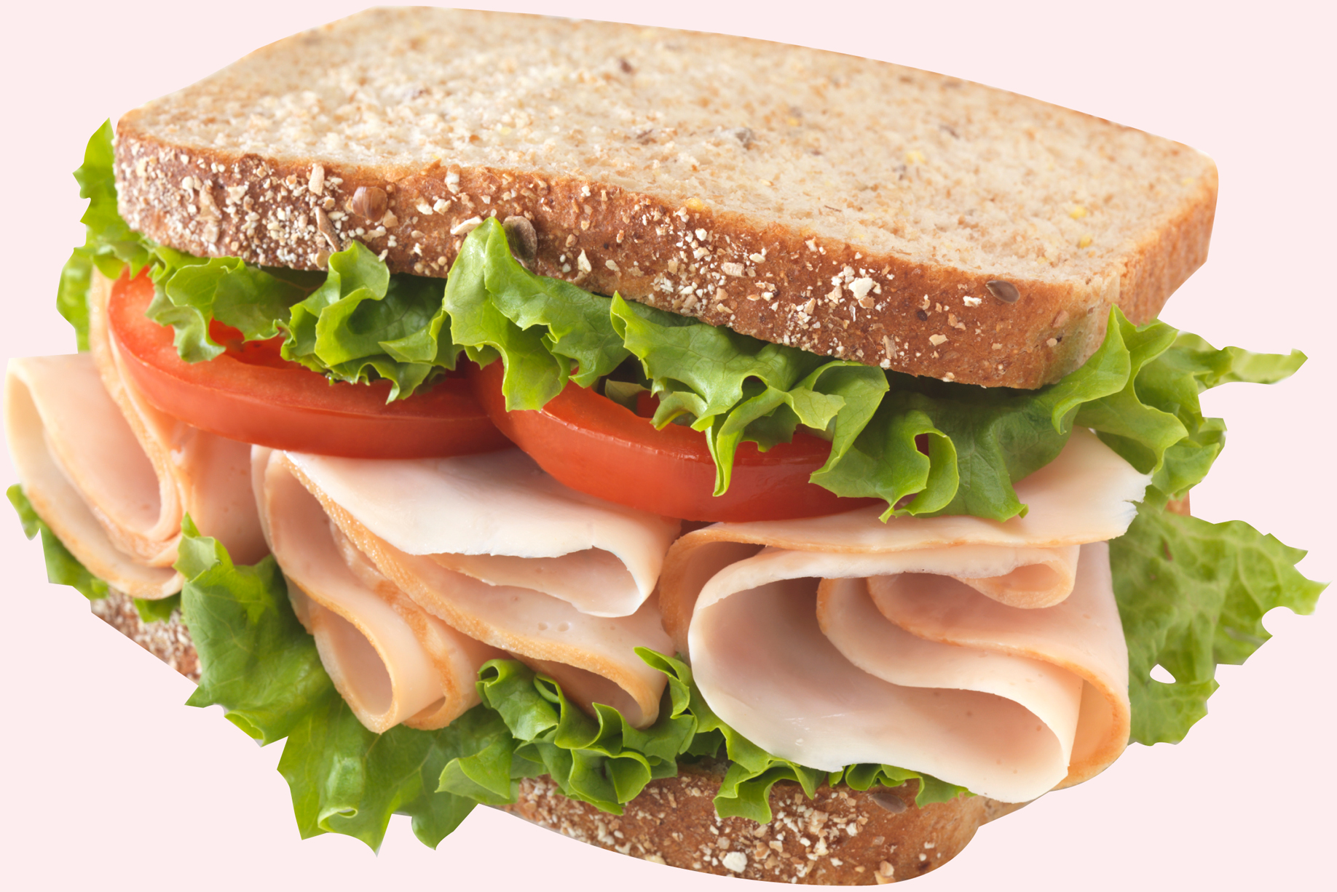
We waste £90 million of bakery products...
...we waste 2 million slices of bread a day

Slide 6
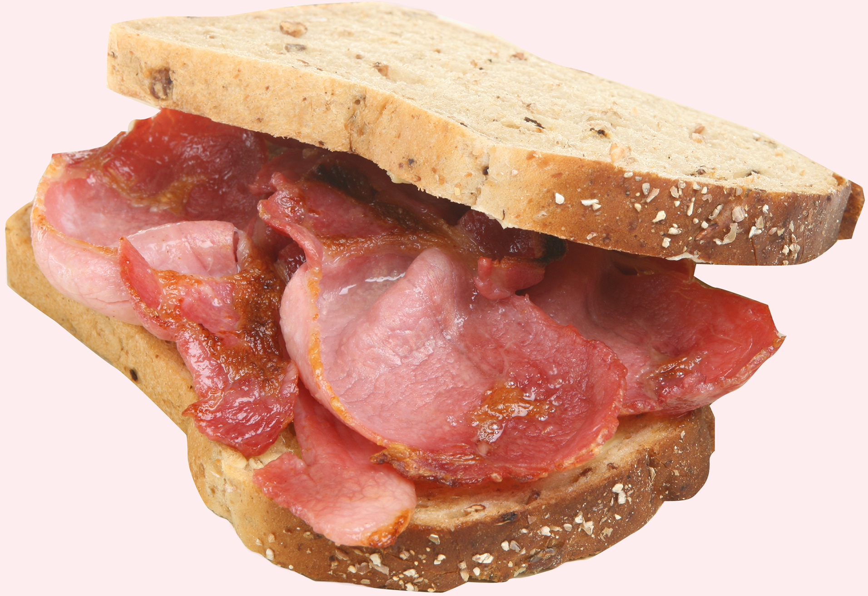
We waste £190 million on fresh meat and fish...
...enough to make everyone in Scotland a bacon buttie every Saturday for the next year

Slide 7

We waste £79 million of fresh fruit...
...enough to give every learner and teacher in Scotland an apple every day for a year

Slide 8

For the average household we could save £460 a year...
...enough for 46 trips to the cinema

Slide 9

For a family of this increases to £700
What would you buy with £700?

Slide 10

When we waste food we waste all the energy and natural resources that go into producing it…
Wasted food also lets off harmful gases in landfill...
...this is bad for our environment

Slide 11

If we saved all the avoidable food waste from the bin in Scotland...
...it would have the same positive environmental impact as taking 1 in 4 cars off the road

Slide 12

The Scottish Government has pledged to reduce food waste in Scotland by 33%
by 2025...
… how can our school help fight against food waste?

